Slide 1
Visual Scanning
& Collision Avoidance

Slide 2
Overview
WHAT
  The ability to recognize hazards, and effectively scan the sky for potential collision threats
WHY
  Safety
  Avoiding other aircraft is very important to creating safe skies
  A diligent visual scan is paramount to the safety of all pilots
CONTENT
See and Avoid
Proper Visual Scanning
Collision Risks
Clearing Procedures
Recognizing Hazards
Collision Avoidance
Conditions that Degrade Vision
Illusions

Slide 3
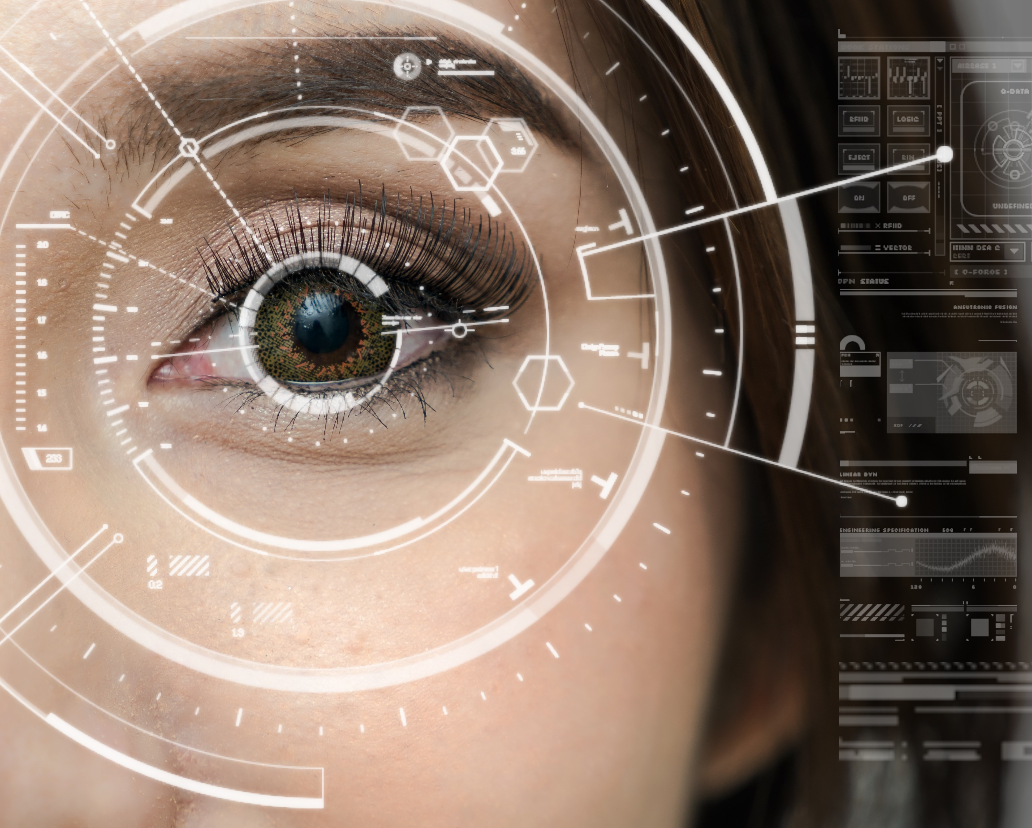
See & Avoid
Vigilance shall always be maintained to see and avoid other aircraft
  Whether IFR or VFR
Although often a shared job, the pilot is always responsibly to see and avoid

Slide 4
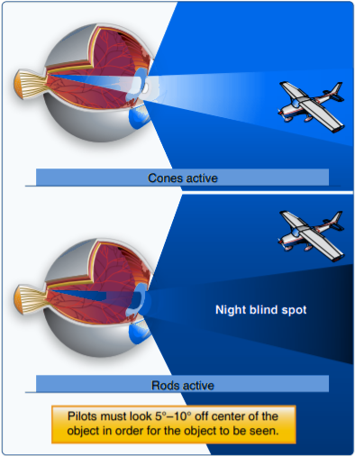
Visual Scanning
Eyes
  Day: Fovea sends a clear, sharp image to the brain
  Night: Fovea is essentially a blind spot
    Peripherals (outside of center) are most effective
Effective Scan
  Short, regularly spaced eye movements bringing successive areas of the sky into the center of vision
  10-degree sectors observed for at least 1 second
  Night: Use peripherals, look 5-10 degrees off center of an object
Poor scanning & distractions increase risk of midair collisions

Slide 5
Collision Risks
High Traffic Areas
  Airports
  VORs
  VFR Corridors & Waypoints
  Training Areas
  Airways
Distractions
  Overconcentration on things other than flying
  Poor visibility conditions
Division of Attention
  90% outside, 10% inside

Slide 6

Clearing Procedures
Before Takeoff
  Ensure the runway & final approach are clear
Climbs & Descents
  Execute gentle banks left and right, and maintain a consistent scan
Straight-and-Level
  Execute clearing turns at periodic intervals, and maintain a consistent scan
Traffic Patterns
  Enter at pattern altitude, scanning for traffic; use aircraft radio calls to assist

Slide 7
Clearing Procedures
VORs
  Highly transited areas, scan vigilantly
Training Areas
  Execute clearing turns prior to, and between maneuvers
Blind Spots
  Momentarily raise/lower the wing as necessary to clear prior to turning or climbing/descending

Slide 8
Recognizing Hazards
Aircraft Speed & Collision Risk
Relative Altitude
  Horizon is a general reference
    Aircraft above the horizon are generally higher and vice versa
Collision Course Targets
  Aircraft that appear to have no relative movement
    Similar to an aim point when landing
Taking Action
  If on a collision course, take immediate action
  Within the FARs, if able, but do whatever is necessary
AIRCRAFT ID & REACTION
Event | Seconds
See Object | 0.1
Recognize Aircraft | 1.0
Become Aware of Collision Course | 5.0
Decision to Turn Left or Right | 4.0
Muscular Reaction | 0.4
Aircraft Lag Time | 2.0
TOTAL | 12.5

Slide 9
Collision Avoidance
Flight Deck Management
  Preparation & organization allows for more focus outside
Visual Obstructions
  Move to see around blind spots
  Raise/lower the wings to clear behind them
  Do not block the windscreen or windows with maps, checklists, etc.
  Ensure clean windscreens
Be Visible
  Use exterior lights, and keep interior lights low at night to preserve night vision
ADS-B & ATC
  ADS-B displays other traffic often with visual/audio alerts
  Use flight following for traffic advisories whenever possible
Safety Pilot

Slide 10

Degraded Vision
Physical Health
Very important to good vision
Vision can be degraded by:
  Medicines
  Exhaustion
  Poor physical conditioning
  Alcohol & tobacco
  Stress & fatigue
  Missing meals
  Hypoxia

Slide 11
Degraded Vision
Environmental Conditions
Dim Lighting
  Small print & charts become unreadable, taking focus from flying and scanning
Dark adaptation
  Takes 30 minutes for eyes to adapt to dark, but only a few seconds to lose adaptation
  Night vision can be impaired by pressure altitudes > 5,000’, CO, Vitamin A deficiency, & bright light
Excessive Illumination
  Can produce glare resulting in squinting, watering eyes, even temporary blindness

Slide 12
Degraded Vision
Environmental Conditions
Outside Visibility
  Smoke, haze, dust, rain, and flying toward the sun can limit ability to see other aircraft
Empty Field Myopia
  With nothing to focus on, the eyes focus on a point slightly ahead of the plane, resulting in poor scanning
  Day: Force eyes to focus further ahead
  Night: Focus on distant light sources

Slide 13
Illusions
Vestibular / In Flight / Visual
Leans
  Can create the illusion of banking in the opposite direction
Coriolis
  Illusion of rotation or movement in an entirely different axis
Graveyard Spin
  Illusion of a spin in the opposite direction
Graveyard Spiral
  Illusion of a wings level descent
Somatogravic
  Acceleration can create illusion of nose up attitude, and vice versa

Slide 14
Illusions
Vestibular / In Flight / Visual
Inversion
  Illusion of tumbling backwards
Elevator
  Upward vertical acceleration creates illusion of being in a climb
False Horizon
  Illusion of not being aligned correctly with the horizon
Autokinesis
  A static light, when stared at, will appear to move about
PREVENTION: Recognize the illusion, and
reference the instruments and/or fixed ground points

Slide 15
Questions?

