Slide 1
Runway Incursion Avoidance

Slide 2
Overview
WHAT
  Practical guidance to increase the safety and efficiency of aircraft movement on the airport surface
WHY
  Runway incursions can lead to serious accidents with significant damage to aircraft and even loss of life
  With increasing air traffic, runway incursions have been on the rise
CONTENT
Runway Incursions
Taxi Instructions
Plan, Review, & Brief
Appropriate Flight Deck Activities
Airport Markings, Signs, & Lights
Airport Operations & Runway Incursions

Slide 3
Runway Incursions
Overview
Any occurrence involving an aircraft, vehicle, person, or object that creates a collision hazard or results in the loss of separation with an aircraft taking off, landing, or intending to land
Average of 3 runway incursions per day
Airport/Taxiing Challenges
  Situational Awareness
  Distractions
Causal Factors
  Failure to comply with ATC instructions
  Lack of airport familiarity
  SOP nonconformance

Slide 4
Runway Incursions
Preventive Practices
Maintain situational awareness
Review airport layouts & know airport signage
Review NOTAMs
Study & use proper phraseology
Write down complex taxi instructions
Readback all runway crossing and hold short instructions
Request progressive taxi instructions, when necessary
Turn on lights when taxiing
Check for traffic before entering any runway or taxiway
When landing, clear the runway ASAP and wait for taxi instructions

Slide 5
Taxi Instructions
Controlled Field
Clearance must be obtained:
  Prior to moving onto the movement area while tower is in operation
  Prior to crossing any runway
When assigned taxi instructions, ATC specifies:
  The runway or point to taxi to
  Route (taxi instructions)
  Hold short instructions or runway cross clearances
Always readback:
  Runway assignment
  Any clearance to enter a specific runway
  Any instruction to hold short of a specific runway

Slide 6
Taxi Instructions
Uncontrolled Field
Announce intentions on CTAF
  Use taxi diagram for planned route
Monitor CTAF and maintain situational awareness
  Apply right-of-way rules
  Give way when appropriate or when safety dictates

Slide 7
Plan, Brief, Review
Route Planning
  Airport Diagram
  Check for pre-designated, or standard taxi routes
Taxi Brief
  Ground Procedures
    Checklists & Communication
    Expected route and any abnormalities or unusual procedures
    Critical locations
    Low visibility operations
  Expectations of Others
    Sterile cockpit
    Airport diagrams
    Cell phones/electronic devices
Record & Review
  Write down ATC taxi instructions
  Review the route given

Slide 8
Appropriate Flightdeck Activities
Workload should be at a minimum during taxi
  All “heads down” activities should only be accomplished when stopped
Sterile cockpit
Taxiing Near other Aircraft
  Keep eyes outside, taxi slowly, and be alert
  Continuous Loop Process
    Always be aware of where you are and what’s coming next
    Monitor other aircraft’s progress and location

Slide 9
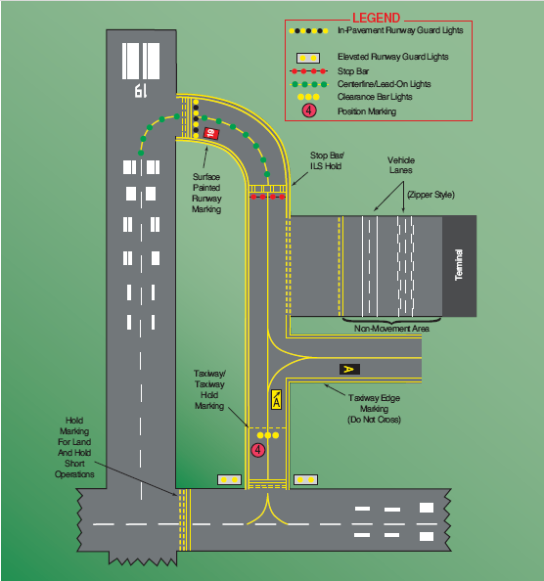
Airport Markings, Signs,
& Lights

Slide 10
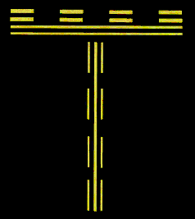
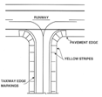
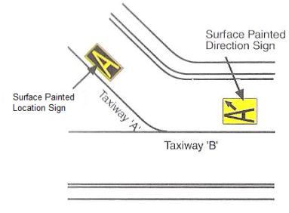
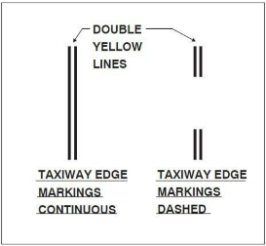


Airport Markings, Signs, & Lights
Taxiway
Centerline Markings
Edge Markings
Shoulder Markings
Direction Signs
Location Signs
Position Markings

Slide 11

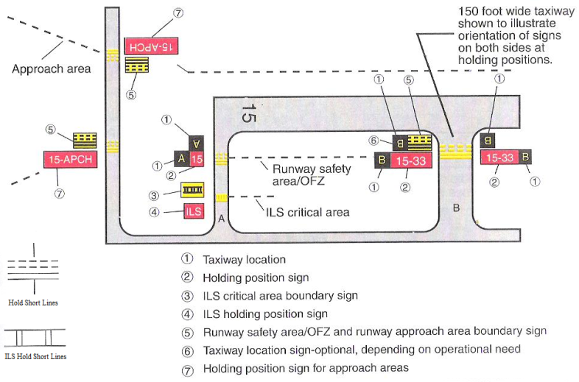
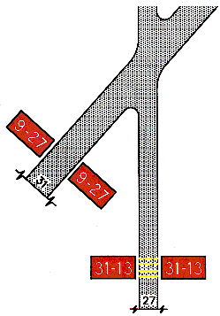
Airport Markings, Signs, & Lights
Holding Position
Show where an aircraft is supposed to stop when approaching a runway

Slide 12
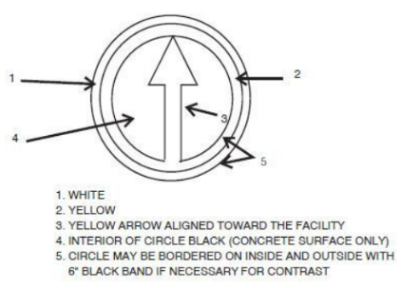

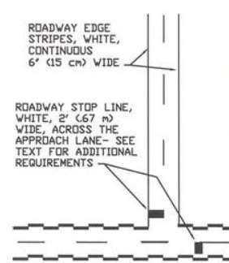
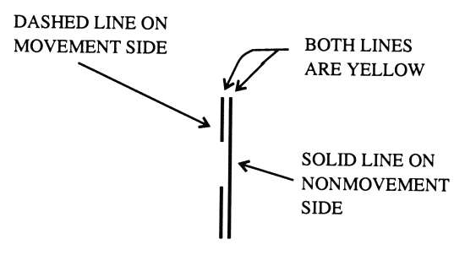
Airport Markings, Signs, & Lights
Airport Markings, Signs, & Lights
Other
VOR Checkpoint
Vehicle Roadway
Closed Runway
Nonmovement Area Boundary

Slide 13
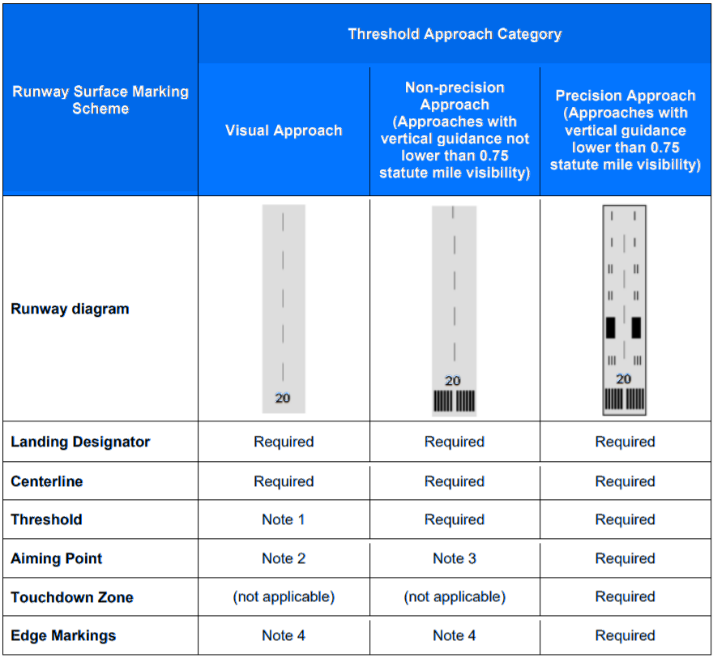
Airport Markings, Signs, & Lights
Runway
NOTES
Required on runways serving category C & D aircraft, and for runways intended for international commercial air transport
Required on 4,200’ or longer runways serving categories C & D airplanes
Required on 4,200’ or longer instrumented runways
Used when the full runway pavement width may not be available for use as a runway

Slide 14
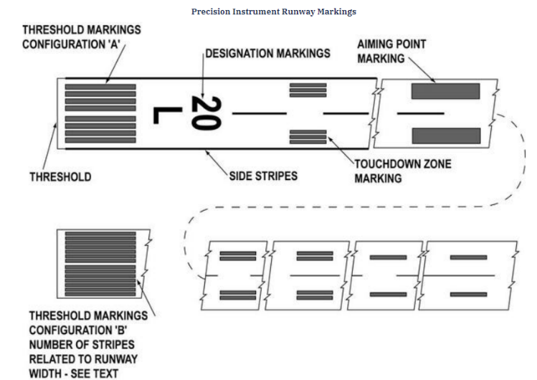
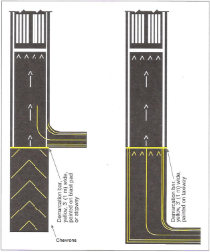
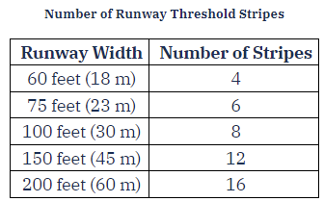
Airport Markings, Signs, & Lights
Runway
Designators
Centerline Markings
Aiming Point Markings
Touchdown Zone Markers
Side Stripes
Shoulder Markings
Threshold Markings
Blast Pad / Stopway Area

Slide 15
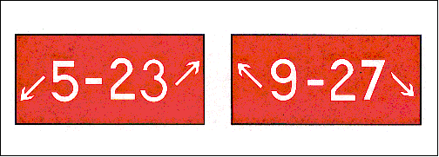



Airport Markings, Signs, & Lights
Mandatory Instruction
Denote entrance to runway or critical area, or area where aircraft are prohibited
Runway Hold Position Sign
Runway Approach Area Hold Position
ILS Critical Area Hold Position
No Entry Sign

Slide 16




Airport Markings, Signs, & Lights
Location
Identify either a taxiway or runway on which the aircraft is located
Taxiway Location Sign
Runway Location Sign
Runway Boundary Sign
ILS Critical Area Boundary Sign

Slide 17
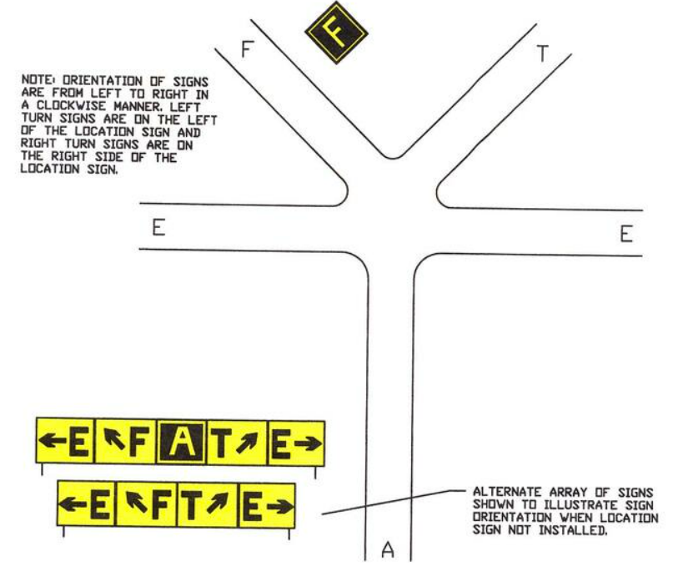
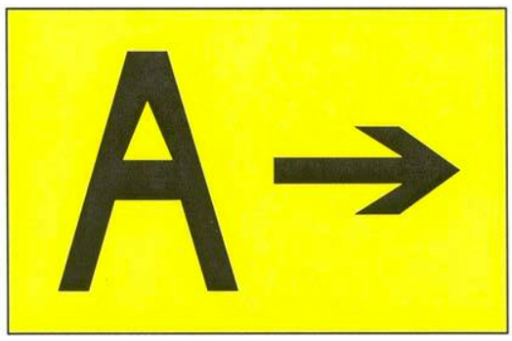
Airport Markings, Signs, & Lights
Direction
Identify the designations of intersections

Slide 18
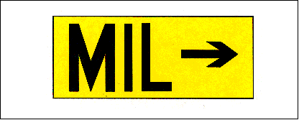
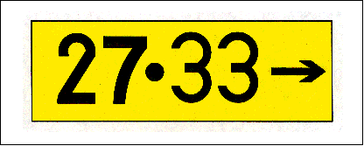
Airport Markings, Signs, & Lights
Destination & Information
Destination – Indicate a destination on the airport:
  Runways
  Aprons
  Terminals
  Military Areas
  Civil Aviation Areas
  Cargo Areas
  International Areas
  FBOs
Information – Provide information on things like:
  Areas the tower can’t see
  Radio frequencies
  Noise abatement procedures

Slide 19

Airport Markings, Signs, & Lights
Runway Distance Remaining
Informs pilots of the distance remaining on the runway in thousands of feet

Slide 20
Airport Markings, Signs, & Lights
Taxiway
Taxiway Edge Lights
  Outline the edges of taxiways at night or with restricted visibility
  Blue lights
Taxiway Centerline Lights
  Facilitate taxiing during low visibility conditions
  Steady green lights along the centerline
Clearance Bar Lights
  Increase visibility of a holding position in low visibility, or indicate the location of an intersecting taxiway
  Three in-pavement steady yellow lights
Runway Guard Lights
  Enhance visibility of taxiway and runway intersections
  Elevated flashing yellow lights on each side of a taxiway, or a row of in-pavement yellow lights across the taxiway
Stop Bar Lights
  Confirm ATC clearance to enter / cross an active runway in low visibility conditions
  Row of red, steady in-pavement lights across the entire taxiway and elevated lights on either side of the taxiway

Slide 21
Airport Markings, Signs, & Lights
Runway
Runway Edge Lights
  Outline the edges of runways
  White lights
    Instrument runways have yellow lights the last 2,000’ or half, whichever is shorter
  Lights marking the end of the runway – Red toward the runway (end) and green outward (threshold)
  Classified based on brightness: High intensity runway lights (HIRL), Medium (MIRL), Low (LIRL)
Runway End Identifier Lights (REIL)
  Installed to provide rapid / positive identification of the approach end of a runway
  Pair of synchronized flashing lights located on each side of the runway threshold

Slide 22
Airport Markings, Signs, & Lights
Runway
Runway Centerline Lighting System (RCLS)
  Installed on some precision runways to facilitate landing in adverse conditions
  White lights until the last 3,000’ where they alternate red / white until the last 1,000’ which are all red
Touchdown Zone Lights (TDZL)
  On some precision runways to indicate the touchdown zone in adverse visibility
Taxiway Centerline Lead-Off Lights
  Provide visual guidance for exiting the runway
  Alternating green/yellow lights from the runway centerline to 1 light position beyond the hold position
Taxiway Centerline Lead-On Lights
  Provide visual guidance for entering the runway
  Same color as lead-off lights. Bi-directional – 1 side emits light for lead-on and the other for lead-off
Land and Hold Short Lights
  Used to indicated the hold short point on runways approved for LAHSO
  Row of pulsating white lights installed across the runway

Slide 23
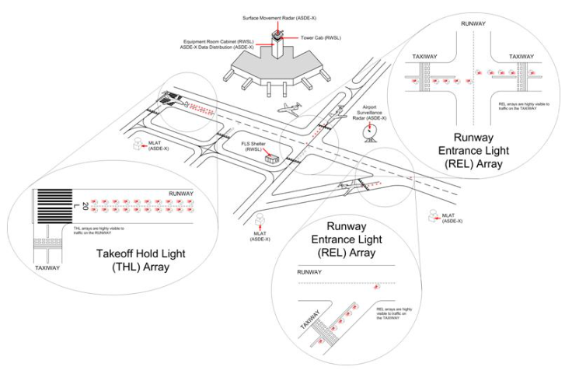
Airport Markings, Signs, & Lights
Runway Status (RWSL)
Automated system providing a direct indication that a runway is safe
  Installed at several major US airports
  Used in conjunction with ATC
    ATC & RWSL must agree
Runway Entrance Lights (REL)
  In pavement red lights
  Warn aircraft waiting to cross/enter a runway that there is conflicting traffic
Takeoff Hold Lights (THL)
  In-pavement red lights
  Warn aircraft in the takeoff position that the runway is occupied

Slide 24
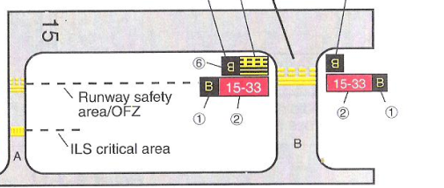
Airport Operations & Runway Incursions
Hold Lines
Indicate where to stop when approaching a runway without a clearance to enter
Approaching from dashed side (exiting runway):
  Cross the dashed lines and stop when fully beyond solid lines
Approaching from the solid side (entering runway):
  At controlled airports, pilots must not cross without ATC clearance
  At uncontrolled airports, pilots must ensure adequate separation from other aircraft
Clarify with ATC if there’s any confusion, never assume

Slide 25
Airport Operations & Runway Incursions
Landing & Rollout
Plan Ahead
  Brief the landing runway & exit/taxi plan
Exiting the runway entirely
  Advise ATC if unable to fully clear the runway
Do not cross another runway without a clearance

Slide 26
Airport Operations & Runway Incursions
Night ops: Exterior Lighting
Starting Engines
  Rotating beacon on
Taxiing
  Navigation, position, & anti-collision lights on
  Taxi light on when moving or intending to move, off when stopped or yielding
Crossing a Runway
  All exterior lights should be illuminated
Entering a Runway for Takeoff or to Line Up & Wait
  Turn on all lights except landing lights
  Line up approximately 3’ off the centerline
Cleared for Takeoff or Starting Takeoff Roll
  Landing lights on

Slide 27
Airport Operations & Runway Incursions
Night ops: Considerations
Taxi slower
Be more cautious
  Reduced visibility & less time to react
Sterile cockpit

Slide 28
Airport Operations &
Runway Incursions
Low Visibility
AIM 4-3-19
Focus entire attention on the safe operation of the aircraft while it is moving
Taxi slowly
Focus should be outside
Sterile cockpit
  Withhold checklists & nonessential communication until stopped with the brakes set
Notify the controller of difficulties or at the first indication of becoming disoriented

Slide 29
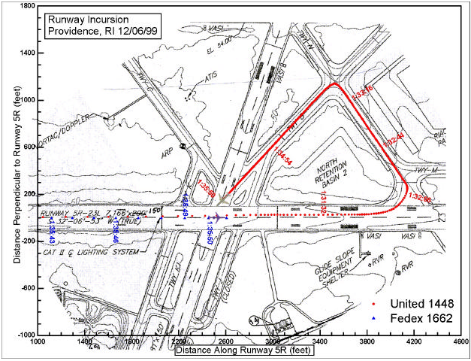
United 1448
Case Study
UAL1448 lands on runway 5R
Cleared to taxi N & T, and report across 16
Become disoriented and turn onto B, back toward 5R
  They stop and advise the controller they believe the airplane is on an active runway
FDX1662 departs 5R passing near 1448
PVD clears US Airways 2998 for takeoff from 5R
  2998 declines the clearance because of their concern about 1448’s position potentially saving numerous lives

Slide 30
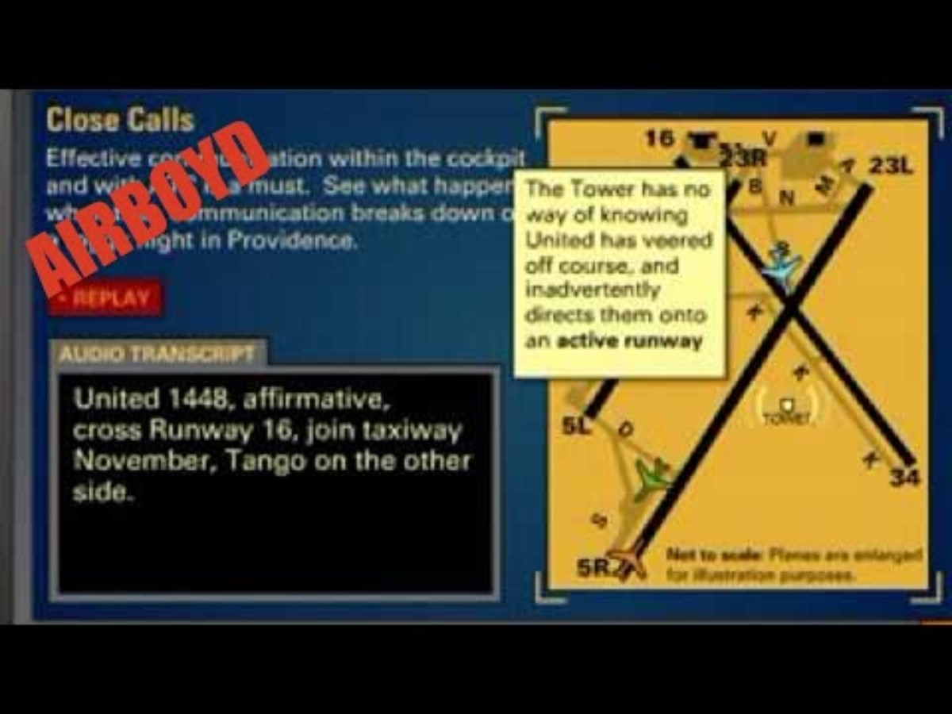
United 1448
Case Study

Slide 31

United 1448
Case Study
RISK MANAGEMENT CONCEPTS
  Low Visibility
  Night Operations
  Entering/Crossing Runways
  Loss of Situational Awareness

Slide 32
Questions?

