Slide 1
Human Factors

Slide 2
Overview
WHAT
  Several health and physiological factors that can influence a pilot’s ability to fly safely
WHY
  Many of these factors not only affect the health and well-being of the pilot, but can quickly lead to in-flight emergencies
CONTENT
Hypoxia & Hyperventilation
Middle Ear and Sinus Problems
Spatial Disorientation
Motion Sickness
Carbon Monoxide Poisoning
Fatigue and Stress
Dehydration
Hypothermia
Optical Illusions
Nitrogen and Scuba Diving
Alcohol and Drugs
ADM, CRM, & SRM

Slide 3
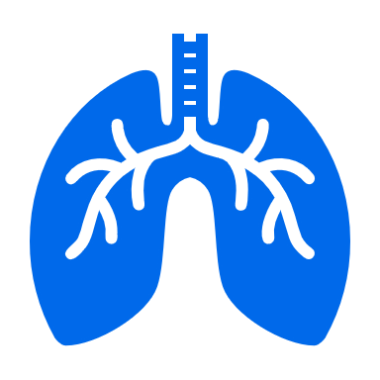



Hypoxia
Types
Hypoxic: Lack of oxygen to the lungs
Hypemic: Not enough blood
Stagnant: Not flowing
Histotoxic: Inability of the cells to use oxygen

Slide 4
Hypoxia
Symptoms & Treatment
Symptoms
  Cyanosis, headache, impaired judgement & reactions, euphoria, visual impairment, drowsiness, lightheaded/dizzy, tingling, numbness
Time of Useful Consciousness
Altitude | Time of Useful Consciousness
40,000’ | 15 to 20 seconds
30,000’ | 1 to 2 minutes
22,000’ | 5 to 10 minutes
Treatment – Use supplemental oxygen immediately and get to a lower altitude

Slide 5
Hyperventilation
Excessive loss of carbon dioxide from the blood
Causes
  Emotional stress, fright or pain, leading to increased breathing rate and depth
Symptoms
  Very similar to Hypoxia
  Lightheaded/dizzy, tingling, visual impairment, hot and cold, muscle spasms
Treatment
  Breathe normally (best prevention and cure)
  Breathe into a paper bag, or talk out loud
  If unsure, treat for Hypoxia (more dangerous condition)

Slide 6
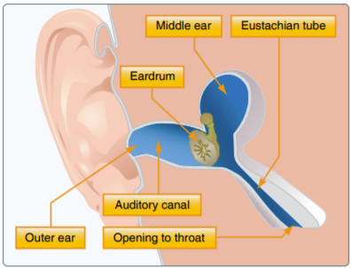
Middle Ear and Sinus Problems
Middle Ear
  Difference in pressure in the middle ear & outside the body
  Symptoms: Pain, reduced hearing sensitivity
  Treatment: Chew gum, stretch jaw, valsalva, medicine
Sinus
  Normally, sinus pressure equalizes with cockpit pressure
  Congestion can prevent pressure from equalizing
  Symptoms: Sinus pain, upper tooth pain, bloody mucus
  Treatment: Slow descent rates, Do Not Fly
Source: PHAK, FAA

Slide 7



Spatial Disorientation
Overview
Lack of orientation with the position, attitude, or movement of the plane in space
Orientation Systems
  Visual: Eyes (largest source of information)
  Somatosensory: Nerves that sense position based on gravity & feeling
  Vestibular: Motion sensing system located in the inner ears
Brain combines 3 systems for orientation
  When 1 or more disagree, conflicting info can lead to disorientation

Slide 8
Spatial Disorientation
In Flight
Flying can result in conflicting info being sent to the brain
Visual System (eyes)
  Primary orientation system
  Prevails over false sensations from other systems
  In IMC, the eyes cannot correct for false sensations
Somatosensory System (nerves)
  Forces in flight can lead to false sensations of the direction of gravity
  The brain cannot differentiate between forces in turns and gravity
  Turbulence can confuse the brain
Vestibular System (ears)
  Semicircular Canals: Detect angular acceleration
  Otolith Organs: Detect linear acceleration

Slide 9
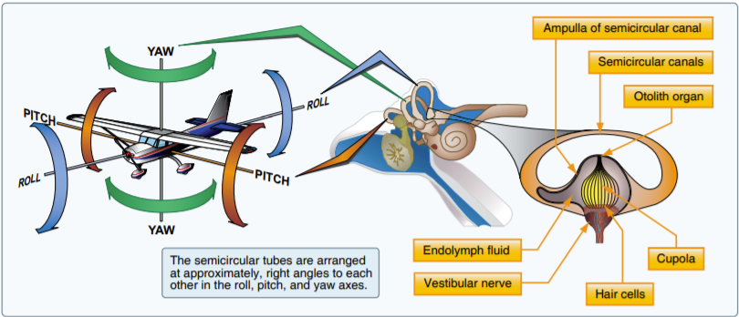
Spatial Disorientation
In Flight: Semicircular Canals
3 tubes, 1 on each axis, at right angles to each other
Canals are filled with endolymph fluid
Cupola (gelatinous structure on sensory hairs) at the center of the canal

Slide 10
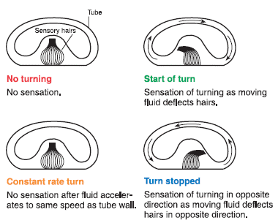
Spatial Disorientation
In Flight: Semicircular Canals
Straight & level: Sensory hairs are upright
A turn puts semicircular canal and its fluid in motion, deflecting the sensory hairs
Brain interprets movement as a turn
Recognizes movement for about 20 seconds
In long turns, the brain can interpret a rollout as a turn in the opposite direction
Source: PHAK, FAA

Slide 11
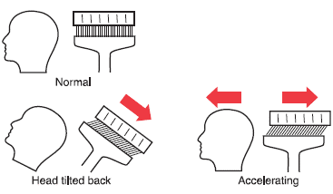
Spatial Disorientation
In Flight: Otolith Organs
Gelatinous membrane with chalk like crystals covering sensory hairs
When you tilt your head forward or backward:
  Weight of the crystals causes the membrane to shift due to gravity
  Sensory hairs detect the shift
  Brain recognizes the movement
Otolith Organs & Acceleration
  Forward acceleration: Illusion of tilting backward
  Deceleration: Illusion of tilting forward
Source: PHAK, FAA

Slide 12
Motion Sickness
Causes
  Brain receiving conflicting messages about the state of the body
  Anxiety and stress
Symptoms
  Discomfort, Nausea, Dizziness, Paleness, Sweating, Vomiting
  Generally, goes away after the first few lessons
Treatment
  Open fresh air vents
  Focus on objects outside the airplane
  Avoid unnecessary head movement
  Take control of the plane and fly smoothly

Slide 13
Carbon Monoxide (CO) Poisoning
How it Happens
  Colorless, odorless gas produced by the engine
  Damaged, leaking exhaust system
  Heater/defrost vents transport CO to the cockpit
CO & the Body
  CO attaches to the hemoglobin in the blood (200x easier than oxygen)
  Prevents hemoglobin from carrying oxygen to cells (hypemic hypoxia)
Effects
  Headache, blurred vision, dizziness, drowsiness, loss of muscle power
Detecting & Correcting
  Carbon monoxide detectors
  Turn off heater, open fresh air vents, use supplemental oxygen, land

Slide 14
Fatigue
Overview
Effects
  Degraded attention & concentration
  Impaired coordination
  Decreased ability to communicate
Causes
  Sleep loss, exercise/physical work, stress, prolonged cognitive work
Acute Fatigue
  Short term, normal occurrence in everyday life
  Skill Fatigue: Special type of acute fatigue affecting piloting skills
  Causes: Physical & psychological stress, mild hypoxia
  Prevention: Proper diet, adequate rest

Slide 15
Fatigue
Types
Chronic Fatigue
  Long term, usually with psychological roots or an underlying disease
  Causes: Continuous high-stress levels
  Symptoms: Weakness, tiredness, heart palpitations, breathlessness, headaches, irritability, aches and pains, emotional illness
  Prevention: Treatment by a physician
Preventing Fatigue
  Acute Fatigue: Stay on the ground
  Avoid flying :
    Without a full night’s rest
    After working excessive hours
    After an especially exhausting or stressful day
  Chronic Fatigue: Should be treated by a physician. Do not fly

Slide 16
Stress
Overview
The body’s response to physical and psychological demands placed upon it
Stress & the Body
  Releases chemical hormones (adrenaline) into the blood
  Increased metabolism to provide more energy to the muscles
  Blood sugar, heart rate, respiration, blood pressure, and perspiration increase
Stressors
  Physical stress (noise or vibration)
  Physiological stress (fatigue)
  Psychological stress (difficult work or personal situations)
Categories of Stress
  Acute Stress (short term)
  Chronic Stress (long term)
    DO NOT FLY

Slide 17
Stress
Types
Acute Stress
  Short term
  Involves an immediate threat that is perceived as a danger (fight or flight response)
  Healthy person can cope with acute stress & prevent stress overload
  On-going acute stress can develop into chronic stress
Chronic Stress
  Long term
  Level of stress presenting an intolerable burden, exceeding the ability to cope
  Performance falls sharply
  Often caused by unrelenting psychological pressure – loneliness, financial/relationship worries, work problems, etc.
  DO NOT FLY – Consult a physician

Slide 18
Dehydration
Critical loss of water from the body
Causes
  High temperatures, wind, humidity, diuretic drinks (coffee, tea, alcohol, caffeinated soda)
Effects
  Fatigue, headaches, cramps, tingling, tiredness, dizziness, degraded physical & mental abilities
Dehydration & Flying
  Flying skills diminish while attention is taken from flying
Prevention
  Stay hydrated
  Wear light, porous clothing, and a hat
  Keep the cockpit ventilated

Slide 19
Hypothermia
How it Happens
The body loses heat faster than it can be produced
  < 95º F / 35º C
Mechanisms of Heat Loss
  Radiation
  Direct Contact
  Wind
Causes
  Insufficiently warm clothing
  Unable to get out of wet clothes
  Too much time in the cold/cold water

Slide 20
Hypothermia
Recognition & Prevention
Symptoms
  Shivering, slurred speech/mumbling, slow, shallow breathing, weak pulse, clumsiness, drowsiness, confusion or memory loss, bright red, cold skin
Prevention (COLD)
  Cover: Wear protective clothing
  Overexertion: Avoid activities resulting in a lot of sweat
  Layers: Lose fitting, layered, lightweight clothing
  Dry: Stay dry

Slide 21
Optical Illusions
Runway Width
  Narrow: Aircraft appears higher than it is
  Wide: Aircraft appears lower than it is
Runway & Terrain Slope
  Upslope: Can cause pilot to fly a lower approach than normal
  Downslope: Can cause pilot to fly a higher approach than normal
Featureless Terrain
  Aircraft appears at a higher altitude than it is
Atmospheric
  Rain: Can create the illusion of greater height
  Haze: Can create the illusion of being a greater distance from the runway
  Fog: Can create the illusion of pitching up
Ground Lighting
  Can create the illusion of runway and approach lights
  Bright lighting can create the illusion of less distance to the runway

Slide 22
Nitrogen & Scuba Diving
Scuba Diving & Flying
  Results in a significant increase in nitrogen dissolved in the body
  Airborne, reduced atmospheric pressure can release the excess nitrogen
  Released too quickly, bubbles can form in the bloodstream, spinal cord, or brain
  Symptoms include severe pain and/or impairment – death in extreme cases
Provide time to allow nitrogen to return to normal levels before flying
  At least 12 hrs. after a dive not requiring a controlled ascent before flight ≥ 8,000’ MSL
  24 hours for flight above 8,000’ MSL
  At least 24 hrs. after a dive requiring a controlled ascent before flight ≥ 8,000’ MSL

Slide 23
Alcohol & Drugs
Alcohol
  DON’T drink & fly
  A small amount impairs judgement & decreases performance & cognition
  Altitude multiplies the effects of alcohol on the brain
  FAR 91.17 – 8 hours “from bottle to throttle”
Medications & Drugs
  Basic Guideline: Do not fly while taking medications, unless FAA approved
  FAR 61.53: Prohibits flying if taking medication that would prevent obtaining a medical certificate
  FAR 91.17: Prohibits drug use that affects safety
  Drugs with no effects on the ground may have serious effects airborne

Slide 24
ADM, CRM, & SRM
Distractions
  Illness
  Medication
  Stress
  Alcohol
  Fatigue
  Emotion
Combat Expectation Bias
  Expectations can influence behavior

Slide 25
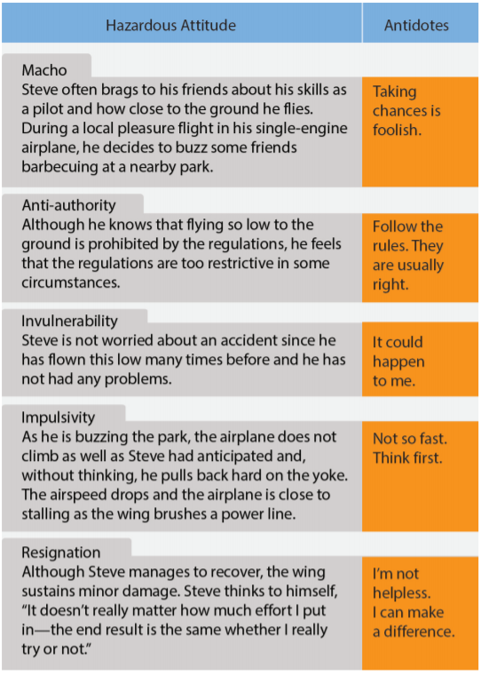
ADM, CRM, & SRM
Hazardous Attitudes
Attitude affects the quality of decisions
Spot hazardous attitudes & remove them

Slide 26
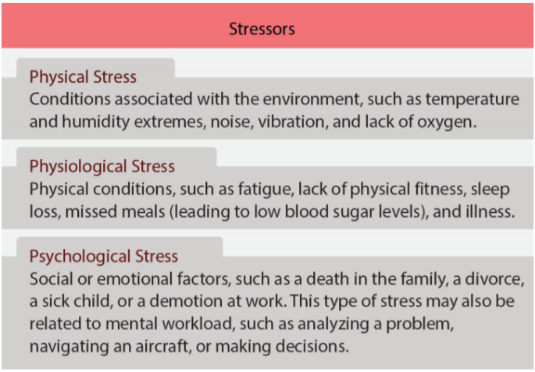
ADM, CRM, & SRM
Stress Management
3 Types of Performance Affecting Stress:
  Physical
  Physiological
  Psychological
Recognize when stress is affecting the learner

Slide 27
ADM, SRM, & CRM
Resources & Workload Management
Use all Resources
  Internal: Equipment, systems, charts, books, ingenuity, knowledge, skill, other passengers
  External: ATC, FSS, Guard, etc.
Plan, Prioritize & Sequence to prevent overload
Prepare for and recognize high workload situations

Slide 28
Questions?

