Slide 1
Regulations & Publications

Slide 2
Overview
WHAT
  Overview and introduction to the various FARs governing the issuance of an instrument rating as well as the rules of IFR flight
WHY
  A student must be familiar with the tools and requirements for the instrument pilot
CONTENT
Part 61 & IFR Pilots
Part 91 & IFR Pilots
Publications
Charts & Procedures

Slide 3
14 CFR Part 61
Part 61 & IFR Pilots
Instrument Rating Requirements (FAR 61.65)
FAR 61.65(a): Instrument Rating Requirements
FAR 61.65(b): Aeronautical Knowledge
FAR 61.65(c): Flight Proficiency
FAR 61.65(d): Aeronautical Experience
FAR 61.65(h): Use of Simulators / FTDs
FAR 61.65(i): Use of an Aviation Training Device

Slide 4
14 CFR Part 61
Part 61 & IFR Pilots
Recent Flight Experience: Pilot in Command (FAR 61.57(c))
Within the last 6 months, must have performed & logged:
  At least 6 instrument approaches
  Holding procedures
  Intercepting & tracking courses using navigation systems
Can be performed under actual or simulated conditions

Slide 5
14 CFR Part 91
Part 91 & IFR Pilots
Can the airplane fly IFR?
  FAR 91.205(d): Required Instruments and Equipment
  FAR 91.411: Altimeter/Pitot-Static Tests & Inspections
  FAR 91.171: VOR Equipment Check
Preflight
  FAR 91.103: Preflight Actions
  FAR 91.169: IFR Alternate Requirements
  FAR 91.167: Fuel Requirements
Departure
  FAR 91.173: ATC Clearance & Flight Plan
  FAR 91.175: Takeoff and Landing IFR

Slide 6
14 CFR Part 91
Part 91 & IFR Pilots
Enroute
  FAR 91.177: Minimum Altitudes
  FAR 91.179: IFR Cruising Altitudes
  FAR 91.181: Course to be Flown
  FAR 91.183: IFR Communications
  FAR 91.185: Communications Failures
  FAR 91.187: Malfunction Reports
Approach (FAR 91.175)
  FAR 91.175(a)(c): Takeoff and Landing IFR
  FAR 91.175(k): ILS Components
  FAR 91.175(d): Landing
  FAR 91.175(e): Missed Approach Procedures
  FAR 91.175(j): Procedure Turns
Part 95: IFR Altitudes
Part 97: Standard Instrument Procedures

Slide 7
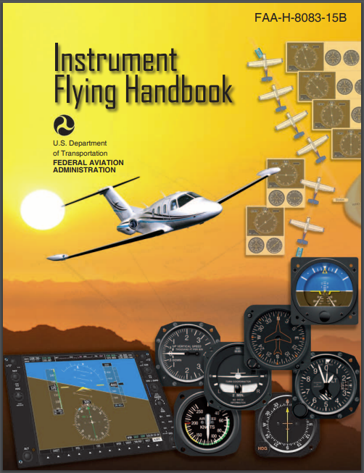
Publications
Instrument Flying Handbook
Knowledge & skills to operate in IMC
Used to prepare for instrument rating tests
Contents include:
  Air Traffic Control
  Instrument Flying Skills
  Navigation & IFR Flight
  Emergency Operations

Slide 8
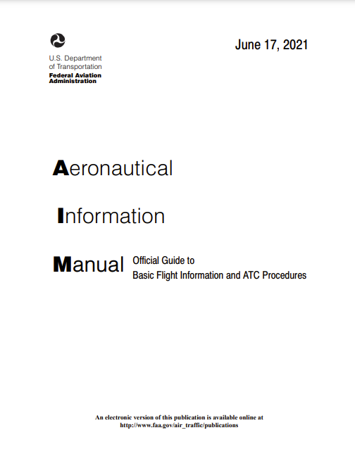
Publications
Aeronautical Information Manual (AIM)
Basic flight information & ATC procedures
Navigation
Airspace
Air Traffic Control
Air Traffic Procedures
Emergency Procedures
Pilot/Controller Glossary

Slide 9
Publications
PTS & ACS
List the tasks a pilot must show skill in to obtain a rating
Current PTS
  Sport
  Recreational
  Instrument Instructor
Current ACS
  Private
  Instrument
  Commercial
  Flight Instructor
  ATP
  Type Rating

Slide 10
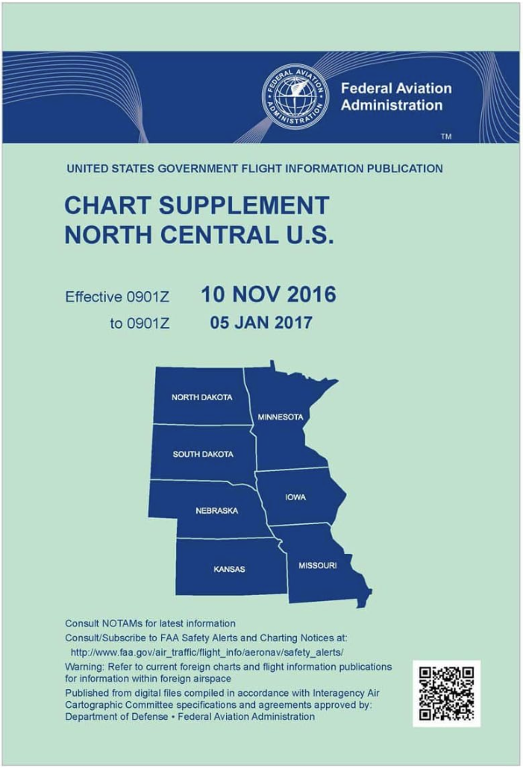
Charts & Procedures
Chart Supplement
Pilot’s directory: Airports, communication data, navigation facilities, procedures, etc.
7 geographical districts
Published by NACO every 8 weeks

Slide 11
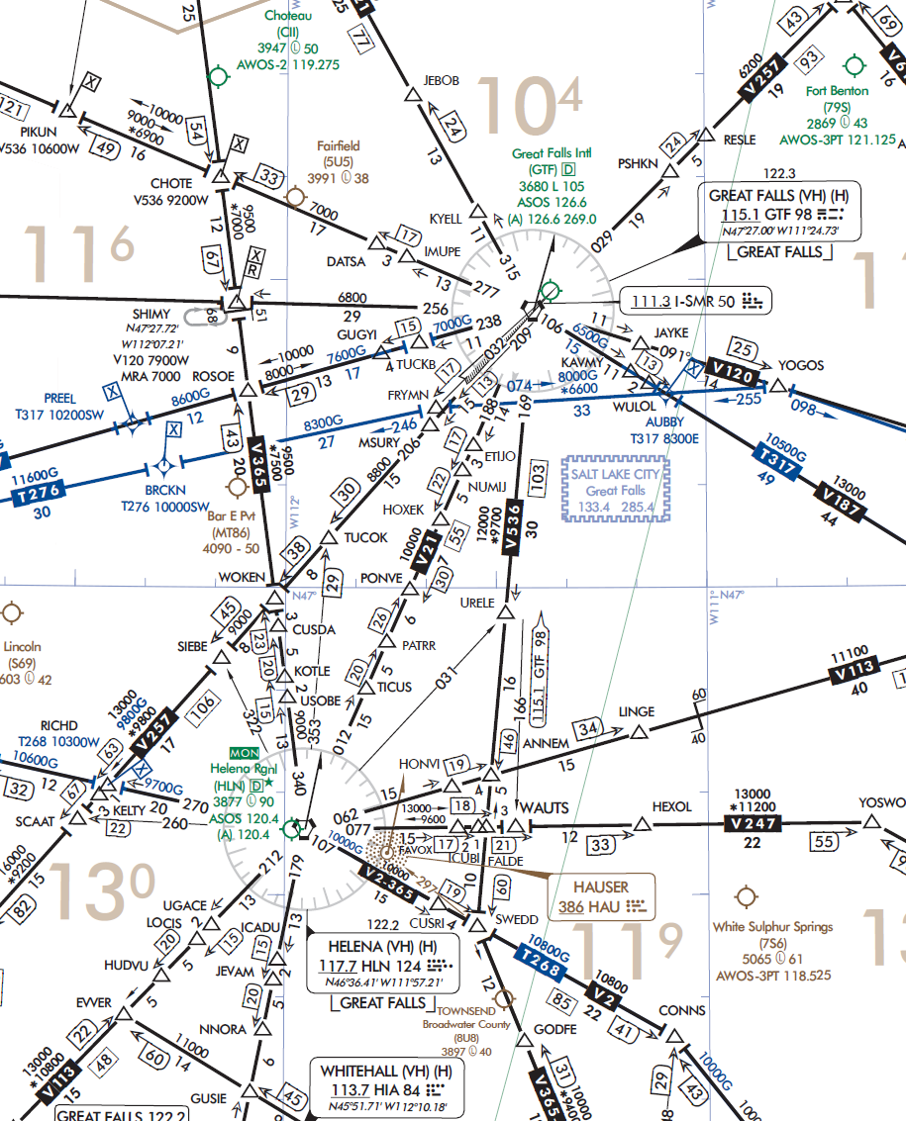
Charts & Procedures
Low Altitude Enroute Charts
For IFR navigation below 18,000’ MSL
Equivalent to the VFR sectional chart
General Content
  Airport Information
  Charted IFR Altitudes
  Navigation Features
Revised every 56 days
FAA Aeronautical Chart User’s Guide

Slide 12
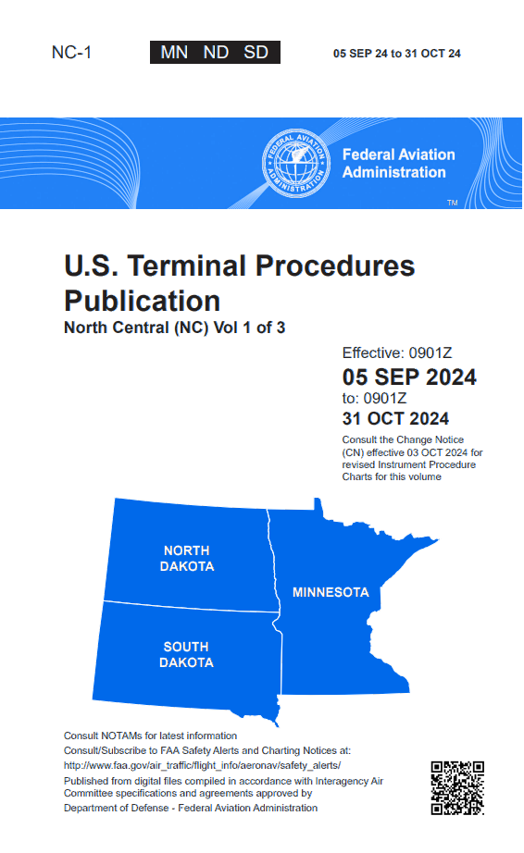
Charts & Procedures
Terminal Procedures Publication (TPP)
Flight procedures in the airport area
Contains:
  Takeoff, Alternate, & Radar Minimums
  Departure Procedures (DPs)
  Standard Terminal Arrival Routes (STARs)
  Instrument Approach Procedures (IAPs)
Exist to make the controller’s & pilot’s jobs safer & more efficient
Revised every 56 days

Slide 13
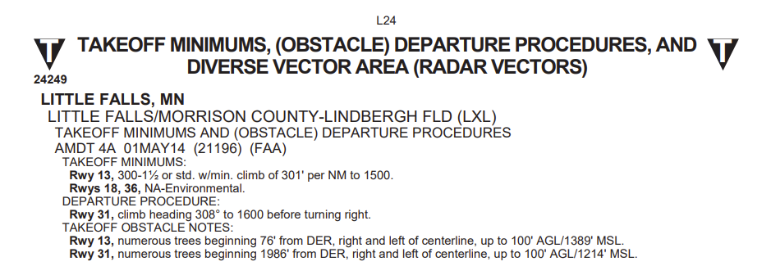
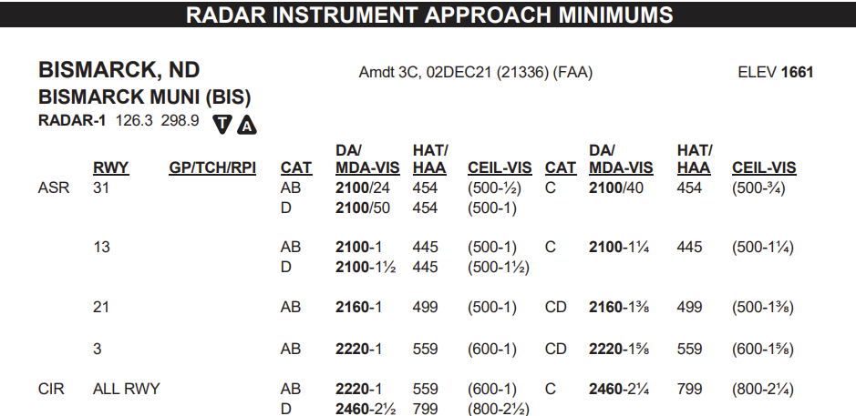
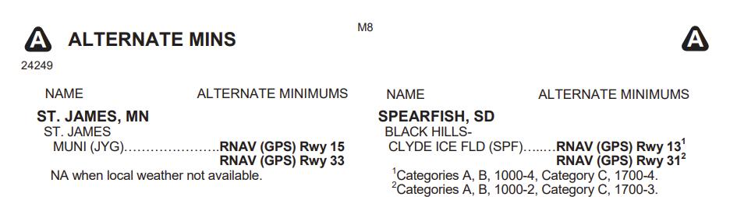
Charts & Procedures
TPP: Minimums
Takeoff Minimums
  Nonstandard IFR takeoff mins
  Obstacle Departure Procedure (ODPs)
  Diverse Vector Area
Alternate Minimums
  Nonstandard IFR alternate mins
Radar Minimums
  PAR/ASR approaches
  Pilot receives course & altitude guidance from a controller
  Used in emergency/distress situations

Slide 14
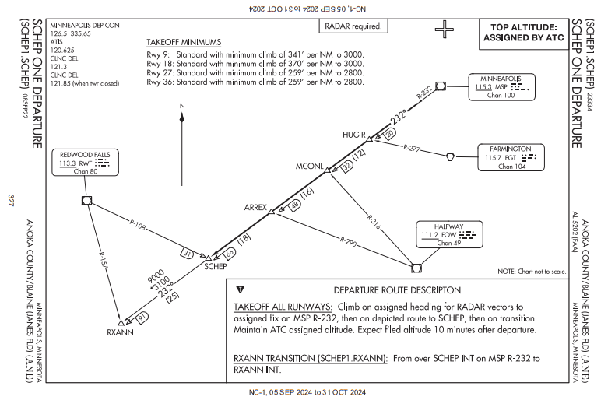
Charts & Procedures
TPP: Departure Procedures
Standard Instrument Departures (SIDS)
Preplanned IFR routing to depart an airfield
Provide obstacle clearance, and reduces communication & departure delays
Text & graphic form

Slide 15
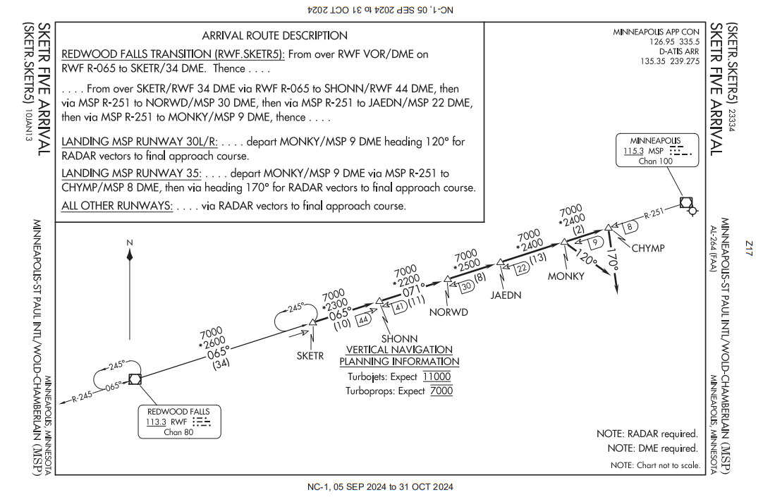
Charts & Procedures
TPP: Arrival Procedures
Standard Terminal Arrival Route (STAR)
Preplanned IFR arrival procedures
Transition from the enroute structure to a terminal fix
Text & graphic form

Slide 16
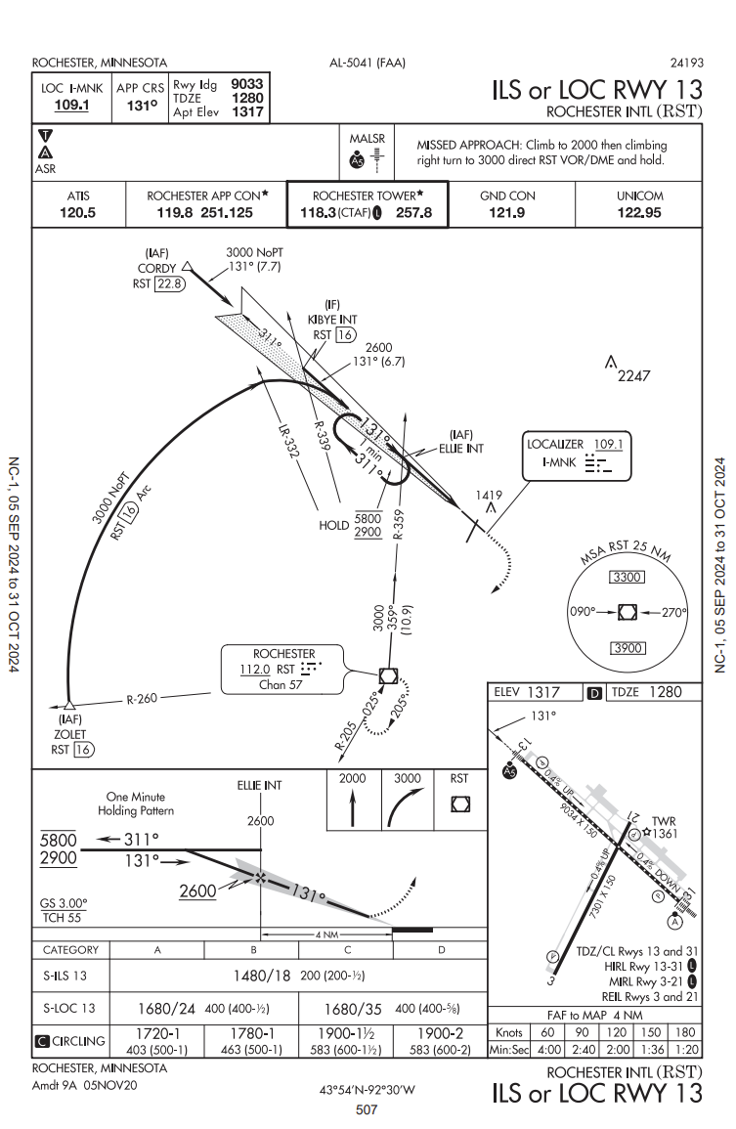
Charts & Procedures
TPP: Instrument Approach Procedures
IAP
Provide the method to descend and land safely in low visibility conditions
Describes navigation requirements, altitude changes, course changes, and other limitations

Slide 17
Questions?

