Slide 1
Flight Instruments & Navigation Equipment

Slide 2
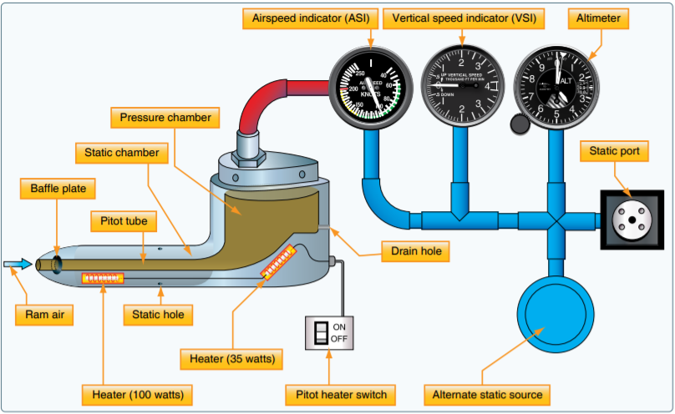
Flight Instruments
Pitot-Static Overview
Airspeed Indicator, Altimeter, Vertical Speed Indicator
Static pressure
  Pressure of the air that is still
  Connects to all 3 instruments
Pitot pressure
  Pointed into the relative wind
  Ram air pressure
  Connects to the Airspeed Indicator
Source: Pilot’s Handbook of Aeronautical Knowledge, FAA

Slide 3
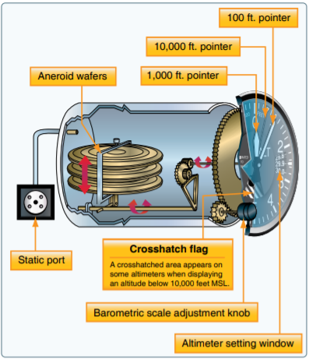
Flight Instruments
Pitot-Static
Altimeter
Operation
  Instrument case connected to the static port
  Static pressure compresses & expands an aneroid
  Compression & expansion changes the altitude displayed
  Kollsman Window: Sets reference pressure
Mechanical Errors
  Within 75’ of airport elevation
Source: Pilot’s Handbook of Aeronautical Knowledge, FAA

Slide 4
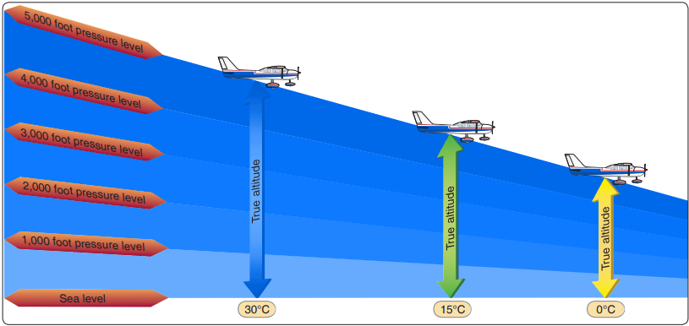
Flight Instruments
Pitot-Static
Altimeter
Non-Standard Temperature
Warmer than Standard
  Air is less dense, pressure levels are spread apart
Colder than Standard
  Air is denser, pressure levels are closer together
Source: Instrument Flying Handbook, FAA

Slide 5
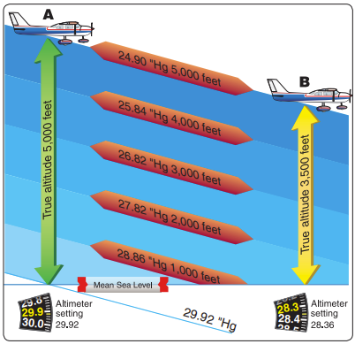
Flight Instruments
Pitot-Static
Altimeter
Non-Standard Pressure
High to Low
  Altimeter interprets decreasing pressure as a climb
Low to High
  Altimeter interprets increasing pressure as a descent
From hot to cold, &
high to low, look out below

Slide 6
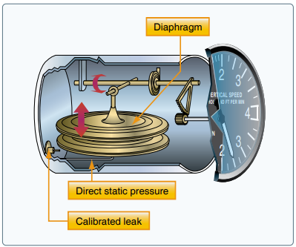
Flight Instruments
Pitot-Static
Vertical Speed Indicator
Differential pressure instrument
Operation
  Instrument case & aneroid vented to static system
  Case: Slow pressure changes
  Aneroid: Immediate pressure changes
  Pressure difference is reflected as vertical speed
  Lags a few seconds

Slide 7
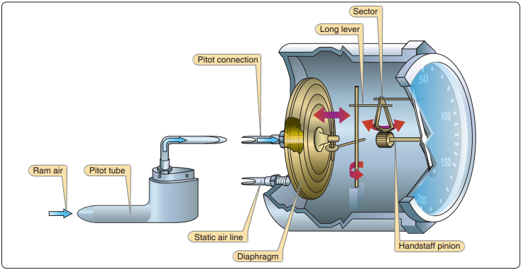
Flight Instruments
Pitot-Static
Airspeed Indicator
Measures Dynamic Pressure
  Difference between static & ram air pressure
Operation
  Diaphragm receives pressure from the pitot tube
  Instrument case receives pressure from the static port
  Difference in static/ram pressure compresses and expands the diaphragm
  Diaphragm movement changes airspeed

Slide 8
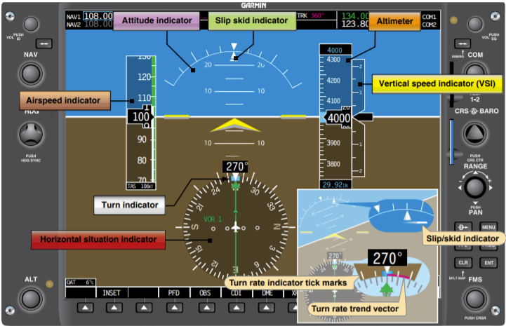
Flight Instruments
Pitot-Static
Air Data Computer (ADC)
Digital Pitot-Static system
Operation
  Computer receives pitot/static pressure and temperature information
  Small, solid-state systems replace wafers, aneroids, gearing, etc.
  Displays instrumentation on glass cockpit

Slide 9
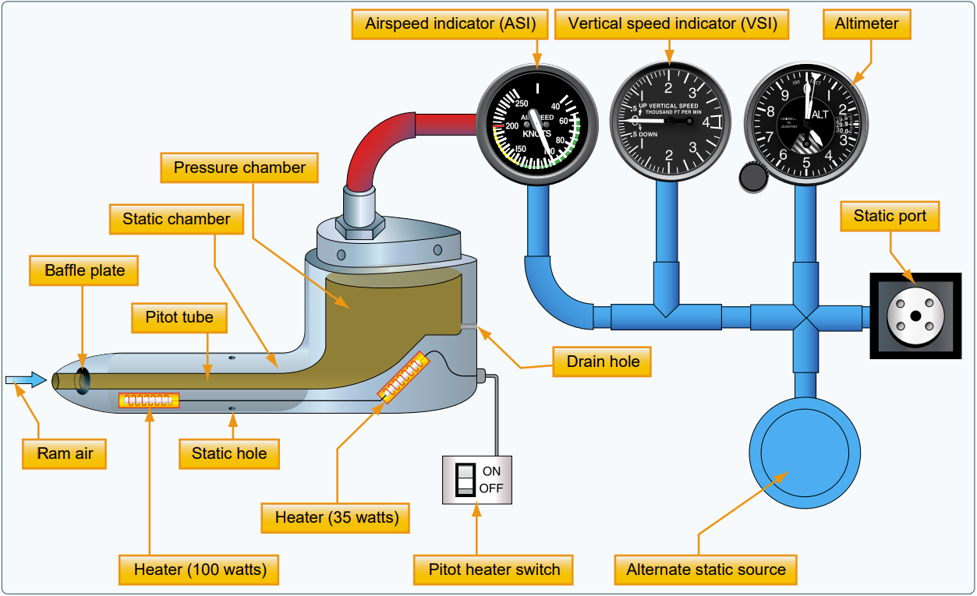
Flight Instruments
Pitot-Static: Blocked System
Airspeed & Vertical Speed Indicator errors almost always indicate pitot-static blockage
Moisture, ice, dirt, insects, etc. can cause a blockage of either system
Always preflight the pitot tube and static ports

Slide 10
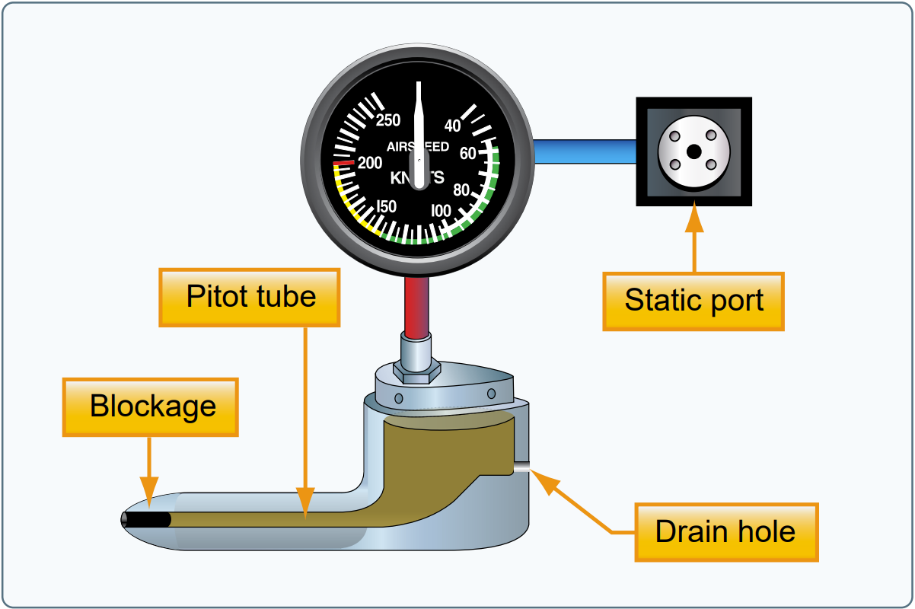
Flight Instruments
Pitot-Static: Blocked System
Ram Air Blocked, Drain Open
Air in the system vents through the drain hole
Ram air pressure drops to match outside (static) air pressure
Airspeed quickly decreases to zero as pressures equalize

Slide 11
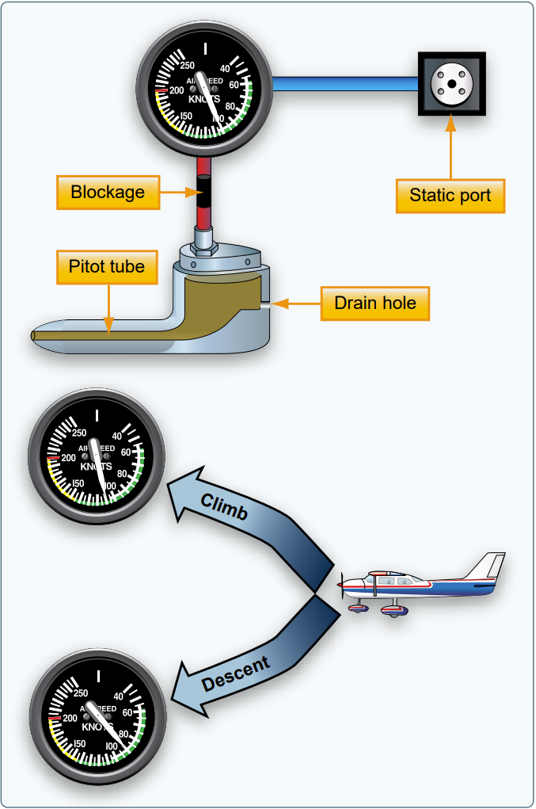
Flight Instruments
Pitot-Static: Blocked System
Ram Air & Drain Blocked
Ram air in the pitot tube is trapped
Static pressure changes with altitude
In a Climb
  Ram air pressure remains constant
  Static pressure decreases
  Airspeed increases
In a Descent
  Ram air pressure remains constant
  Static pressure increases
  Airspeed decreases
Airspeed Indicator acts like an Altimeter

Slide 12
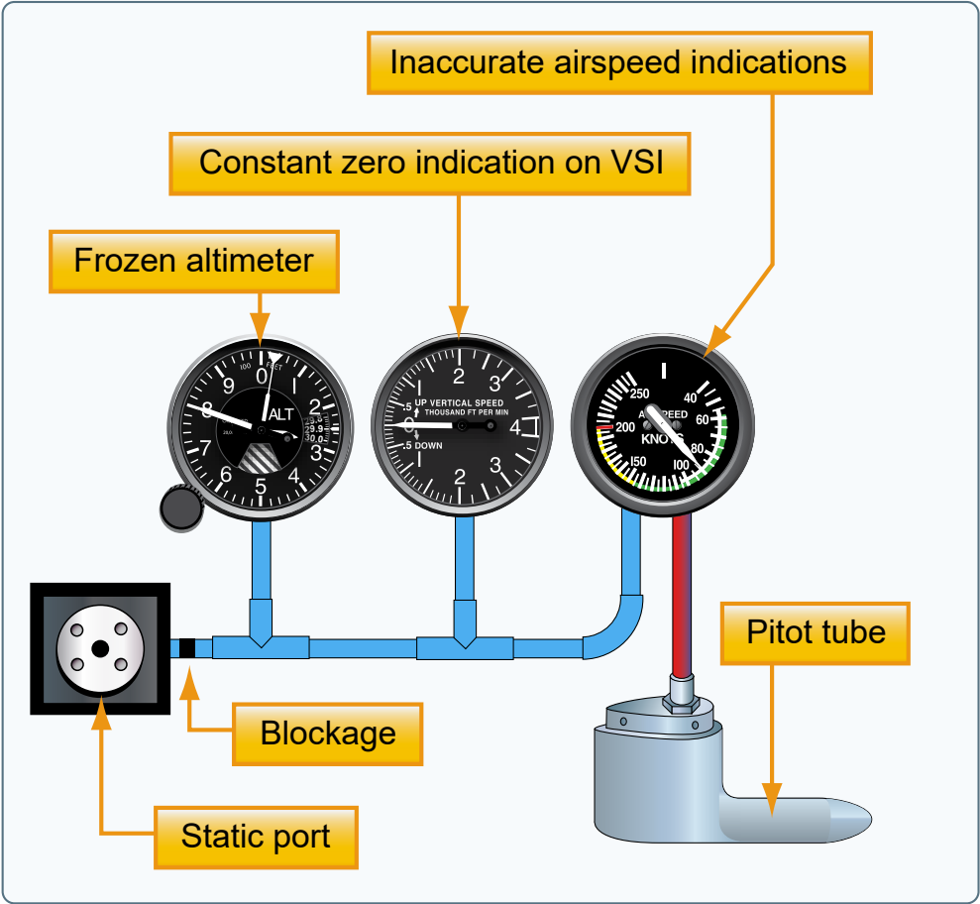
Flight Instruments
Pitot-Static: Blocked System
Static Blocked, Pitot Open
Airspeed Indicator
  Operates but is inaccurate
  Above Blockage Altitude: Airspeed indicates lower than actual
  Below Blockage Altitude: Airspeed indicates higher than actual
Altimeter
  Freezes at the blockage altitude
Vertical Speed Indicator
  Shows zero

Slide 13
Flight Instruments
Pitot-Static
Alternate Static Source
Alternate source of static pressure in case the primary is blocked
Normally inside the flight deck
  Flight deck pressure is lower than outside static pressure
Instrument Indications
  Altimeter: Slightly higher than actual
  Airspeed: Greater than actual airspeed
  Vertical Speed: Momentary climb

Slide 14
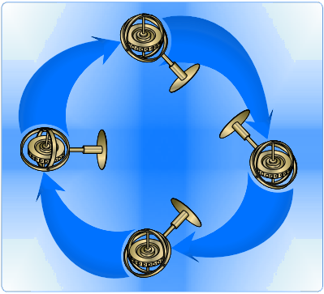
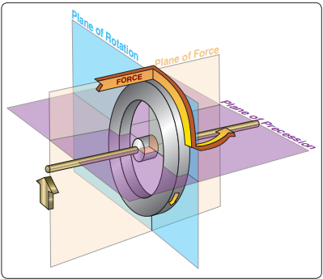
Flight Instruments
Gyroscopic System
Attitude Indicator, Heading Indicator, Turn Coordinator
Gyroscope
  Small wheel with its weight concentrated around its periphery
Rigidity: Gyro is rigid in space
  Case and aircraft rotate about the gyro
  Attitude & Heading instruments
Precession
  A force is felt 90-degrees from the point of application in the direction of rotation
  Rate instruments

Slide 15
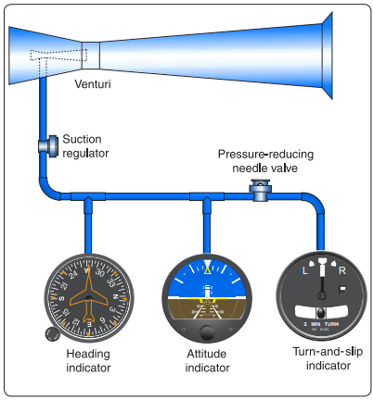
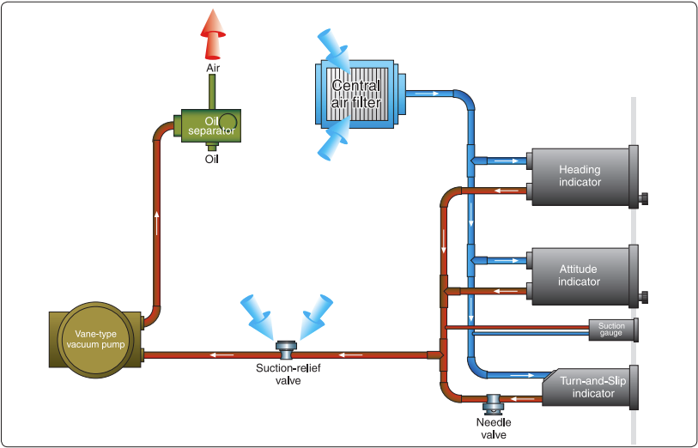
Flight Instruments
Gyroscopic System
Attitude Indicator, Heading Indicator, Turn Coordinator
Power Sources
  Electrical
  Vacuum
  Venturi Tube
  Wet-Type Vacuum
  Dry-Air Pump
  Pressure

Slide 16
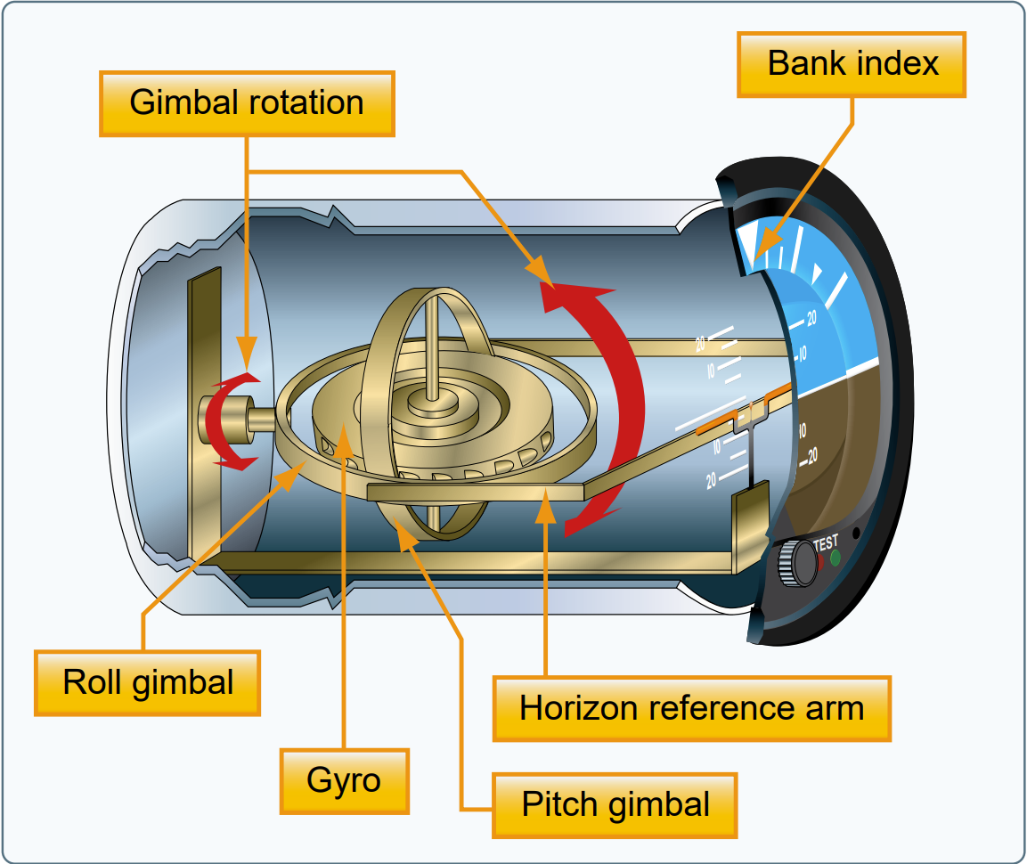
Flight Instruments
Gyroscopic System
Attitude Indicator
Operation
  Brass wheel with a vertical spin axis
  Double gimbal allows pitch & roll about the gyro
  Horizon disk attached to gimbal
  Plane pitches & rolls around horizon disk
Errors
  Nose up during rapid acceleration
  Small bank & pitch error after a 180º turn
  Precession & tilting

Slide 17
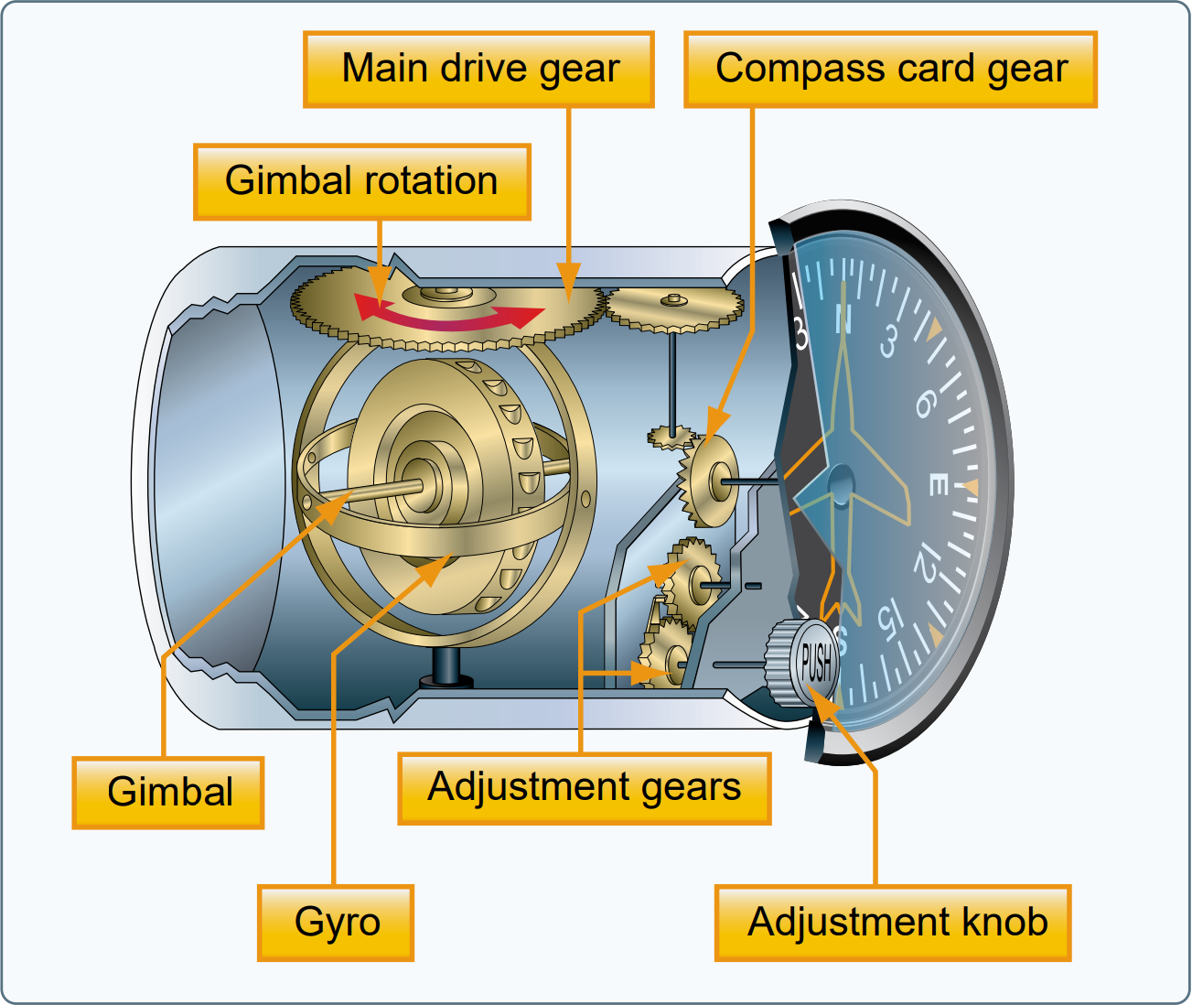
Flight Instruments
Gyroscopic System
Heading Indicator
Operation
  Senses rotation about the vertical axis
  Double gimbal
  Heading is set to match the compass
  Rigidity maintains position
In-Flight Maintenance
  Match heading to compass every 15 mins

Slide 18
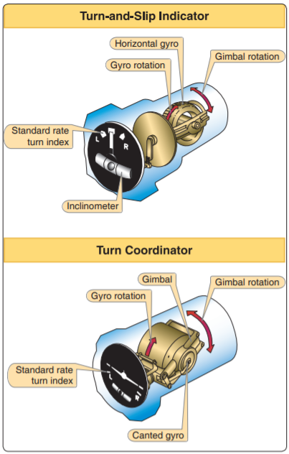
Flight Instruments
Gyroscopic System
Turn & Slip Indicator
Basics
  Displays turn direction & turn rate
  Operates on principal of Precession
Operation
  Gyro mounted in a single gimbal
  Yawing produces a force in the horizontal plane
  Precession causes the gyro/gimbal to rotate about gimbal axis
  Pointer deflects to indicate rate of turn
Limitation
  Only senses rotation on the vertical axis

Slide 19
Flight Instruments
Gyroscopic System
Turn Coordinator
Basics
  Displays turn direction, rate of bank, & rate of turn
  Operates on principal of Precession
  Miniature aircraft (rather than a needle)
  Dashes indicate standard rate turn
Operation
  Powered by an air or electric motor
  Like the turn-and-slip indicator but gimbal frame is angle up 30-degrees
    Allowing it to sense roll & yaw

Slide 20
Flight Instruments
Gyroscopic System
Inclinometer/Coordination Ball
Basics
  Part of Turn Indicator & Turn-and-Slip Indicator
  Glass ball sealed in curved glass tube with liquid
  Measures relationship between bank angle and yaw (coordinated flight)
Indications
  Centered: No inertia, coordinated flight
  Ball Inside the Turn: Bank is too steep (slipping)
  Ball Outside the Turn: Bank is too shallow (skidding)

Slide 21
Flight Instruments
Pitot-Static
Attitude & Heading Reference System (AHRS)
Digital Gyroscopic System
Operation
  Solid-state systems
  Inertial sensors, rate gyros, magnetometers, satellite reception
  Displayed on glass cockpit

Slide 22
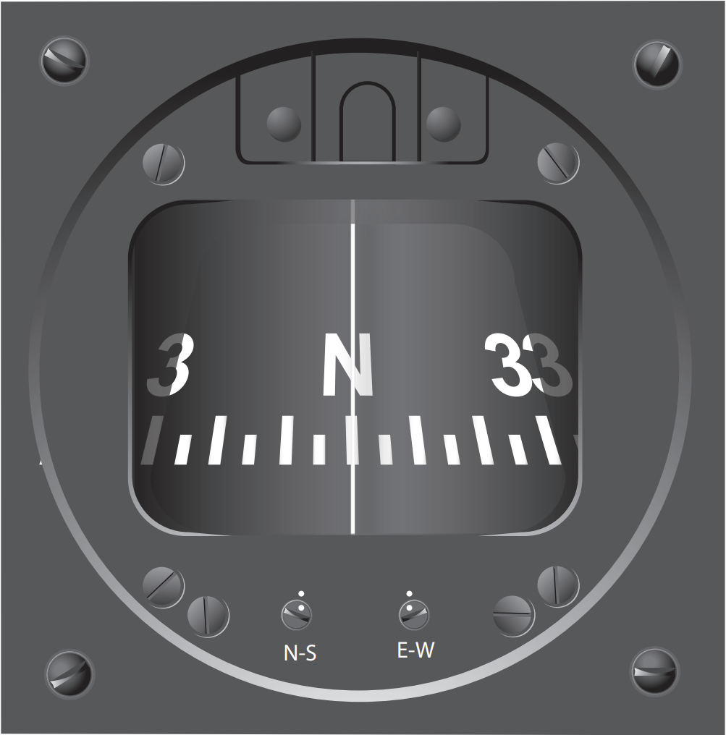
Magnetism
Magnetic Compass
Operation
  2 magnets attached to a metal float in a clear compass fluid
  Compass card is wrapped around the float and displays headings
  Lubber line indicates current heading
  Pilot always sees the compass from its backside
Technique
  Move the desired heading to the lubber line

Slide 23
Magnetism
Magnetic Compass: Errors
Variation
  Difference between magnetic & true North
  Isogonic line: Connect points with the same magnetic variation
  Agonic line: Line along which the two poles are aligned – No variation
Deviation
  Magnetic fields within the aircraft
  Degrees of deviation is displayed on compass correction card
Compass Course
  True course corrected for Variation & Deviation
  True Course ± Variation = Magnetic Course
  Magnetic Course ± Deviation = Compass Course
  East is least, West is best

Slide 24
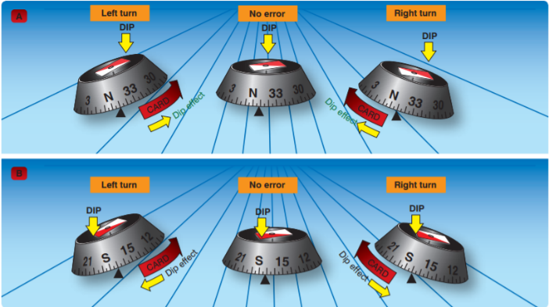
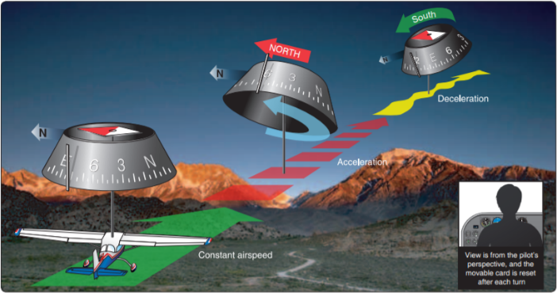
Magnetism
Magnetic Compass: Dip Errors
Lines of magnetic flux
  Perpendicular at the poles
  Parallel at the surface
Northerly & Southerly Turning Errors
  Turns from a Southerly Direction: Compass Leads
  Turns from a Northerly Direction: Compass Lags
  UNOS: Undershoot North, Overshoot South
Acceleration Error
  Aft of compass tilts up when accelerating and down when decelerating
  ANDS: Accelerate North, Decelerate South

Slide 25
Magnetism
Magnetic Compass: Oscillation Error
Combination of all other errors & airplane movement
Use the average heading

Slide 26
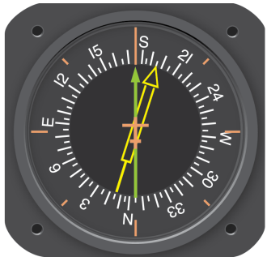
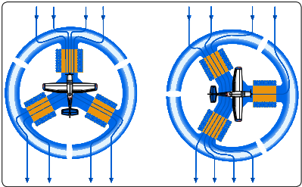
Magnetism
Radio Magnetic Indicator (RMI)
Bearing indicator overlayed on a heading indicator
Flux valve: Automatically rotates the compass card using Earth’s magnetic fields
Bearing indicators are driven by an ADF or VOR

Slide 27
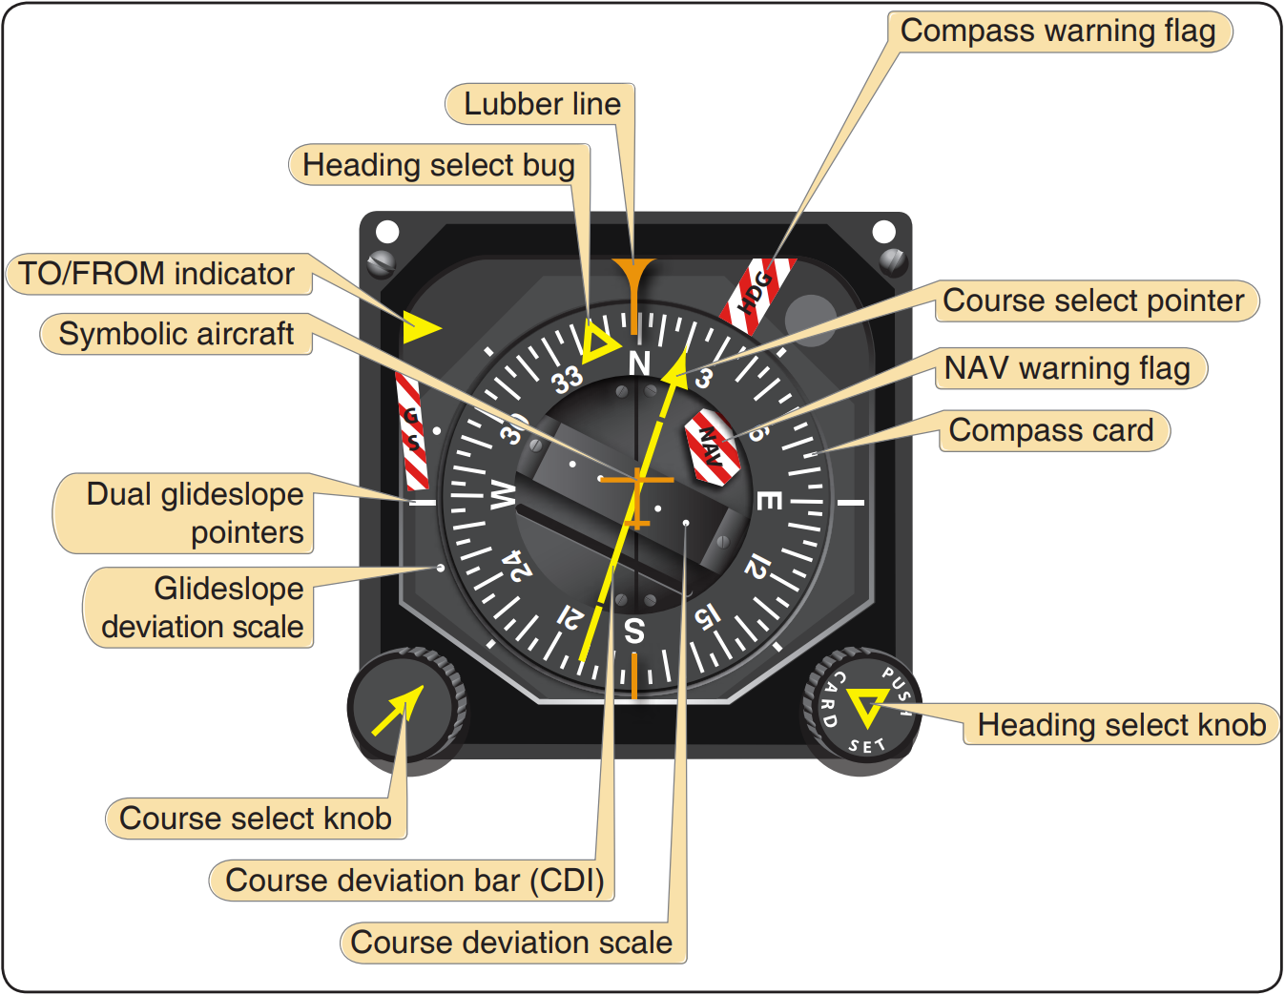
Magnetism
Horizontal Situation Indicator (HSI)
Heading indicator + Navigation
  RMI on steroids
Operation
  Flux valve uses magnetic fields to drive heading indications
  Navigation is displayed over the heading indicator

Slide 28
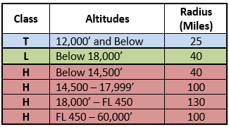
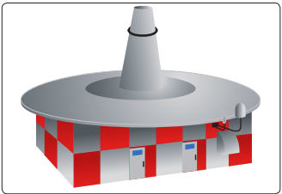
Navigation Equipment
VOR
What is it?
  VHF Omnidirectional range
  Radials projected in all directions referenced to magnetic north
  Radial: Line of magnetic bearing extending outward from the VOR
  Terminal, Low, High class
Types
  VOR
  VOR/DME: VOR + Distance Measuring Equipment
  VORTAC: VOR + TACAN

Slide 29
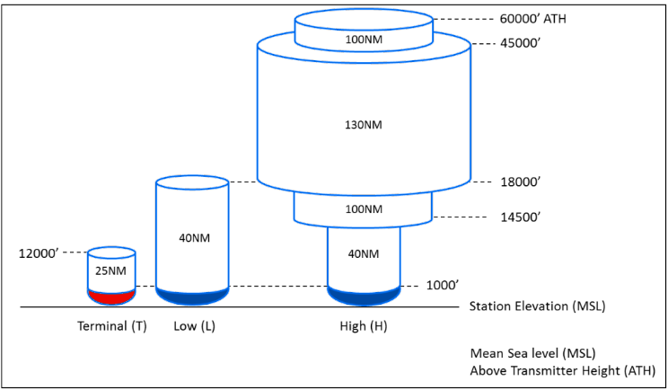
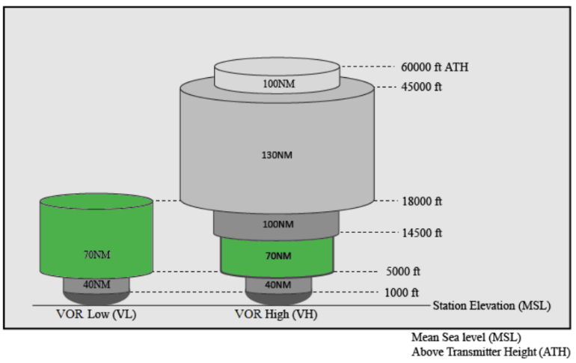
Navigation Equipment
VOR Mon (Min Op Network)
NAS is transitioning to PBN
Reducing number of VORs (from 896 to 590)
New service volumes – Designed to enable near continuous VOR signal at/above 5,000’ AGL
LEGACY SERVICE VOLUMES
NEW MON SERVICE VOLUMES

Slide 30
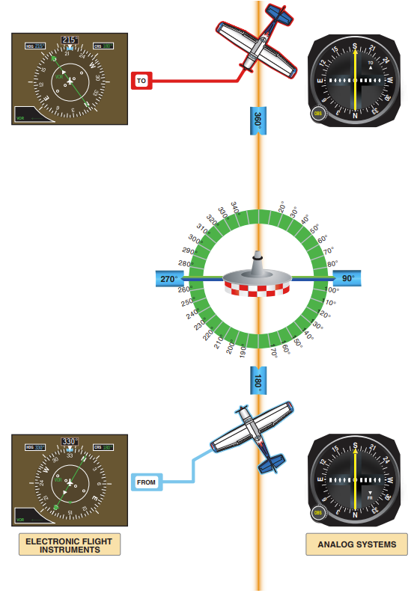
Navigation Equipment
VOR
Ground Components
  VOR station
Aircraft Components
  Antenna – Picks up signal
  Receiver – Processes signal
  VOR Instrument – Displays signal
VOR Instrument
  Omnibearing Selector (OBS): Selects desired radial
  Course Deviation Indicator (CDI): Indicates position relative to the selected course
  To/From Indicator: Displays whether the selected course takes the aircraft to or from the VOR
  Flags: Indicates unusable/unreliable signals

Slide 31
Navigation Equipment
VOR Operation Basics
Tune, Identify, Monitor (TIM)
  Tune the VOR frequency on the receiver
  Verify with morse code/voice/display
  Monitor the identification
Orientation
  Rotate the OBS to center the needle
  Note TO/FROM
Navigating To a VOR
  Rotate OBS so TO shows, center the CDI, fly the course
Navigating From a VOR
  Center the CDI with a FROM indication, fly the course
Always adjust heading for wind

Slide 32
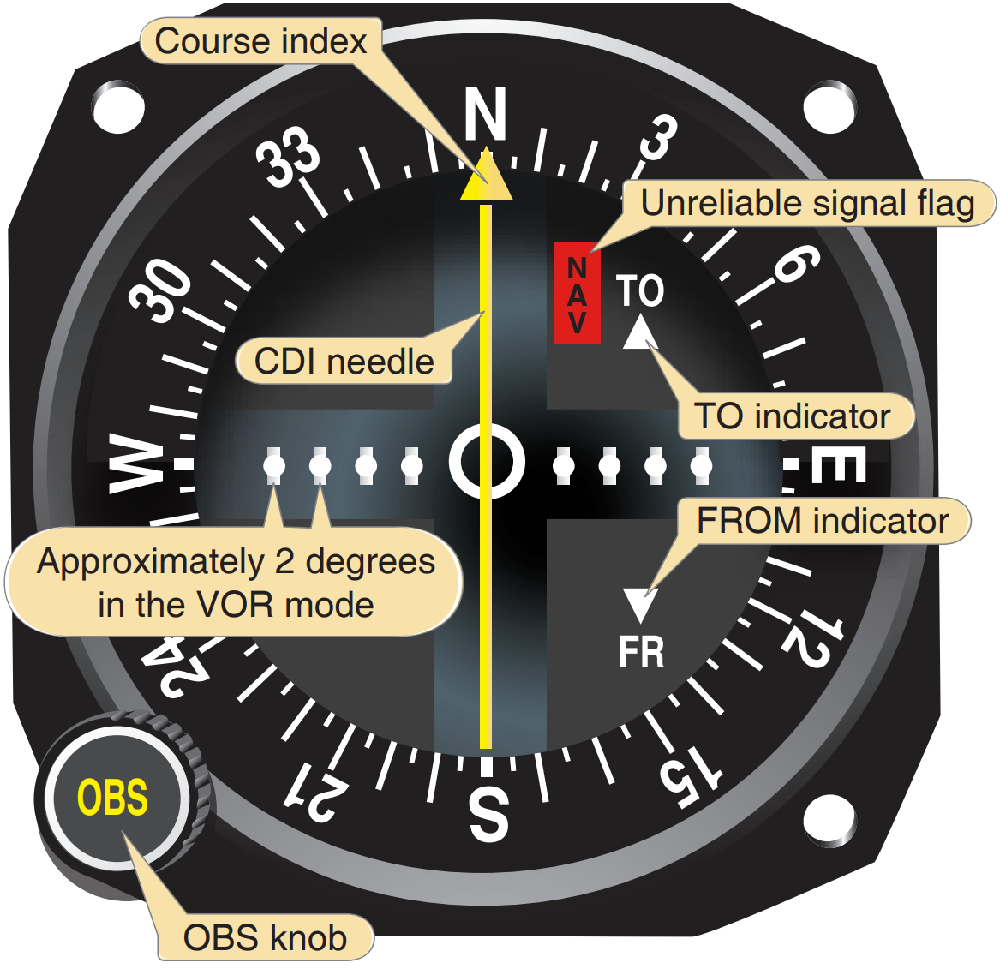
Navigation Equipment
VOR Checks
FAR 91.171
  VOR check required in the last 30 days for IFR operations
Types of Checks
  FAA Test Facility
  Certified Airborne Checkpoint
  Certified Ground Checkpoint
  Dual VOR check
Chart Supplement contains checkpoints
Ground Check: ± 4 degrees
Airborne Check: ± 6 degrees

Slide 33
Navigation Equipment
Distance Measuring Equipment (DME)
Provides slant range distance from a station
Ground Equipment
  VOR/DME, VORTAC, ILS/DME & LOC/DME
Aircraft Equipment
  DME Antenna & Receiver
  Pilot Controls (on/off, frequency, modes, altitude)
Errors
  Line-of-sight
  Slant Range Distance: Straight line distance from the aircraft to the ground facility
    Error is smallest at low altitudes & long range
    Negligible if 1 mile (or more) away for each 1,000’ above the facility

Slide 34
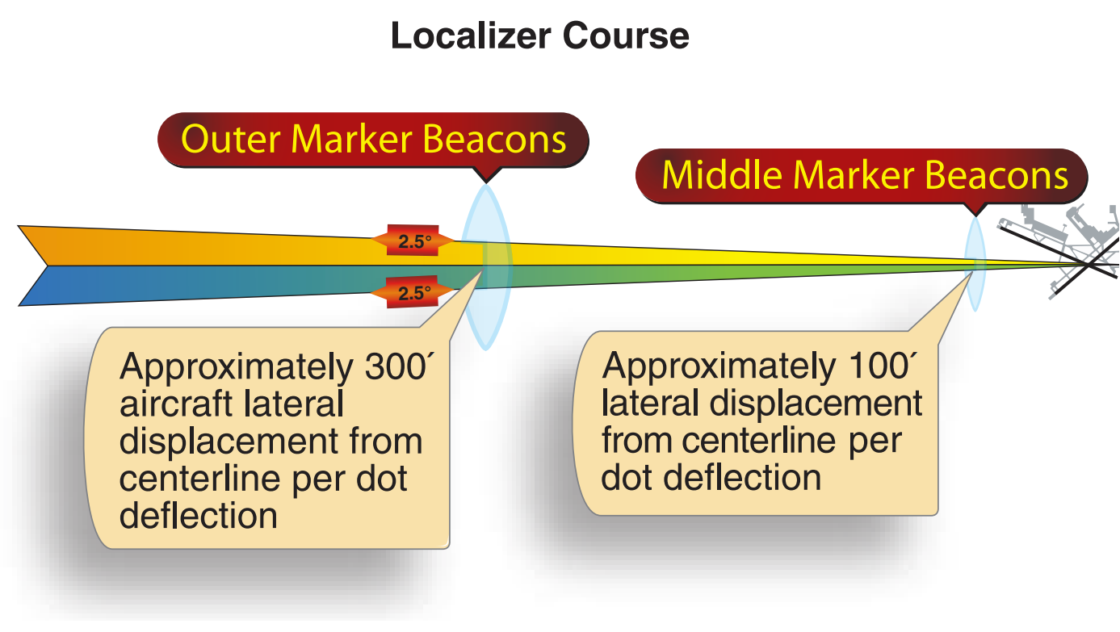
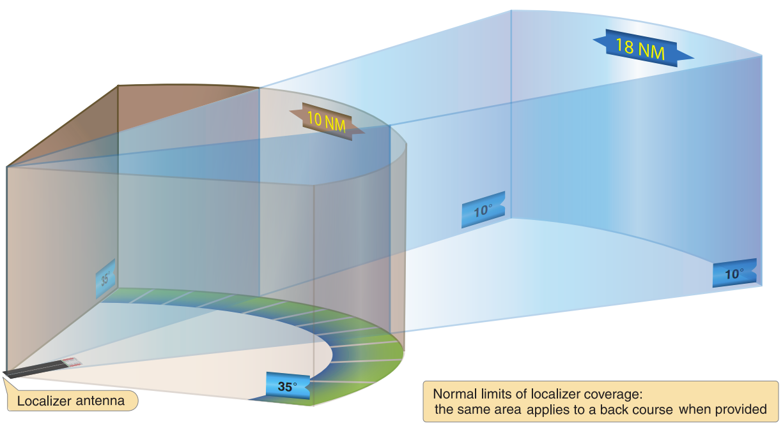
Navigation Equipment
Instrument Landing System (ILS)
Electronic system providing horizontal & vertical guidance to a runway
Types
  Cat I: Descent no lower than 200’ AGL
  Cat II: Descent no lower than 100’ AGL
  Cat III: No decision height minimums
  Cat II & III require certification & equipment
Source: Instrument Flying Handbook, FAA

Slide 35
Navigation Equipment
Instrument Landing System (ILS)
Localizer: Horizontal guidance
  Projects a front and back course
  Narrow course – 5 degrees
  Projects 18 NM & 4,500’ above the antenna
  108.1 – 111.95 MHz
Glideslope: Vertical guidance
  Generally, a 3-degree glidepath
  Only projects a front course
  1.4 degrees thick
  Tied to localizer frequency
Source: Instrument Flying Handbook, FAA

Slide 36
Navigation Equipment
ILS Ground Components
Marker Beacons: Range information
Outer (OM): 4-7 NM out/GS intercept
Middle (MM): 3,500’ out/200’
Inner (IM): DH on a Cat II approach
Compass Locator: With OM/MM
Source: Instrument Flying Handbook, FAA

Slide 37
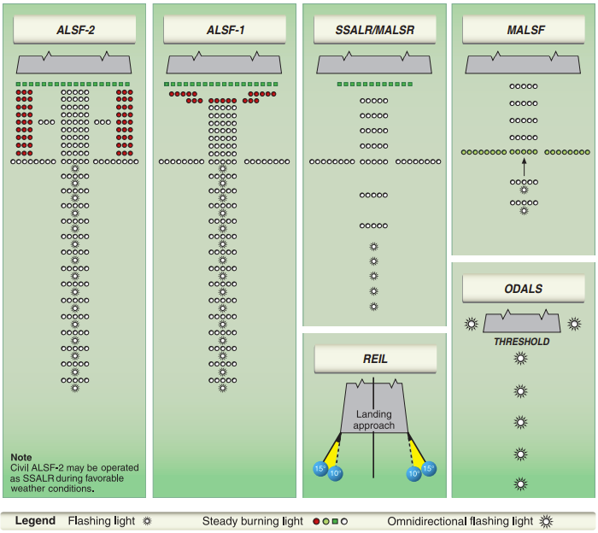
Navigation Equipment
ILS Ground Components
Approach Lights: Transition to visual flight
ALSF: Approach Light System with Sequenced Flashing lights
SSALR: Simplified Short Approach Light System with Runway alignment indicator lights
MALSR: Medium intensity Approach Light System with Runway alignment indicator lights
REIL: Runway End Identification Lights
MALSF: Medium intensity Approach Light System with Sequenced Flashing lights (& runway alignment)
ODALS: Omnidirectional Approach Light System
Source: Instrument Flying Handbook, FAA

Slide 38
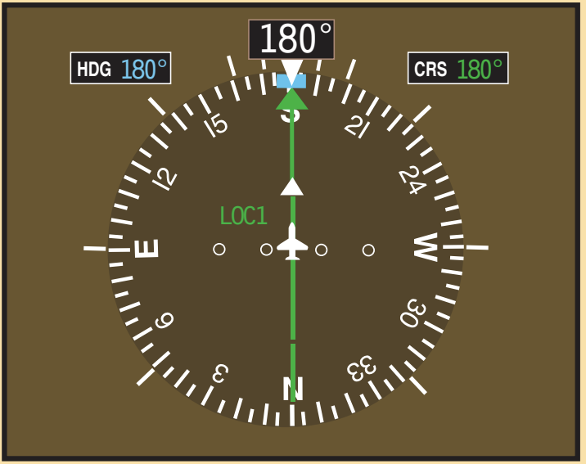
Navigation Equipment
ILS Airborne Components: Localizer
Receiver
  Same as a VOR receiver
Navigation
  Navigation: Like a VOR, but more sensitive
  Rotating the OBS has no effect
  Directional Indications when inbound on the front course or outbound on the back course
  Opposite indications when outbound on the front course or inbound on the back course
Flying
  Center the LOC, fly the inbound course
  Apply drift corrections
Source: Instrument Flying Handbook, FAA

Slide 39
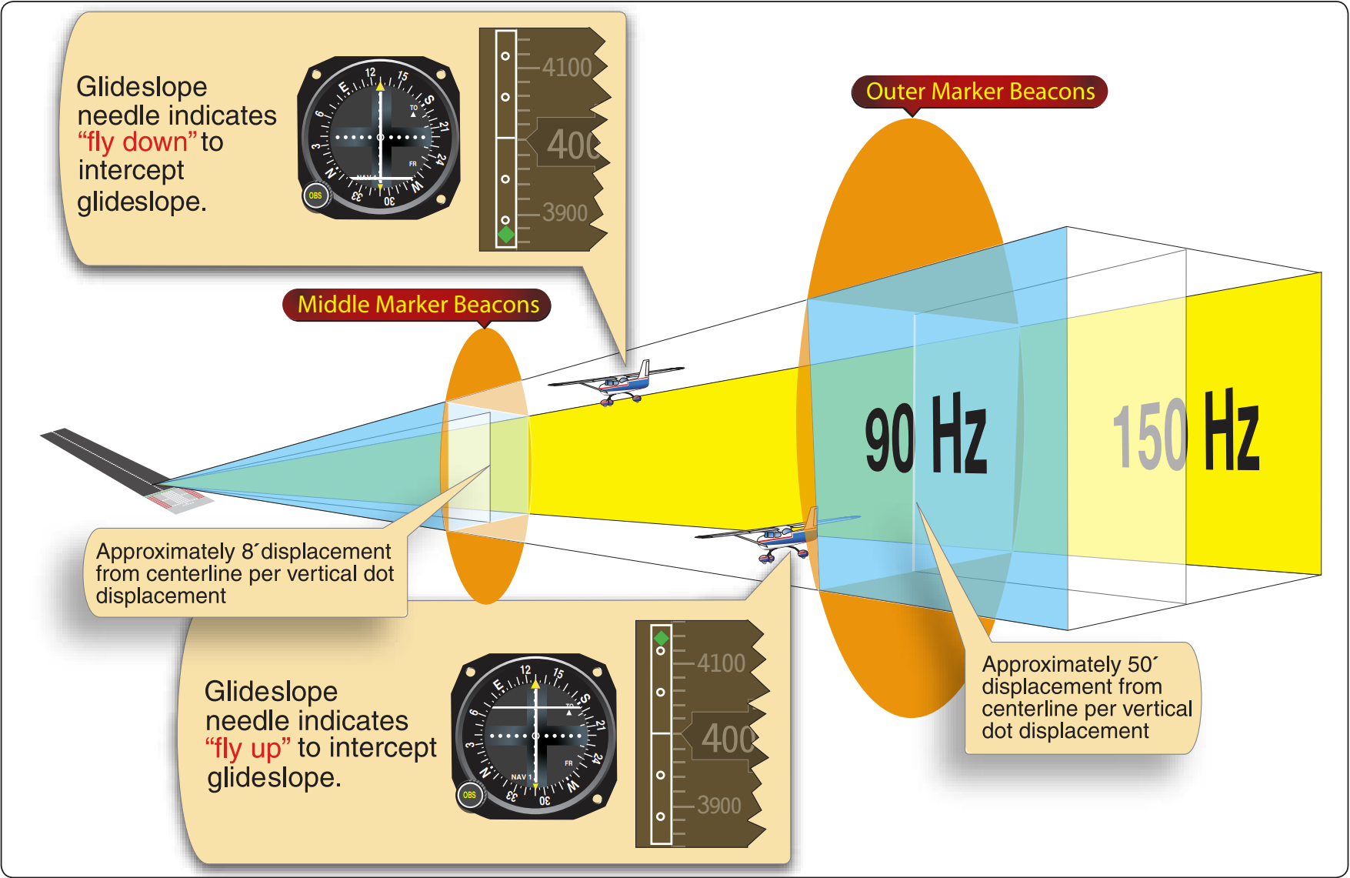
Navigation Equipment
ILS Airborne Components: Glideslope
Receiver
  Auto tuned with the localizer frequency
Navigation
  Needle/diamond represent the glideslope
  On Glidepath: Needle or diamond centered
Flying
  Set pitch & power as GS is intercepted
  Small pitch adjustments to maintain slope
  Divide attention
Source: Instrument Flying Handbook, FAA

Slide 40
Navigation Equipment
ILS Airborne Components
Marker Beacons
  OM: Low pitch, Continuous dashes, Purple/blue
  MM: Intermediate pitch, Dots/dashes, Amber
  IM: High pitch, Continuous dots, White
  BCM: High pitch, Two dots, White
DME
  Often included for waypoints/location
Compass Locators
  Transition from enroute NAVAIDS to ILS system
DME collocated with Glide Slope Transmitter
  Provides distance to touchdown information
Source: Instrument Flying Handbook, FAA

Slide 41
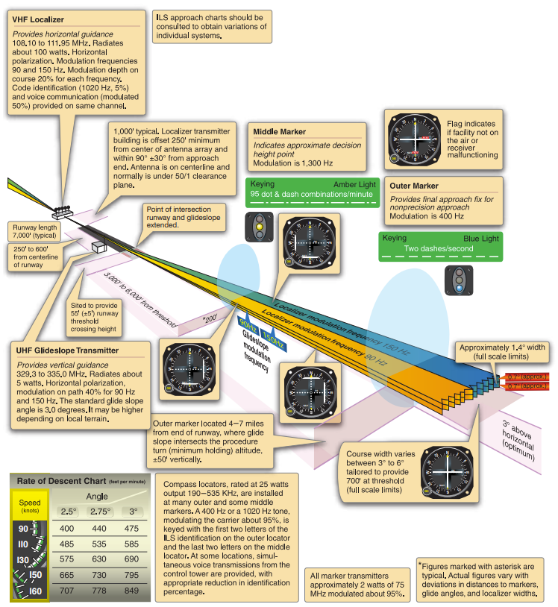
ILS Airborne Components
Source: Instrument Flying Handbook, FAA

Slide 42
Navigation Equipment
ILS Errors
Reflection
  Surface vehicles & aircraft below 5,000’ AGL can disturb the signal
False Courses
  GS facilities inherently produce additional courses at higher vertical angles
  Lowest occurs at 9-12º
  Can cause confusion & high descent rates
  Fly the altitudes on the approach chart
Source: Instrument Flying Handbook, FAA

Slide 43
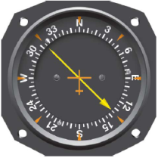
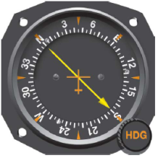
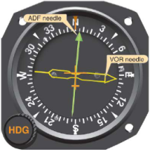
Navigation Equipment
ADF & NDB
Nondirectional Radio Beacon (NDB)
  Ground-based radio transmitter transmitting energy in all directions
Automatic Direction Finder (ADF)
  Needle points to the NDB ground station to determine relative bearing
Magnetic Heading + Relative Bearing = Magnetic Bearing
  Mary Had Roast Beef, Mary Barfed (MH + RB = MB)
Ground (NDB) Components
  NDB ground station
Airborne (ADF) Components
  2 antennas
  Receiver
  Indicator instrument

Slide 44
Navigation Equipment
ADF & NDB
Fixed Card ADF
  Always indicates 0 at the top
  Needle indicates RB to the station
  Pilot must determine MB
Movable Card ADF
  Pilot can rotate MH to the top of the instrument
  Head of the needle indicates MB to the station
  Less work for the pilot
Radio Magnetic Indicator (RMI)
  Automatically rotates to display aircraft heading (flux valve)
  Can have two needles – ADF / VOR
  ADF: Head indicates MB to station / Tail indicates MB from station
  VOR: Indicates radial relative to the station

Slide 45
Navigation Equipment
ADF & NDB
Fixed Card ADF
  Visualize the ADF dial in terms of the longitudinal axis
  Relate RB to MH to determine MB
Movable Card ADF
  Rotate aircraft heading to the top of the instrument
  Turn toward the head of the needle
  Reset aircraft heading after each turn
Radio Magnetic Indicator (RMI)
  Turn toward the head of the needle
Station Passage
  Approaching the station, the needle becomes more sensitive
  Abeam when needle points 90º off your track

Slide 46
Navigation Equipment
Global Positioning System (GPS)
Space Segment
  24 satellite constellation 11,000 NM above earth
  5 satellites in view at any time (12-hour orbits)
  Transmit a unique code to GPS receivers
  UHF – unaffected by weather but subject to line-of-sight
Control Segment
  Master control station
  5 monitoring stations
  3 ground antennas
User Segment
  All components associated with the GPS receiver
  Receiver utilizes satellite signal/code to provide position, velocity, & precise timing to users

Slide 47
Navigation Equipment
GPS: Operation
Solving for Location
  Receiver uses 4 best positioned satellites for a 3-D fix
  Satellites broadcast course/acquisition (CA) code
  Receiver uses CA code to compute distance
  Receiver triangulates position using several satellite signals
Navigating
  As simple as selecting a destination & tracking the course
    Can add SIDs, routes/airways, STARs, approaches, holds, etc.
  Course deviation is linear – no change in sensitivity

Slide 48
Navigation Equipment
GPS: RAIM
Receiver’s ability to verify satellite signal integrity
Requires minimum of 5 satellites
  Or 4 and a barometric altimeter
2 Types of Messages
  Not enough satellites in view
  Potential error exceeds limits for the phase of flight
Alternate Means of Navigation
  Un-augmented GPS equipment must be equipped with an alternate means of navigation
  No need to monitor alternate equipment if using RAIM
  Active monitoring of nav equipment is required if RAIM fails

Slide 49
Navigation Equipment
GPS: Substitution
May be used as a substitute for ADF & DME when:
Determining position over a DME fix
Flying a DME arc
Navigating To/From an NDB or Compass Locator
Determining position over an NDB or Compass Locator
Determining position over a fix defined by an NDB or Compass Locator bearing crossing a VOR/LOC course
Holding over an NDB or Compass Locator

Slide 50
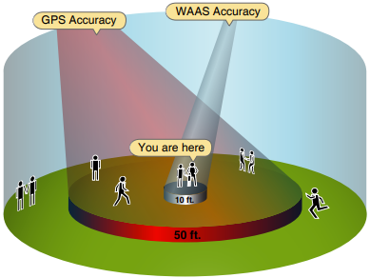
Navigation Equipment
Wide Area Augmentation System (WAAS)
Improves GPS accuracy, integrity & availability
Capabilities
  Navigation system from takeoff through Cat I approaches
  Electronic glidepath independent of ground equipment
  Approaches without the cost of installing a ground station
  Eliminates cold temperature effects, incorrect altimeter settings or lack of an altimeter source
Approach with Vertical Guidance
  WAAS generated glidepath - Similar to an ILS

Slide 51
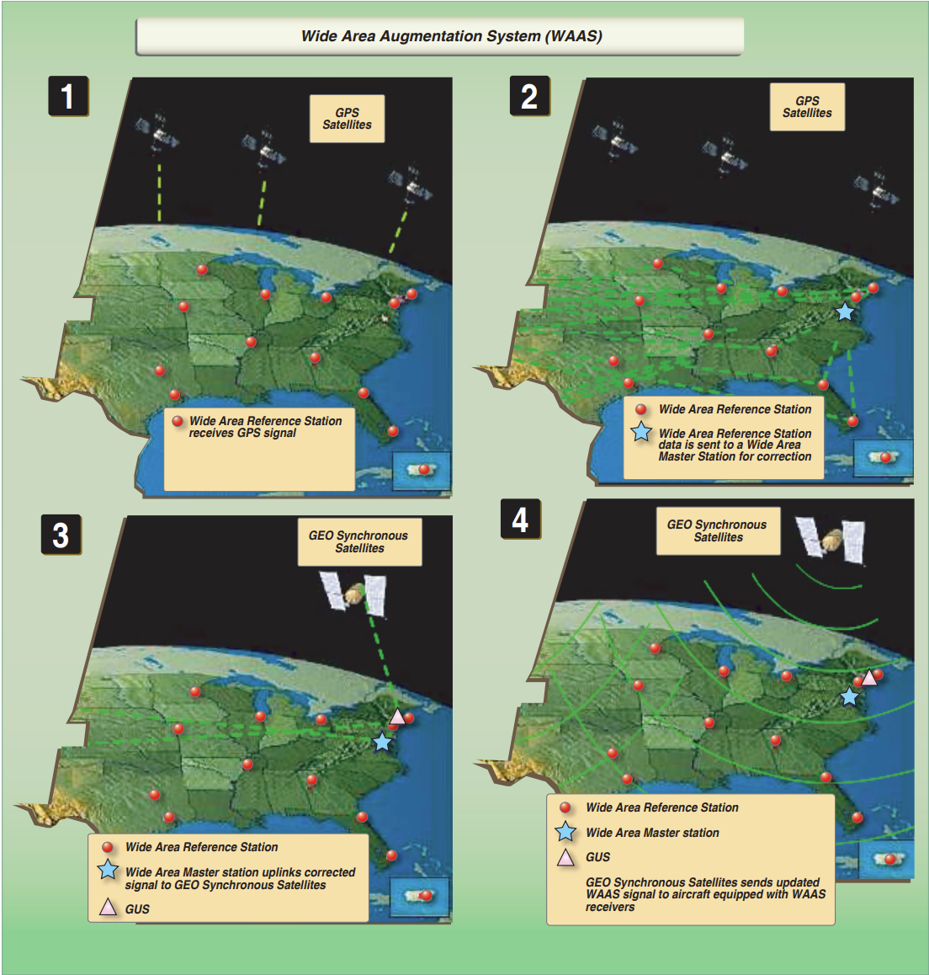
Navigation Equipment
Wide Area Augmentation System (WAAS)
Source: Instrument Flying Handbook, FAA

Slide 52
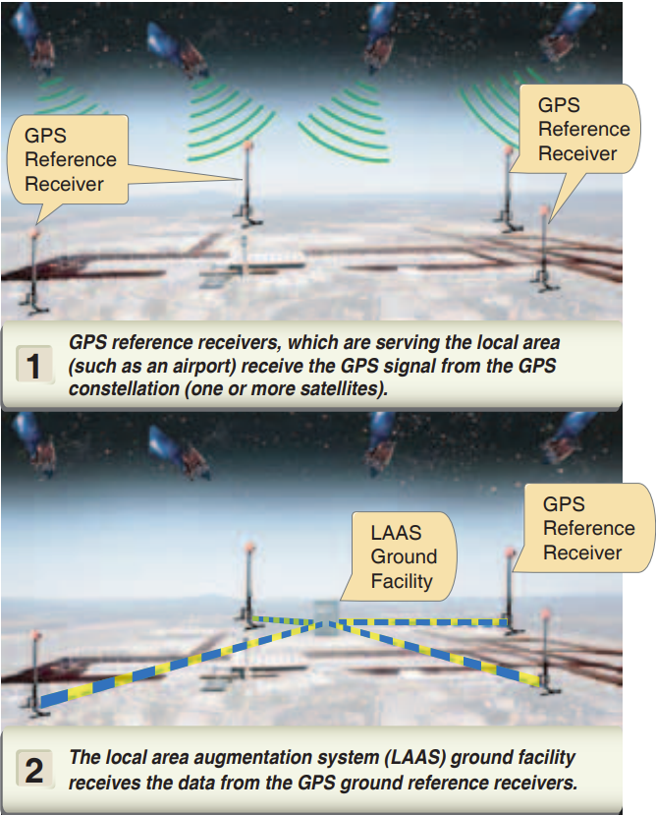
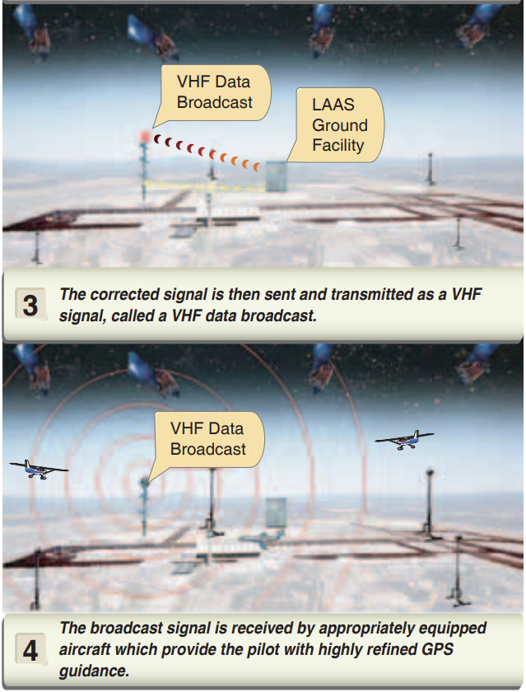
Navigation Equipment
Local Area Augmentation System (LAAS)
WAAS with more ground augmentation
Real-time correction of GPS signal
Airport receivers send data to a central location
Correction message is transmitted to users
Corrects GPS signals to provide CAT I or better

Slide 53
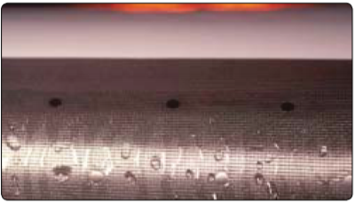
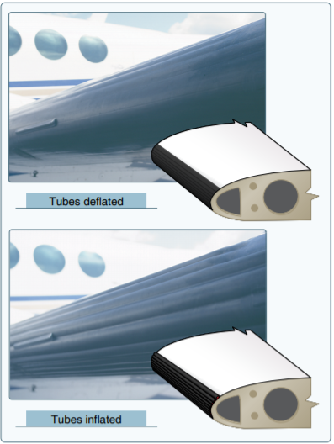
Anti-Ice / Deice
Systems
Weeping Wing
  Anti-ice mixture is excreted through tiny holes in the wing
Heated Surfaces
  Jet aircraft use hot engine bleed air to prevent ice build-up
Boots
  Bleed air is used to inflate leading edge “boots” to remove ice
Pitot Heat
  Electrically heated pitot mast to prevent icing
Windshield Defrost
  Heat ducted to the windshield to remove light icing
Big Picture
  Avoid icing. If in icing, leave as soon as possible

Slide 54

Questions?

