Slide 1
Aeromedical Factors

Slide 2
Overview
What
  A number of health and physiological factors that can influence a pilot’s ability to fly safely
Why
  Many of these factors not only affect the health and well-being of the pilot, but can quickly lead to inflight emergencies
Content
Hypoxia
Hyperventilation
Middle Ear and Sinus Problems
Spatial Disorientation
Illusions
Motion Sickness
Carbon Monoxide Poisoning
Fatigue and Stress
Dehydration
Alcohol and Drugs
Nitrogen and Scuba Diving
IMSAFE Checklist

Slide 3
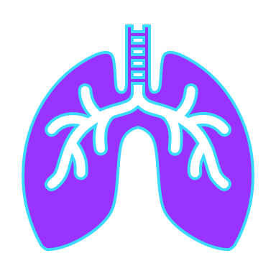



Hypoxia
Lack of Oxygen
4 Types
  Hypoxic: Lack of oxygen to the lungs
  Hypemic: Not enough blood
  Stagnant: Not flowing
  Histotoxic: Inability of the cells to use oxygen
Symptoms
  Cyanosis, headache, impaired judgement & reactions, euphoria, visual impairment, drowsiness, lightheaded, tingling, numbness
Time of Useful Consciousness
Altitude | Time of Useful Consciousness
40,000’ | 15 to 20 seconds
30,000’ | 1 to 2 minutes
22,000’ | 5 to 10 minutes
Treatment: Supplemental oxygen & lower altitudes

Slide 4
Hyperventilation
Excessive loss of carbon dioxide from the blood
Causes
  Emotional stress, fright or pain, leading to increased breathing rate and depth
Symptoms
  Very similar to Hypoxia
  Lightheaded/dizzy, tingling, visual impairment, hot and cold, muscle spasms
Treatment
  Breathe normally (best prevention and cure)
  Breathe into a paper bag, or talk out loud
  If unsure, treat for Hypoxia (more dangerous condition)

Slide 5
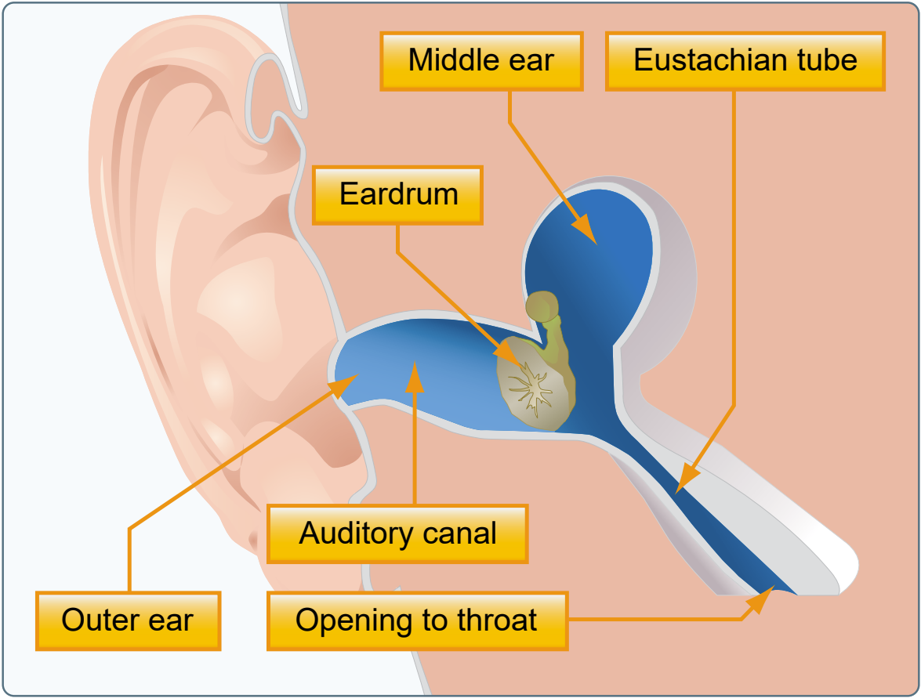
Middle Ear & Sinus Problems
Middle Ear
  Air pressure difference in the middle ear & outside
  Symptoms: Pain, reduced hearing sensitivity
  Treatment: Chew gum, stretch jaw, valsalva, medicine
    Valsalva only in a descent
Sinus
  Normally, sinus pressure equalizes with cockpit pressure
  Congestion can prevent pressure from equalizing
  Symptoms: Sinus and/or upper tooth pain, bloody mucus
  Treatment: Slow descent rates, Do Not Fly
Source: PHAK, FAA

Slide 6



Spatial Disorientation
Lack of orientation with the position, attitude, or movement of the plane in space
Orientation Systems
  Visual
    Eyes (largest source of information)
  Somatosensory
    Nerves, that along with hearing, sense position based on gravity, feeling, and sound
  Vestibular
    Motion sensing system located in the inner ears
Brain combines 3 systems for orientation
  Conflicting information can lead to disorientation

Slide 7
Spatial Disorientation
Flying can result in conflicting information in the brain
Visual System (eyes)
  Primary orientation system
  Prevails over false sensations from other systems
  In IMC, the eyes cannot correct for false sensations
Somatosensory System (nerves)
  Forces in flight can lead to false sensations of the direction of gravity
  The brain cannot differentiate between forces in turns and gravity
  Turbulence can confuse the brain
Vestibular System (ears)
  Semicircular Canals: Detect angular acceleration
  Otolith Organs: Detect linear acceleration

Slide 8
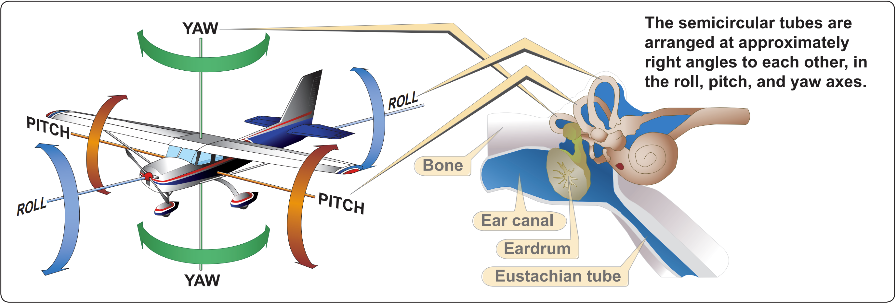
Spatial Disorientation in Flight
Semicircular Canals
3 tubes, 1 on each axis, at right angles to each other
Canals are filled with endolymph fluid
Cupola (gelatinous structure on sensory hairs) at the center of the canal

Slide 9
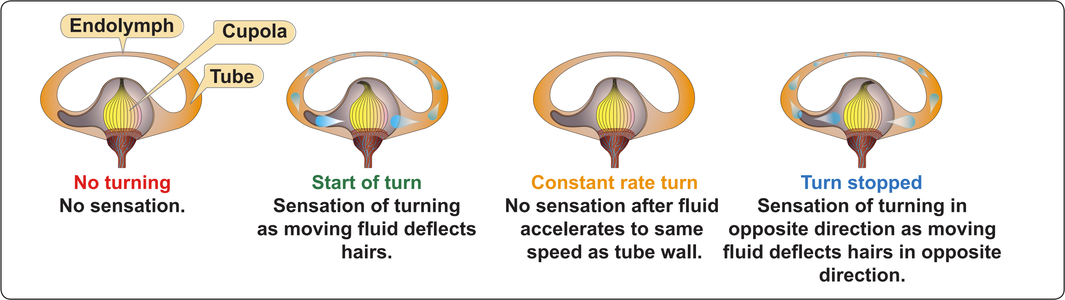
Spatial Disorientation in Flight
Semicircular Canals & Turning
Straight & Level: Sensory hairs are upright
A turn puts semicircular canal and its fluid in motion, deflecting the cupola hairs
Brain interprets movement as a turn, but only recognizes movement for about 20 seconds
In long turns, the brain can incorrectly interpret a rollout as a turn in the opposite direction

Slide 10
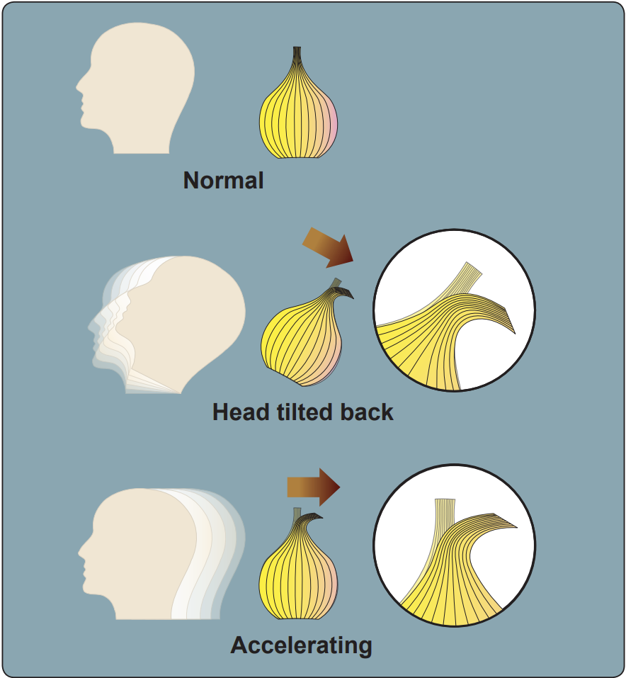
Spatial Disorientation in Flight
Otolith Organs
Gelatinous membrane with chalk like crystals covering sensory hairs
When you tilt your head forward or backward:
  Weight of the crystals causes the membrane to shift due to gravity
  Sensory hairs detect the shift
  Brain recognizes the movement
Otolith Organs & Acceleration
  Forward acceleration: Illusion of tilting backward
  Deceleration: Illusion of tilting forward

Slide 11
Illusions
The Leans
  Reason: Abrupt correction after entering a turn too slowly to stimulate the inner ear
  Illusion: Banking in the opposite direction
  Result: Pilot rolls back to the original banked attitude, thinking it’s straight-and-level
Coriolis Illusion
  Reason: Abrupt head movement in a prolonged constant rate turn
  Illusion: Rotation or movement in an entirely different axis
  Result: Pilot may maneuver into a dangerous attitude to stop the perceived rotation

Slide 12
Illusions
Somatogravic Illusion
  Reason: Rapid acceleration or deceleration
  Illusion: Acceleration – Nose up attitude
  Deceleration – Nose down attitude
  Result: Pilot enters a nose low, dive attitude, or a nose high, stall attitude
Graveyard Spin
  Reason: Recovery from a spin that has stopped stimulating the inner ear
  Illusion: Spinning in the opposite direction
  Result: Pilot will return the aircraft into the original spin

Slide 13
Illusions
Graveyard Spiral
  Reason: Observed loss of altitude during a prolonged turn no longer stimulating the inner ear
  Illusion: Wings level descent
  Result: Pilot pulls back on the controls, tightening the spiral, and increasing altitude loss
Inversion Illusion
  Reason: Abrupt change from a climb to straight-and-level
  Illusion: Tumbling backward
  Result: Pilot will push the aircraft abruptly into a nose low attitude

Slide 14
Illusions
Elevator Illusion
  Reason: Abrupt vertical acceleration, usually due to an up/downdraft
  Illusion: Upward = Climb, Downward = Descent
  Result: Pilot will push the aircraft into a nose low or nose high attitude
False Horizon
  Reason: Sloping cloud formations, obscured horizon, dark scene with ground lights & stars, certain ground lighting patterns
  Illusion: Not being aligned correctly with the horizon
  Result: Pilot will put the aircraft into a dangerous attitude

Slide 15
Motion Sickness
Causes
  Brain receiving conflicting messages about the body’s state
  Anxiety and stress
Symptoms
  Discomfort, Nausea, Dizziness, Paleness, Sweating, Vomiting
  Generally, goes away after the first few lessons
Treatment
  Open fresh air vents
  Focus on objects outside the airplane
  Avoid unnecessary head movement
  Take control of the plane and fly smoothly

Slide 16
Carbon Monoxide (CO) Poisoning
How it Happens
  Colorless, odorless gas produced by the engine
  Damaged, leaking exhaust system
  Heater / defrost vents transport CO to the cockpit
CO and the Body
  CO attaches to the hemoglobin in the blood (200x easier than oxygen)
  Prevents hemoglobin from carrying oxygen to cells (hypemic hypoxia)
Effects
  Headache, blurred vision, dizziness, drowsiness, loss of muscle power
Detecting & Correcting
  Carbon monoxide detectors
  Turn off heater, open fresh air vents, use supplemental oxygen, land

Slide 17
Fatigue
Effects
  Degraded attention and concentration
  Impaired coordination
  Decreased ability to communicate
Causes
  Sleep loss, exercise/physical work, stress, prolonged cognitive work
Acute Fatigue
  Short term, normal occurrence in everyday life
  Skill Fatigue: Special type of acute fatigue affecting piloting skills
    Timing disruption
    Perceptual field disruption
  Causes: Physical & psychological stress, mild hypoxia
  Prevention: Proper diet, adequate rest

Slide 18
Fatigue
Chronic Fatigue
  Long term, usually with psychological roots or an underlying disease
  Causes: Continuous high-stress levels
  Symptoms: Weakness, tiredness, heart palpitations, breathlessness, headaches, irritability, aches and pains, emotional illness
  Prevention: Treatment by a physician
Preventing Fatigue
  Acute Fatigue: Stay on the ground
  Avoid flying :
    Without a full night’s rest
    After working excessive hours
    After an especially exhausting or stressful day
  Chronic Fatigue: Should be treated by a physician. Do not fly

Slide 19
Stress
The body’s response to physical and psychological demands placed upon it
Stress & the Body
  Releases chemical hormones (adrenaline) into the blood
  Increased metabolism to provide more energy to the muscles
  Blood sugar, heart rate, respiration, blood pressure, and perspiration increase
Stressors
  Physical stress (noise or vibration)
  Physiological stress (fatigue)
  Psychological stress (difficult work or personal situations)
Categories of Stress
  Acute Stress (short term)
  Chronic Stress (long term)
    DO NOT FLY

Slide 20
Stress
Acute Stress
  Short term
  Involves an immediate threat that is perceived as a danger (fight or flight response)
  Healthy person can cope with acute stress & prevent stress overload
  On-going acute stress can develop into chronic stress
Chronic Stress
  Long term
  Level of stress presenting an intolerable burden, exceeding the ability to cope
  Performance falls sharply
  Often caused by unrelenting psychological pressure – loneliness, financial/relationship worries, etc.
  DO NOT FLY – Consult a physician

Slide 21
Dehydration
Critical loss of water from the body
Causes
  High temperatures, wind, humidity, diuretic drinks (coffee, tea, alcohol, caffeinated soda)
Effects
  Fatigue, headaches, cramps, tingling, sleepiness, dizziness
  Degraded physical and mental performance
Dehydration & Flying
  Without proper hydration, fatigue progresses to dizziness, weakness, nausea, tingling, cramps & thirst
  Flying skills diminish while attention is taken from flying
Prevention
  Stay hydrated – limit soda, caffeine, and avoid alcohol the day prior
  Wear light, porous clothing, and a hat
  Keep the cockpit ventilated

Slide 22
Alcohol & Drugs
Alcohol
  DON’T drink & fly
  Even small amounts of alcohol impairs judgement & decreases performance and mental cognition
  Altitude multiplies the effects of alcohol on the brain
  FAR 91.17 – 8 hours “from bottle to throttle”
Medications / Drugs
  Basic Guideline: Do not fly while taking medication, unless FAA approved
  FAR 61.53: Prohibits flying if taking medication that would prevent obtaining a medical certificate
  FAR 91.17: Prohibits drug use that affects safety
  Drugs with no side effects on the ground may have serious effects airborne

Slide 23
Nitrogen & Scuba Diving
Scuba Diving & Flying
  Diving results in a significant increase in nitrogen dissolved in the body
  At sea level, nitrogen in the body and outside the body is in equilibrium
  Airborne, reduced pressure can release the excess nitrogen
  If released too quickly, bubbles can form in the bloods, spinal cord, or brain
  Symptoms: Severe pain and/or impairment – death in extreme cases
Provide time to allow nitrogen to return to normal levels before flying
  No Controlled Ascent: At least 12 hrs. before flight ≥ 8,000’ MSL
    24 hours for flight above 8,000’ MSL
  Controlled Ascent: At least 24 hrs. before flight ≥ 8,000’ MSL

Slide 24
IMSAFE
Always perform your own preflight
Self Preflight
  Illness: Am I sick?
  Medication: Am I taking any medications that might affect judgement or make me drowsy?
  Stress: Am I under any psychological pressure from work? Money, health, or family problems?
  Alcohol: Have I been drinking within 8 hours? 24 hours? Am I hungover?
  Fatigue: Am I tired and not adequately rested?
  Emotion: Am I emotionally upset?

Slide 25
Questions?

