Slide 1
Weather Information

Slide 2
Overview
WHAT
  A discussion of how weather forms, interacts, and its relation to flying
  Weather charts and their interpretation and application
WHY
  Weather can have a profound affect on the safety of flight. The better the understanding of weather theory, and how to read weather data, the better the pilot is prepared
CONTENT
The Atmosphere
Wind
Temperature
Moisture & Precipitation
Weather System Formation
Clouds
Turbulence
Thunderstorms
Frost & Icing
Fog & Mist
Obstruction to Visibility
Importance of a Weather Briefing
Weather Reports & Charts
In-Flight Weather Advisories
Recognizing Weather Hazards
Go/No Go Decision

Slide 3
Atmospheric Composition & Stability
Composition
4 gases make up 99.98% of the atmosphere
Nitrogen, Oxygen, Argon & Carbon Dioxide

Slide 4
Atmospheric Composition & Stability
Vertical Structure
Troposphere
  Surface to about 36,000’
  Air becomes thinner & temperature decreases with height
  Almost all weather occurs here
Stratosphere
  Tropopause to about 31 miles above the surface
  Temperature increases with height due to absorption of UV radiation
Mesosphere
  Stratopause to about 53 miles above the surface
  Temperature decreases with height
Thermosphere
  Mesopause to about 430 miles above the surface
  Temperature increases with height – up to 2,000º C
Exosphere
  Thermopause to 6,200 miles above the surface
  Satellites orbit and atoms & molecules escape into space

Slide 5
Atmospheric Composition & Stability
Standard Atmosphere
Average of conditions throughout the atmosphere for all latitudes, seasons & altitudes
Hypothetical vertical distribution of temperature, pressure, and density
15ºC (59ºF) & 29.92” Hg

Slide 6
Wind
Air motion relative to the surface
Causes the formation, dissipation and redistribution of weather
Affects all phases of flight
3 primary forces affect the flow of wind
  Pressure Gradient Force (PGF)
  Coriolis Force
  Friction

Slide 7
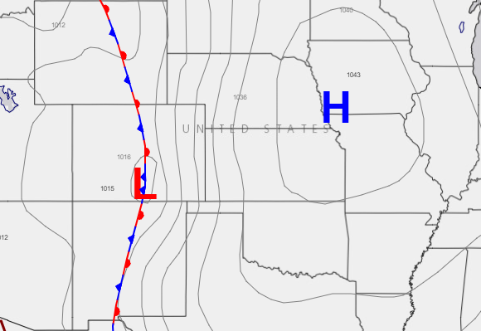
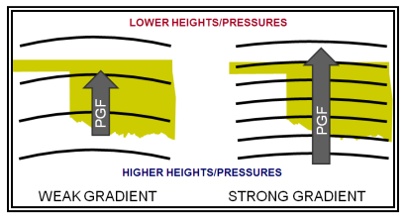
Wind
Pressure Gradient Force
Wind flows from high to low pressure
Wherever a pressure difference exists, the PGF makes the wind blow to equalize the differences
Wind speed is proportional to the PGF
Displayed by contour gradients on pressure charts & isobar gradients on surface charts
  Closely spaced isobars indicate strong winds

Slide 8
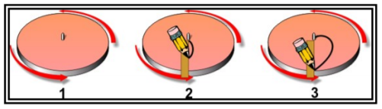
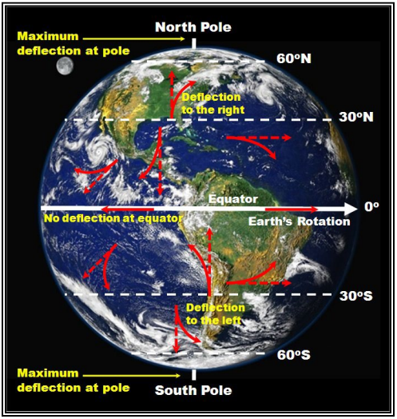
Wind
Coriolis Force
Air is deflected to the right in the Northern Hemisphere & left in the Southern Hemisphere
Turntable Illustration
Acts at a right angle to wind direction
Directly proportional to wind speed
Varies with latitude
  Zero at the equator & maximum at the poles

Slide 9
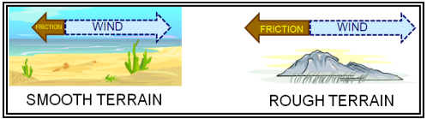
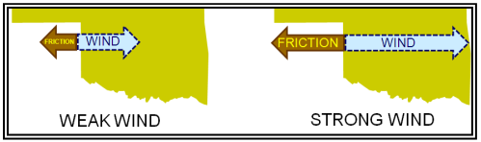
Wind
Friction
Friction between the wind and terrain slows the wind
Greater friction with rougher terrain and higher wind speeds
Friction decreases with height
  Insignificant above a few thousand feet AGL

Slide 10
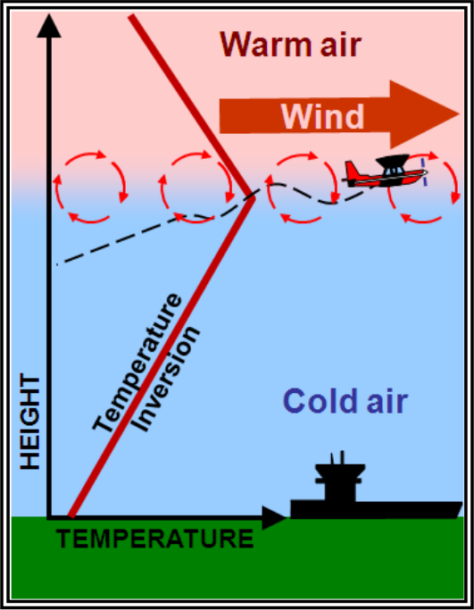
Wind
Wind Shear
Sudden, drastic change in wind speed and/or direction over a small area
  Can occur at any altitude
Low level WS is commonly associated with:
  Passing frontal systems
  Thunderstorms
  Temperature inversions
  Strong upper-level winds

Slide 11
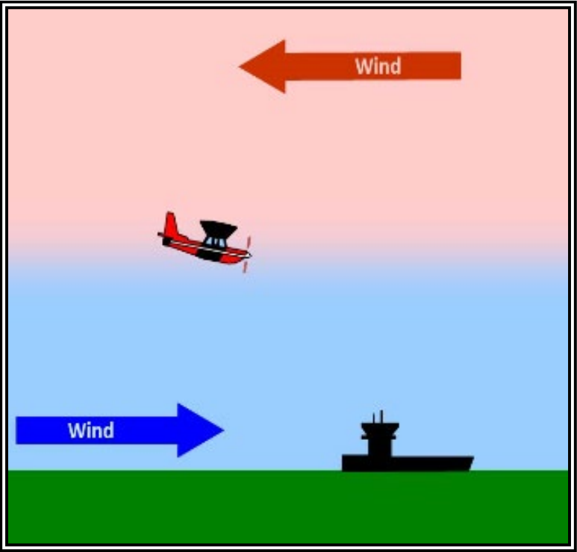
Wind
Wind Shear
Dangers
  Violent updrafts/downdrafts & changes to horizontal movement
  Rapid performance changes
    Increasing Headwind: Performance Increases
    Increasing Tailwind: Performance Decreases
  Often remains undetected

Slide 12
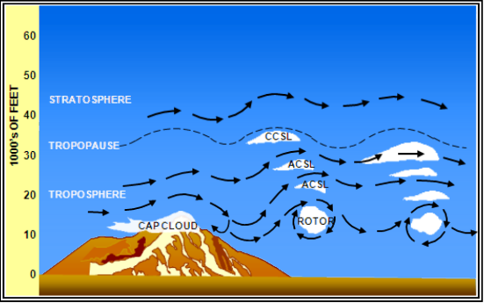
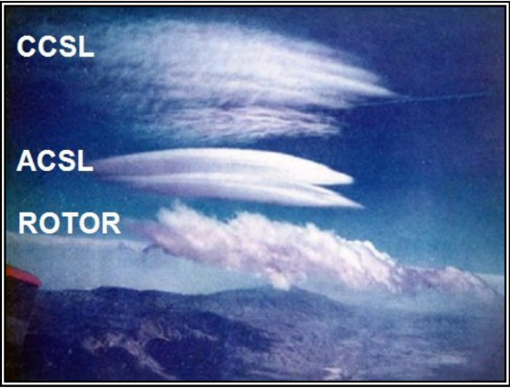
Wind
Mountain Waves
Occur when air is blown over a mountain range
  Air hits the upwind side, creating a smooth updraft
  Passing the crest, it becomes a turbulent downdraft
  Turns into a wave that can last for miles
Hazards
  Strong downdrafts and/or turbulence on the immediate leeward side of the mountain
Visual Indicators
  Cap clouds, Cirrocumulus Standing Lenticular, Altocumulus Standin Lenticular, Rotor Clouds

Slide 13
Temperature
Heat Transfer
Represents the average kinetic energy of the molecules in matter
Heat Transfer
Energy transfer because of temperature difference
Energy from the sun is transferred to the earth’s surface
Radiation
Sun radiates heat to the earth
Conduction
Transfer of energy by molecular activity in contact
Heat always flows from the warmer substance to the colder
Convection
Transport of heat within a fluid
Plays a vital role in earth’s atmospheric heat transfer process

Slide 14
Temperature
Temperature & the Earth/Atmosphere
Water is more resistant to temperature changes than land
  Warms/cools slowly & helps moderate nearby temperatures
Temperature decreases about 2º Celsius per 1,000’
  Not always the case
  Isothermal Layer: Temperature remains constant with height
  Temperature Inversion: Temperature increases with altitude
    Surface-based Inversion
    Inversion Aloft

Slide 15
Moisture & Precipitation
Necessary Ingredients
Water Vapor
Sufficient Lifting
  Condenses water vapor into clouds
Growth Process
  Allows droplets to grow large & heavy enough to fall as precipitation
  Collision-Coalescence: Collisions between droplets cause them to coalesce to larger droplets
  Ice Crystal Process: Water vapor deposits directly onto ice crystals

Slide 16

Moisture & Precipitation
Types of Precipitation
Rain
  Deep layer of above freezing air at the surface
Ice Pellets
  Shallow layer of above freezing air aloft
  Deep below freezing layer at the surface
Freezing Rain
  Deep layer of above freezing air aloft
  Shallow below freezing layer at the surface
Snow
  Below freezing layer of air from top to bottom

Slide 17
Weather System Formation
Air Masses
Large body of air with mostly uniform temperature & humidity
Source Region: Area from which an air mass originates
Classified based on temperature & moistures properties of the source region
  Temperature: Arctic, Polar, Tropical
  Moisture: Continental, Maritime

Slide 18
Weather System Formation
Air Masses
TYPES OF AIR MASSES
Continental Arctic & Polar: Cold, dry
Continental Tropical: Hot, dry
Maritime Polar: Cool, moist
Maritime Tropical: Warm, moist
Maritime Arctic: Seldom, if ever, forms
As an air mass moves around the Earth, it can acquire different attributes

Slide 19
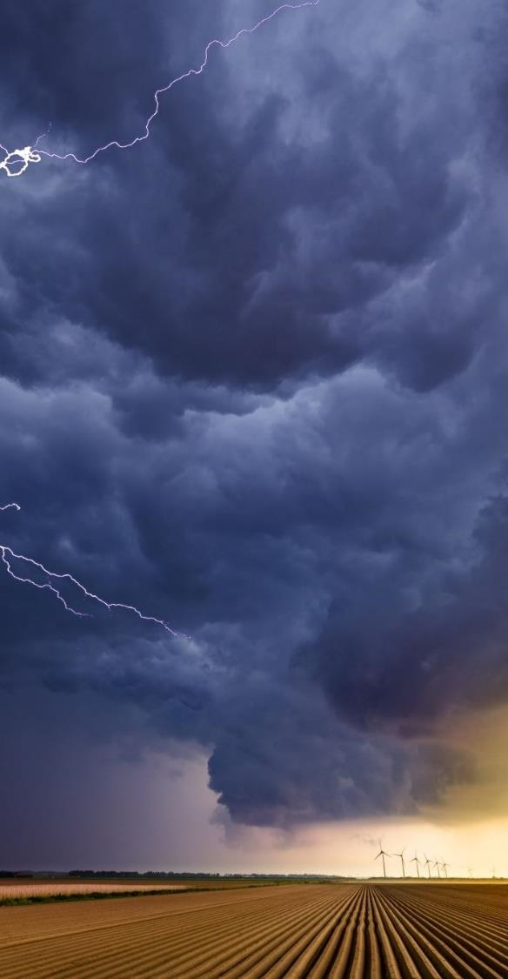
Fronts
Overview
Front: Boundary or transition between two air masses
  Most weather occurs at the periphery of air masses, the front
  Classified by which type of air mass is replacing the other
Detectable in several ways:
  Significant temperature gradients
  Converging winds
  Decreased pressure as the front approaches, increased pressure after it passes

Slide 20
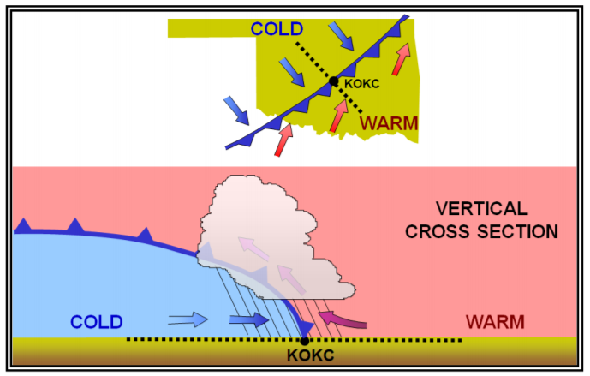
Fronts
Cold Front
Steep slope
Warm air is forced up abruptly
Unstable warm air often leads to a band of showers and thunderstorms along the front

Slide 21
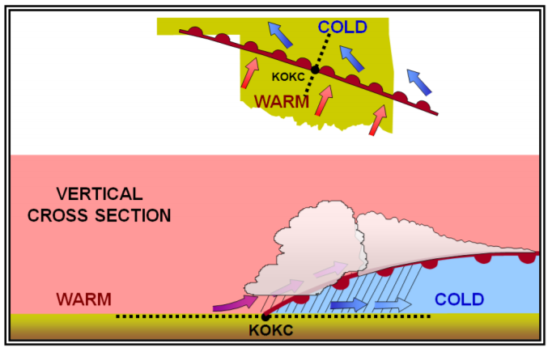
Fronts
Warm Front
Gentle slope
Warm air rises gradually
Stable warm rising air leads to widespread layered or stratiform cloudiness and precipitation along and ahead of the front

Slide 22
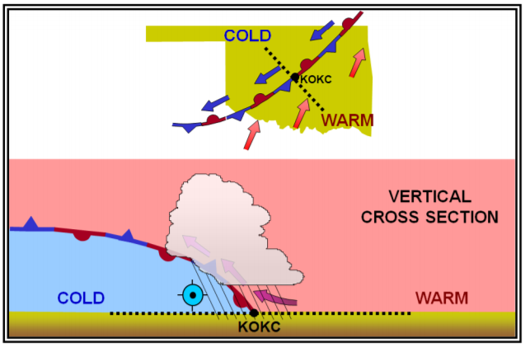
Fronts
Stationary Front
Slopes vary
Clouds and precipitation form in the warm rising air along the front

Slide 23
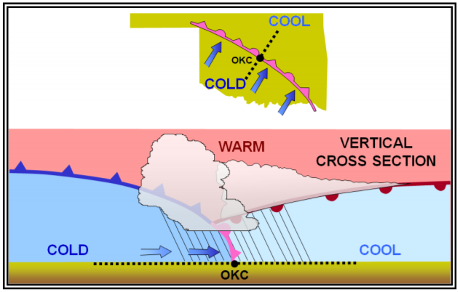
Fronts
Occluded Front
Cold fronts typically move faster than warm fronts
  As a cold front catches up to a warm front and they merge, an occluded front forms
Cold air undercuts a retreating cooler air mass further lifting the already rising warm air
Clouds and precipitation can occur in the areas of frontal lift along, ahead of, and behind the occluded front

Slide 24
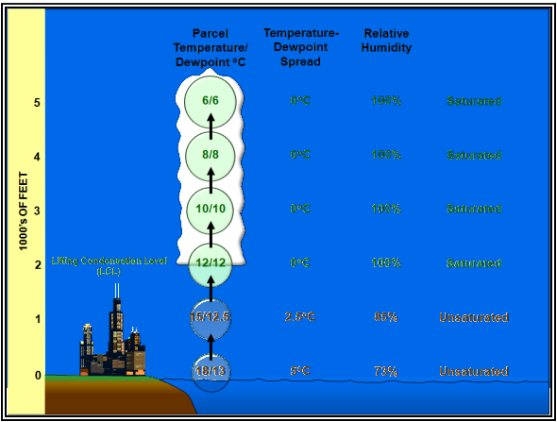
Clouds
Vertical Motion & Cloud Formation
Air cools as it rises
  Temp decreases 3º C per 1,000’
    Dry Adiabatic Lapse Rate
  Dewpoint decreases 0.5º C per 1,000’
Lifted Condensation Level (LCL)
  Temp/Dewpoint spread = 0
  Relative humidity = 100%
  Temp decreases about 2º C per 1,000’
As air expands and cools, vapor decreases
  Water vapor condenses to droplets/ice crystals
  Forms clouds

Slide 25
Clouds
Vertical Motion
Orographic Effects
  Mountains & valleys causing air to ascend/descend
Frictional Effects (Northern Hemisphere)
  High Pressure: Surface wind spirals clockwise & outward
    Winds diverge away, causing air to sink, compress and warm
  Low Pressure: Surface wind spirals counter-clockwise & inward
    Winds converge causing air to rise, expand and cool
Frontal Lift
  Cold, denser air wedges under warm, less dense air, forcing it up
  Overrunning: Warm air rises up and over cold air
Buoyancy
  Air near the ground warms at different rates
  Differing air densities allow warm air to rise and cold to sink

Slide 26

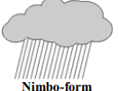
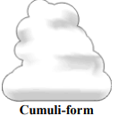
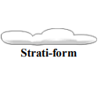
Clouds
Cloud Forms
Cirri-form
  High level clouds above 20,000’ composed of ice crystals
  Thin & white
Nimbo-form
  Latin word meaning “rain”
  7,000 to 15,000’ with steady precipitation
Cummuli-form
  White, fluffy cotton balls
  Show vertical motion in the atmosphere
Strati-form
  Latin for “layer” or “blanket”
  Featureless low layer that can cover the entire sky

Slide 27
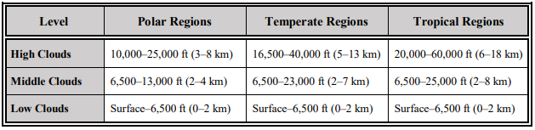
Clouds
Cloud Levels
High, Middle, Low
Each cloud level is divided by type of cloud

Slide 28

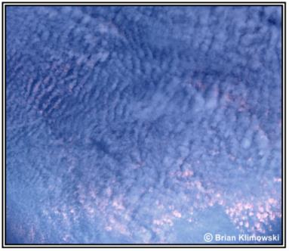
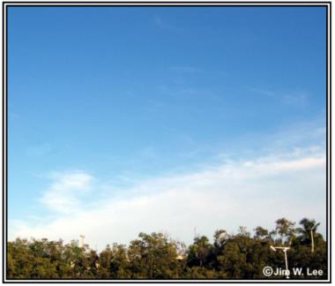
Clouds
High Clouds
CIRRUS
Ice crystal particles often trail downward in wisps called mares’ tails
No significant turbulence or icing
CIRROCUMULUS
Composed of highly super cooled water droplets and/or ice crystals
Expect some turbulence and icing
CIRROSTRATUS
Primarily ice crystals. So thin and transparent that it can be hard to discern
Little, if any, icing and no turbulence

Slide 29
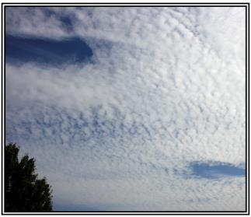
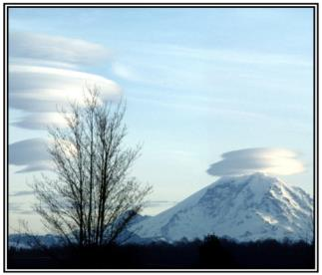
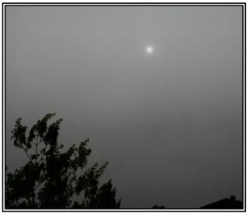
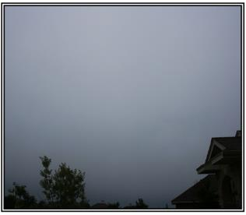
Clouds
Middle Clouds
ALTOCUMULUS
Primarily small liquid water droplets resulting in sharp outline and small internal visibility
Expect some turbulence and small amounts of icing
ALTOCUMULUS LENTICULARIS
Formations are caused by wave motions in the atmosphere
Don’t necessarily give an indication of turbulence or up/down drafts
ALTOSTRATUS
Sheet of clouds often totally covering the sky with irregularly shaped and spaced gaps and rifts
Little to no turbulence, but light to moderate icing
NIMBOSTRATUS
Composed of suspended water droplets, and falling raindrops/snow (no lighting, thunder, or hail)
Very little turbulence, but can pose serious icing issues

Slide 30
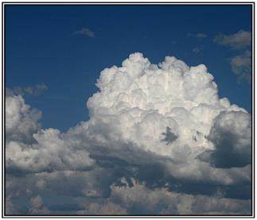

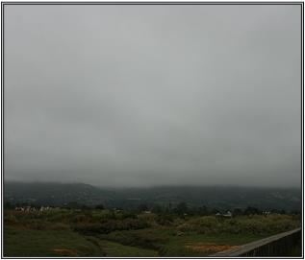
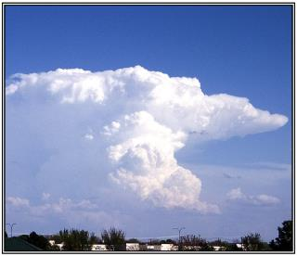
Clouds
Low Clouds
CUMULUS & TOWERING CUMULUS
First stage of a thunderstorm, vertically developed with rising mounds. Showery rain
Cumulus: Little icing & some turbulence Towering: Clear icing & strong turbulence
STRATOCUMULUS
Composed of water droplets, soft hail, even snowflakes. Virga may form below. Precipitation is rare
Expect some icing & turbulence
STRATUS
Uniform composition of widely dispersed water droplets creates a gray layer with a uniform base. Precipitation is rare
Icing can be hazardous, but little or no turbulence
CUMULONIMBUS
Exceptionally dense and vertically developed. Associated with heavy precipitation and lightning
Entire spectrum of flying hazards

Slide 31
Turbulence
Convective
Results from convective currents and subsequent rising/sinking of air
Cumuliform clouds are convective turbulence signposts
  Expect turbulence in and beneath the clouds
  No indication in dry air

Slide 32
Turbulence
Mechanical
Caused by obstructions to wind flow
  Trees, buildings, mountains, etc.
Mountain Waves
  Stable air over a mountain or ridge creating waves downwind & above the mountain

Slide 33
Turbulence
Wind Shear
Rate of change in wind direction and/or speed causing turbulence
Temperature Inversion
  Strong wind shears often occur across inversion layers
Clear Air Turbulence
  High altitude turbulence in cloud-free areas with wind shear
  Particularly between the core of a jet stream and the surrounding air

Slide 34
Thunderstorms
Overview
Ingredients
  Sufficient Water Vapor
  Unstable Air
  Lifting Mechanism
Life Cycle
  Towering Cumulus: Strong conductive updraft
  Mature: When precipitation reaches the surface
    Descending precipitation drags air downward creating a downdraft alongside the updraft
  Dissipating: Downdraft replaces the updraft
    Moisture supply is cut off

Slide 35

Thunderstorms
Types
Single Cell
  One cell storm (rare)
  Easily circumnavigated, except at night or if embedded in clouds
Multicell
  Cluster of cells at various stages of their life cycle
  Difficult to circumnavigate & too high to fly over
  Lines of thunderstorms can extend for hundreds of miles and persist for many hours
Supercell
  Single, quasi-steady rotating updraft persisting for an extended period
  Very organized structure leading to especially dangerous weather

Slide 36

Thunderstorms
Hazards
Lighting
Adverse Wind
Downbursts / Microbursts
Turbulence
Icing
Hail
Rapid Altimeter Changes
Static Electricity
Tornados

Slide 37
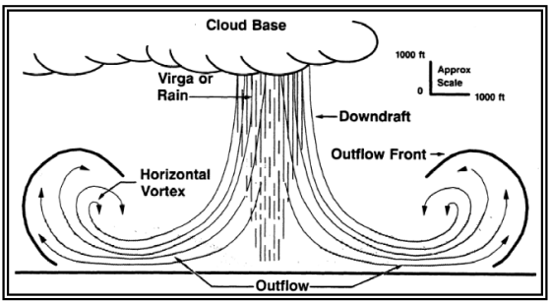
Thunderstorms
Microbursts
Most severe type of windshear (convective)
1–2-mile diameter, 1,000’ depth
Lasts 5-15 minutes
Downdrafts up to 6,000 fpm
Headwind losses of 30-90 knots
Very strong turbulence and hazardous changes in wind

Slide 38
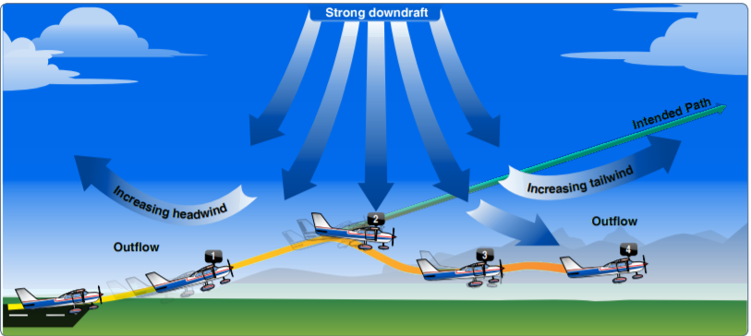
Thunderstorms
Microbursts
Performance increasing headwind
Performance decreasing downdrafts
Rapidly increasing tailwind / decreasing performance
Potential to force the airplane to the ground

Slide 39
Thunderstorms
Microbursts
Visual Indications of a Microburst
  Convective activity (very general)
  Intense rain shaft at the surface, but virga at the cloud base
  Ring of blowing dust
Windshear / Microburst Alerting Systems
  Major airports contain alerting systems (LLWAS, TDWR, ASR-9 WSP)
  Many smaller airports have no wind shear or microburst alerting systems
Avoiding Windshear
  Don’t fly near or during thunderstorms or wind shear
  Be alert for visual cues
  PIREPs, LLWAS

Slide 40

Frost & Icing
Frost
Frost = Dew in freezing temperatures
Poses a flight safety hazard
  Disrupts the smooth airflow over the wing, drastically reducing lift and increasing drag
Aircraft should be thoroughly cleaned & free of frost

Slide 41
Frost & Icing
Icing
Rime
  Small, supercooled water droplets freezing as they strike the aircraft
  Rough, milky and opaque ice
Clear
  Slow freezing of large super-cooled water droplets
  A small portion of the drop freezes while the remaining smears over the surface and gradually freezes
  Glossy, clear, or translucent ice
  More hazardous than rime icing
Mixed
  Mixture of clear and rime ice

Slide 42
Frost & Icing
Icing Hazards
Degrades engine performance
Destroys smooth airflow over the wing, reducing lift & increasing drag
  Ice as thick as sandpaper reduces lift 30% & increases drag by 40%
  Larger amounts of ice can reduce lift & increase drag 80% or more
Weight of ice is insignificant compared to airflow disruption
Clear icing is more hazardous than rime icing

Slide 43
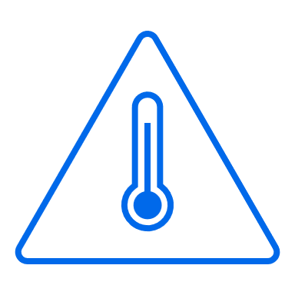
Frost & Icing
Freezing Level
Be alert for icing in temperatures near or below 0º C with visible moisture
Water carried above the freezing level becomes supercooled
  Freezes on impact with an aircraft
  Below -15º C, most water vapor becomes ice crystals
  Between 0 & -15º C, abundance of large, supercooled droplets makes clear icing very rapid
  Higher levels & colder temperatures tend to produce rime (or mixed) icing

Slide 44
Fog & Mist
Fog
Visible aggregate of minute water droplets at the surface reducing visibility to < 1 km
  5/8 statute miles
Clouds at the surface

Slide 45
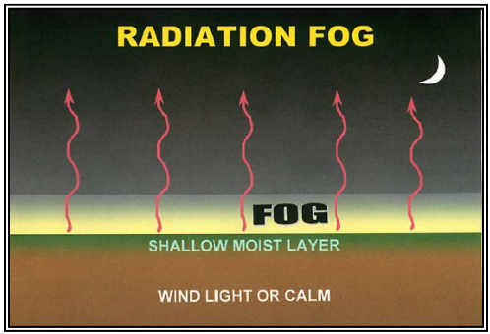
Fog & Mist
Radiation Fog
Terrestrial radiation cools the ground, the ground cools the air, & fog forms
  Generally, nighttime occurrence that burns off soon after sunrise
Factors favoring Radiation Fog
  Shallow surface layer of moist air beneath a dry layer, clear skies, and light surface winds

Slide 46
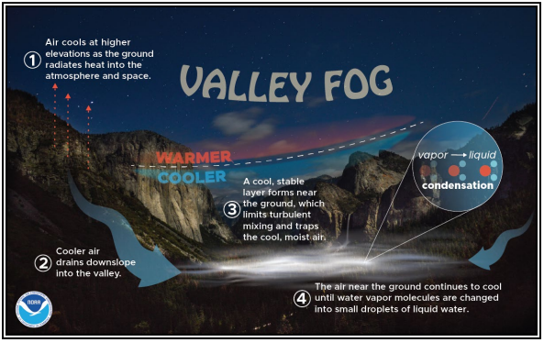
Fog & Mist
Mountain/Valley Fog
Formation
  Ground cools overnight
  Dense, cool mountaintop air sinks into valleys
  Valley fills from the bottom with cold layers of air
  Cooler air lowers the temp toward the dewpoint
  With sufficient moisture, fog forms
Most common in fall & spring
Densest around sunrise

Slide 47
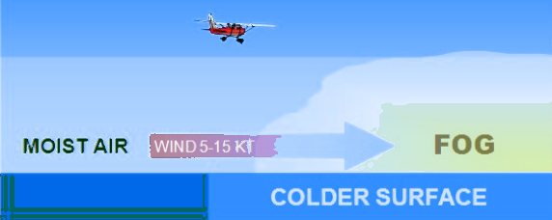
Fog & MIST
Advection Fog
Moist air moves over a colder surface, cooling it below the dewpoint
Common along coastal areas
Deepens with winds up to 15 knots
  Stronger winds tend to lift the fog to low stratus or stratocumulus clouds

Slide 48
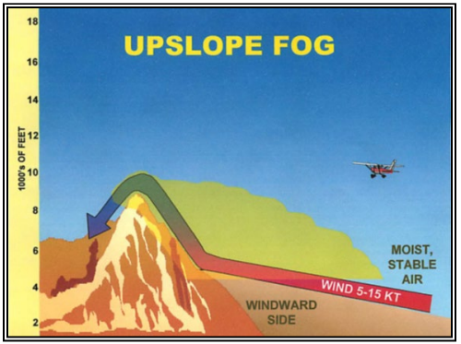
Fog & Mist
Upslope Fog
Moist stable air cooling to the dewpoint as it moves up sloping terrain
Winds of 5-15 knots are most favorable
  Stronger winds tend to lead to a low layer of stratus clouds

Slide 49
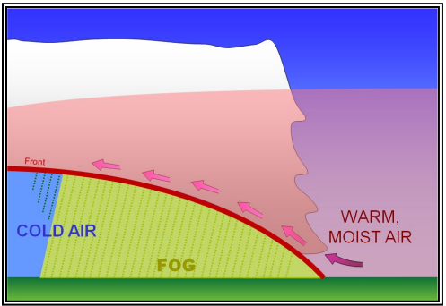
Fog & Mist
Frontal Fog
When warm, moist air is lifted over a front, clouds & precipitation may form
If the cold air below is near its dewpoint, evaporation may saturate the cold air and form fog
Commonly associated with warm fronts
Can be quite dense and continue for an extended period

Slide 50
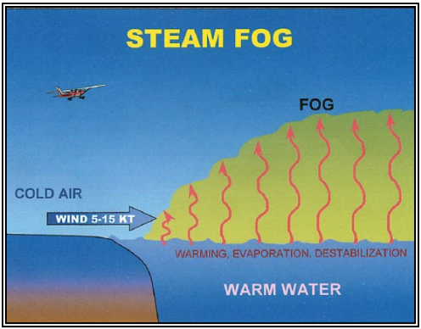
Fog & Mist
Steam Fog
Very cold air moves over relatively warm water
Moisture evaporates saturating the air
Rising water vapor meets the cold air and immediately recondenses
Fog appears as rising streamers resembling steam
Often very shallow

Slide 51
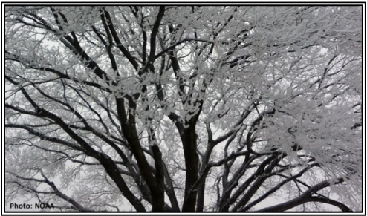
Fog & Mist
Steam Fog
Tiny, supercooled liquid water droplets in fog freeze on exposed surfaces when temperatures are at/below freezing
Can form a layer of ice on the aircraft, making flight very dangerous

Slide 52

FOG & MIST
Mist
Tiny water droplets reducing visibility to < 7 SM but ≥ 5/8 SM
Intermediate between fog & haze

Slide 53
Obstructions to Visibility
Haze
Numerous extremely small particles giving the air an opalescent appearance
Occurs in stable air
  Usually only a few thousand feet thick, can extend upwards of 15,000’
Visibility varies greatly depending on if you’re facing toward or away from the sun

Slide 54

Obstructions to Visibility
Smoke
Suspension of small particles produced by fires, industrial burning, etc.
Can reduce visibility to near zero
Many highly toxic compounds (CO)
Must be dispersed by movement of air

Slide 55
Obstructions to Visibility
Volcanic Ash
Fine particles of rock powder
  Ash is composed of silica or glass
Ash may not be visible at night or in IMC
  Hard to distinguish from clouds
Very hazardous to aircraft
  Severe engine damage is likely

Slide 56
Obstructions to Visibility
Blowing Snow
Snow lifted to a height of 6’ or more
Reduces visibility to less than 7 SM
Whiteout: Strong winds keep snow suspended up to 50’, reducing visibility to zero
Visibility improves rapidly when the wind subsides

Slide 57
Obstructions to Visibility
Dust Storms
Originate in regions where fine-grained soils, rich in clay & silt, are exposed to strong winds
  Most common in Southwest US
Can reduce visibility to zero
Creation & Dissipation
  Extreme heating of barren ground + turbulent unstable air mass
  Strong cooling after sunset settles the dust
Hazards
  Visibility can drop to zero in seconds
  Dust can clog intakes, damage systems, and affect human health
  Slant range visibility is greatly reduced compared to surface reported visibility

Slide 58
Obstructions to Visibility
Sandstorms & Haboobs
Sandstorms
  Particles of sand carried aloft by strong winds
  Like dust storms, but more localized since the sand particles are heavier
  10-50’ AGL
Haboobs
  Dust storm that forms as cold downdrafts from a thunderstorm lift dust & sand airborne
  Often short lived, but can be intense

Slide 59
Importance of a Weather Briefing
First step in determining a flight can be conducted safely & where problems may occur
FAR 91.103
  PIC shall become familiar with weather reports & forecasts
Know what to expect and be alert to changing or unexpected conditions enroute
Make an informed Go/No Go Decision

Slide 60
Weather Sources
General Awareness
  Internet, weather apps, TV, etc.
  Used in the days leading up to a flight
Detailed Briefing (Day of the flight)
  FSS (1-800-WXBRIEF) - Primary source for preflight weather
  AviationWeather.gov
  ForeFlight
  Self-Brief (AIM 7-1-2-C & AC 91-92)
Inflight
  FSS (as published, or 122.2)
  ForeFlight, or other apps
  FIS-B (Flight Info Service Broadcast) & Satellite Weather

Slide 61

Weather Reports & Charts
METAR
Aviation Routine Weather Report
Current surface weather at an airport in a standard, international format
Updated hourly
  Special Weather reports (SPECI) published as necessary
https://aviationweather.gov/metar

Slide 62
Weather Reports & Charts
METAR
METAR KBTR 161753Z 14021G26 ¾SM –RA BR BKN008 OVC012 18/17 A2970 RMK PRESFR
Type
  Routine or special (SPECI)
Station
Date & Time
  First two digits are date, last 4 are UTC time
Modifier (automated source or corrected)
Wind
  3 digits for wind direction, 2 digits for speed
  Gusting winds (G) show peak gust speed
  V shows wind varying by more than 60 degrees
Visibility
  Statute miles
  RVR: R, runway number, slant, visual range (feet)
Weather
  Qualifiers show intensity, proximity, or descriptors
    -, +, VC, SH, TS, FZ, etc.
  Phenomena describe different types of weather
    DZ, RA, HZ, SS, DS, SN, etc.
Sky Condition
  Amount, height, type
  3 digits in hundreds of feet AGL
Temp & Dewpoint
  Degrees Celsius (below zero is preceded by “M”)
Altimeter
  4 digits preceded by “A”
Remarks
  Wind data, variable visibility, pressure info, etc.

Slide 63
Weather Reports & Charts
METAR
Wind
  Reported in degrees true
  00000 = Calm wind
  Winds greater than 100 knots are preceded by “P”
    P99KT
Sky Condition
  Amount of sky coverage is reported in eighths of the sky from horizon to horizon
Sky Cover | < 1/8 Clear | 1/8 – 2/8 Few | 3/8 – 4/8 Scattered | 5/8 – 7/8 Broken | 8/8 Overcast
Contraction | SKC/CLR/FEW | FEW | SCT | BKN | OVC

Slide 64

Weather Reports & Charts
TAF
Terminal Aerodrome Forecast
Weather outlook for the 5 sm radius around an airport
Valid for 24-hours
  Updated 4 times a day (0000Z, 0600Z, 1200Z, 1800Z)
Same descriptors and abbreviations as the METAR
https://aviationweather.gov/taf

Slide 65
Weather Reports & Charts
TAF
Type
  Routine (TAF) or amended (TAF AMD)
Station
Date & Time
  First two digits are date, last 4 are UTC time
Valid Period Date & Time
  6 digits: First two are date, next two are the start time and last two are the end time
Wind
  3 digits for wind direction, 2 digits for speed
Visibility
  Statute miles
  Greater than 6 SM is shown as P6SM
Weather
  Same as METAR
  NSW: No significant weather forecast
Sky Condition
  Same as METAR
  Only “CB” clouds are forecast
Change Group
  FM: Rapid, significant change usually within an hour
  BECMG: Gradual change over no more than 2 hours
  TEMPO: Conditions lasting less than 1 hour
Probability
  % probability of thunderstorms/precipitation

Slide 66
Weather Reports & Charts
TAF
TAF
KPIR 111130Z 111212 15012KT P6SM BKN090
TEMPO 1214 5SM BR
FM1500 16015G25KT P6SM BKN080 OVC150 PROB40 0004 3SM TSRA BKN030CB
FM0400 1408KT P6SM SCT040 OVC080
TEMPO 0408 3SM TSRA OVC030CB
BECMG 0810 32007KT=

Slide 67
Weather Reports & Charts
Graphical Forecast for Aviation (GFA)
Scope
  Set of web-based displays intended to give a complete picture of weather than may affect a flight
  Weather systems and conditions affecting flight over relatively large areas
Purpose
  Forecast for the enroute phase of flight and locations without a TAF
Description
  Web-based displays providing observations and forecasts of safety critical weather phenomena
  Complete weather picture of US, Alaska, Hawaii, Gulf, Caribbean, and portions of the Atlantic/Pacific
  Observational data, forecasts & warnings – 14 hours in the past to 18 hours in the future
    Thunderstorms, clouds, flight category, precipitation, icing, turbulence, and wind
  Hourly models & forecasts
https://aviationweather.gov/gfa

Slide 68
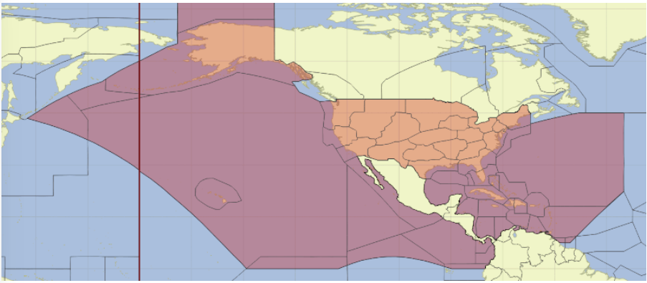
Weather Reports & Charts
Graphical Forecast for Aviation (GFA)

Slide 69
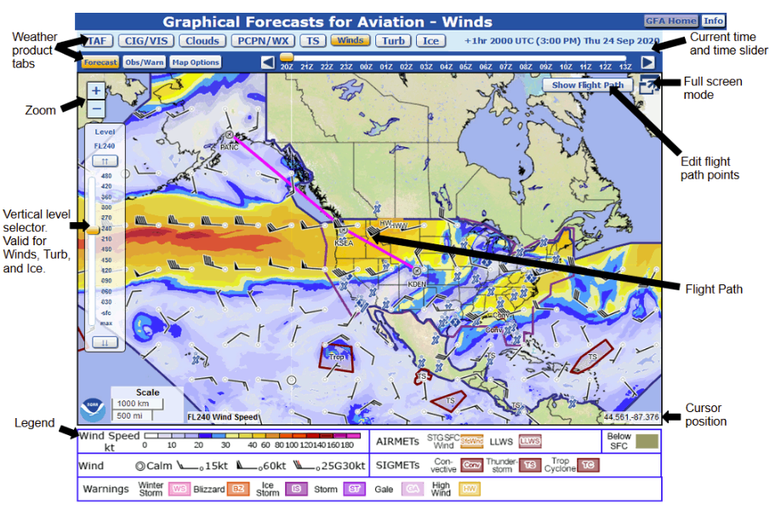
Weather Reports & Charts
GFA

Slide 70
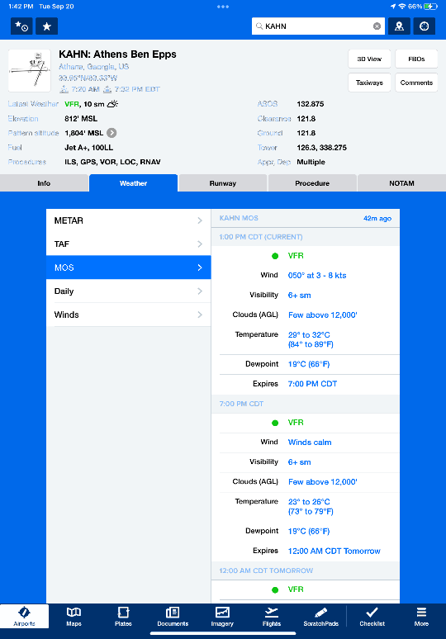
Weather Reports & Charts
Model Output Statistics (MOS)
What is it?
  Applies statistical methods & historical observations to weather models to produce a specific point forecast
  Completely automated
  Temperature/dewpoint, visibility, chance & type of precipitation, cloud cover/height, wind speed/direction
Uses
  Improved weather reporting
  Improved aviation weather planning
Limitations
  Not a legal weather source
  Forecasting
  Precipitation discrimination
  US only
Source: ForeFlight App

Slide 71
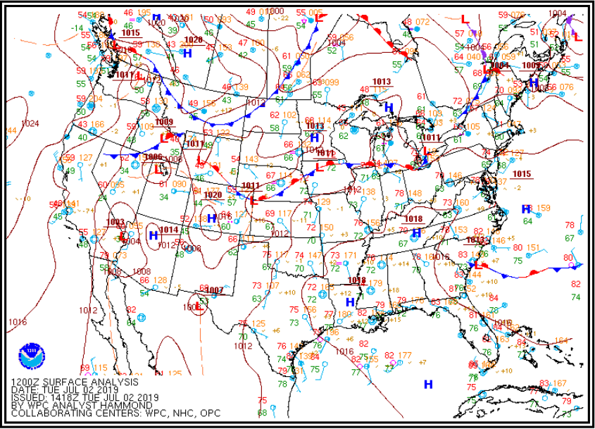
Weather Reports
& Charts
Surface Analysis Chart
Analysis of the surface weather covering 48 states & nearby areas
  High/low pressure, fronts, temperatures & dewpoints, wind direction & speed, weather, and visual obstructions
Computer prepared every 3 hours
  (00, 03, 06, 09, 12, 15, 18, 21 UTC)
Surface Weather Observations
  Specific reporting points across the US are depicted with various weather information
Source: AviationWeather.gov, FAA

Slide 72
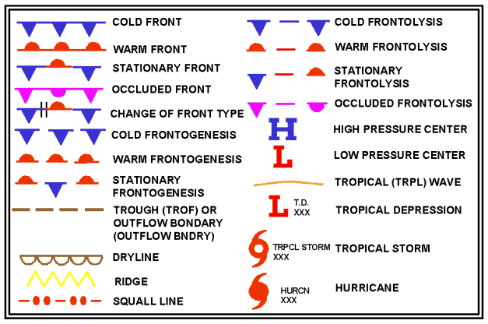
Weather Reports & Charts
Surface Analysis Chart
Source: Aviation Weather Handbook, FAA

Slide 73
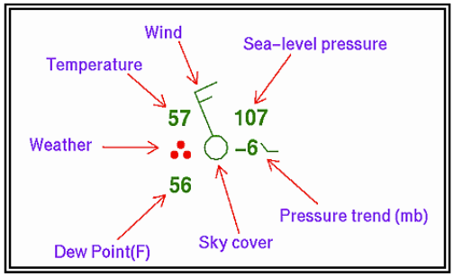
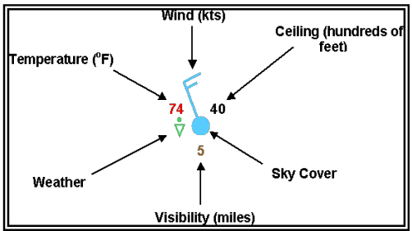
Weather Reports & Charts
Surface Analysis Chart
Surface Weather Observations
  Aid in analyzing and interpreting surface weather
  NWS Plot Model (top picture)
  NWS Aviation Plot Model (bottom picture)
Surface Weather Observation Information
  Ceiling: Hundreds of feet AGL
  Visibility: Whole statute miles
  Temperature: Degrees Fahrenheit
  Dewpoint: Degrees Fahrenheit
Source: Aviation Weather Handbook, FAA

Slide 74
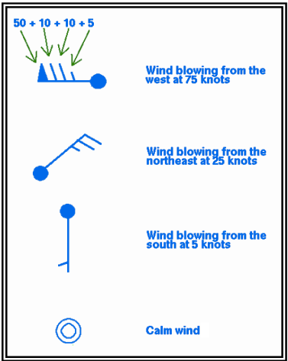
Weather Reports & Charts
Surface Analysis Chart
SURFACE WEATHER OBSERVATION INFO
Wind
  Plotted in increments of 5 kt.
  Referenced to true north
  Calm wind = only a circle over the station
Source: Aviation Weather Handbook, FAA

Slide 75
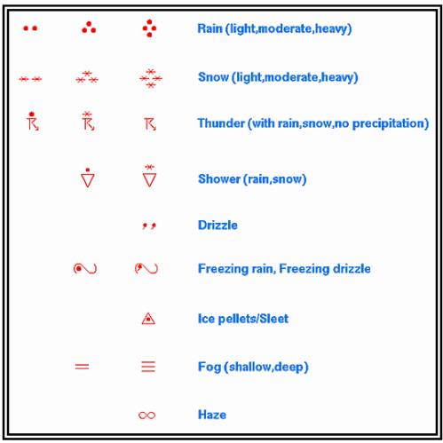
Weather Reports & Charts
Surface Analysis Chart
SURFACE WEATHER OBSERVATION INFO
Weather
  Plotted if, at the time of observation, precipitations is occurring or there is reduced visibility
Source: Aviation Weather Handbook, FAA

Slide 76
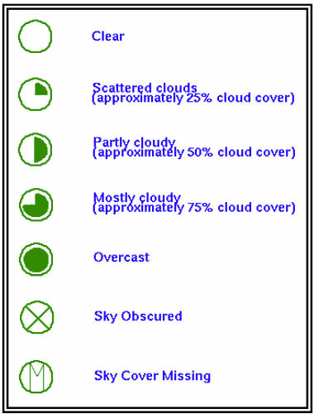
Weather Reports & Charts
Surface Analysis Chart
SURFACE WEATHER OBSERVATION INFO
Sky Cover
  Amount the circle is filled reflects sky cover
Source: Aviation Weather Handbook, FAA

Slide 77
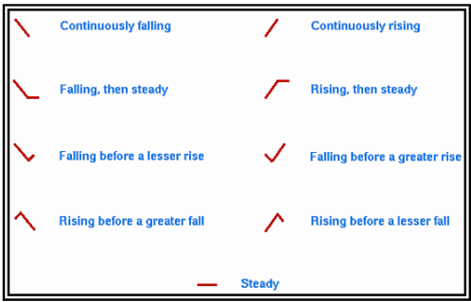
Weather Reports & Charts
Surface Analysis Chart
SURFACE WEATHER OBSERVATION INFO
Pressure
  Plotted in tenths of millibars
Pressure Trend
  Number: 3-hour change in tenths of millibars
  Symbol: Graphis illustration of change
Source: Aviation Weather Handbook, FAA

Slide 78
Weather Reports & Charts
Surface Analysis Chart
Source: Aviation Weather Handbook, FAA
Surface analysis with surface observations

Slide 79

Weather Reports & Charts
Surface Analysis Chart
Source: Aviation Weather Handbook, FAA
Surface analysis with radar composite

Slide 80

Weather Reports & Charts
Surface Analysis Chart
Source: Aviation Weather Handbook, FAA
Surface analysis with satellite composite

Slide 81


Weather Reports & Charts
Ceiling & Visibility Charts (CVA)
Combines satellite & surface observations to show ceiling & visibility conditions across the US
Used for big picture planning and to avoid hazardous ceiling and visibility conditions

Slide 82

Weather Reports & Charts
Winds & Temperatures Aloft Forecast
Wind and temperature forecasts based on altitude for specific locations
  Published twice a day (0000Z & 12000Z)
  https://aviationweather-cprk.ncep.noaa.gov/windtemp
Wind
  Direction = True North; Speed = Knots
  First 2 numbers are direction, second two are speed
    100-199 knots: Subtract 50 from wind direction, and add 100 to wind speed
    > 200 knots: Subtract 50 from wind direction; Wind group is coded as 99
Temperature (Celsius)
  Temperatures > 24,000’ MSL are negative

Slide 83
Weather Reports & Charts
Source (both): AviationWeather.gov, FAA
Convective Outlook Chart
Depicts area forecast to have severe & non-severe convection
  Severe: Tornado, wind gusts 50 knots or greater, or hail 1” in diameter or greater
4 Charts covering 8 Days
  Day 1, 2, 3, & 4-8
General thunderstorm area + 5 levels of risk depict weather & intensity

Slide 84
Weather Reports & Charts
Source (both): AviationWeather.gov, FAA
Convective Outlook Chart
Levels of Risk
TSTM
  Area of general thunderstorms (≥ 10% probability of storms)
MRGL
  Severe storms of limited organization/longevity or low coverage & marginal intensity
SLGT
  Severe/organized storms expected in low coverage with varying intensity

Slide 85
Weather Reports & Charts
Source (both): AviationWeather.gov, FAA
Convective Outlook Chart
Levels of Risk
ENH
  Greater concentration with varying intensity
MDT
  Potential for widespread severe weather with several tornados and/or storms
HIGH
  Severe weather expected from tornados or long-lived derecho

Slide 86
Weather Reports & Charts
Convective Outlook Chart
Day 4-8 Chart
Show 15% or 30% probability forecast
Highlighted areas represent SLGT or ENH
If no 15% forecast, it shows:
  Predictability too low
  Potential too low
More Info
  Current Charts
  Probabilities

Slide 87
In-Flight Weather Advisories
AIRMETs (WA)
SIGMETs (WS)
Convective SIGMETs (WST)
PIREPs – Pilot generated weather report

Slide 88
In-flight Weather Advisories
AIRMET (WA)
Weather information of interest to all, but specific to phenomena dangerous to light aircraft
Types of AIRMETs (WA)
  Sierra: IFR and mountain obscurement
  Tango: Turbulence, strong surface winds, and low-level windshear
  Zulu: Icing and freezing levels
Issued every 6 hours with intermediate updates as needed
Aviation Weather Graphical AIRMETs

Slide 89
In-flight Weather Advisories
SIGMET (WS)
In flight non-convective weather advisory potentially hazardous to all aircraft
Issued for
  Severe icing
  Extreme turbulence
  Clear air turbulence
  Dust / sandstorms (visibility < 3 miles)
  Volcanic ash
SIGMETs are unscheduled advisories
  Valid for 4 hours
  Hurricane related SIGMETs are valid for 6 hours
Aviation Weather SIGMETs

Slide 90
In-Flight Weather Advisories
Convective SIGMET (WST)
Hazardous convective weather that affects the safety of all aircraft
Issued for:
  Severe thunderstorms with:
    Surface winds > 50 knots
    Hail at the surface ¾ inch or greater in diameter
    Tornadoes
  Embedded thunderstorms
  Line of thunderstorms
  Thunderstorms with heavy or greater precipitation affecting at least 40% of an area ≥ 3,000 square miles
Aviation Weather SIGMETs

Slide 91
In-Flight Weather Advisories
Center Weather Advisories (CWA)
Unscheduled inflight, flow control, air traffic, and air crew advisory
Produced for weather beginning in the next 2-hours
Issued:
  As a supplement to existing SIGMET, Convective SIGMET, or AIRMET
  When an inflight advisory has not been issued, but pilot reports & other conditions indicate it should be
  When observed or developing weather doesn’t meet SIGMET, Convective SIGMET, or AIRMET criteria but pilot reports indicate the weather will adversely affect the safe flow of air traffic

Slide 92
In-Flight Weather Advisories
PIREP
Pilot generated weather report of phenomena encountered in flight
Allows for real time weather reports
  Cloud tops, icing, turbulence, temperatures, wind, etc.
Helps fill the gaps between reporting stations
Aviation Weather PIREPs

Slide 93

In-Flight Weather Advisories
PIREP
Prepared using a prescribed format
  Type of PIREP
  Location of Phenomena
  Time
  Altitude
  Aircraft Type
  At least one element to describe reported phenomena

Slide 94
In-Flight Weather Advisories
PIREP
Urgent PIREP (UUA)
  Tornados
  Severe/extreme turbulence
  Severe icing
  Hail
  LLWS within 2,000’ of the surface
  Volcanic ash
  Any weather considered to be hazardous
Routine PIREP (UA)
  Doesn’t contain any urgent information

Slide 95

In-Flight Weather Advisories
Other Info
FSS
  Updated briefing enroute
Onboard Weather Equipment
  ADS-B
    Free weather information, if your system can receive it
  FIS-B
    Free weather information, if your system can receive it
  Satellite Weather
  Be proficient in any installed weather equipment

Slide 96
Go / No Go Decision
Consider weather, aircraft, equipment, as well as yourself
  Weather briefing, charts / reports
  PAVE Checklist
  Consider overall and recent flight experience
Set personal minimums and do not bend them
Consider recent flight experience
  Currency and, more importantly, proficiency

Slide 97
Go / No Go Decision
Recognizing Weather Hazards
  Interpretation of aviation charts & reports
  Enroute updates and inflight reports
  Visual indications
Continual process of decision making
  Flight planning, pre-flight, and enroute
  Don’t be afraid to discontinue the flight or divert
  Potential No Go Conditions: Reduced visibility, hazardous weather, UUA/UA PIREPs, personal minimums, etc.

Slide 98

Questions?

