Slide 1
Navigation & Flight Planning

Slide 2
Overview
WHAT
  The process of planning and executing cross country flights (> 50 nm distance)
  Procedures for different situations that may arise during flight
WHY
  Integral to safely flying from point to point
    Time, fuel requirements, prevent getting lost, etc.
  Make planning flights easier and more organized
CONTENT
Terms
Aeronautical Charts & Chart Supplement
Navigation
Flight Planning & Nav Logs
VFR Flight Plan
Weather Check
GPS Navigation
Diversion to an Alternate
Lost Procedures
Flight Following & Intercept Procedures

Slide 3
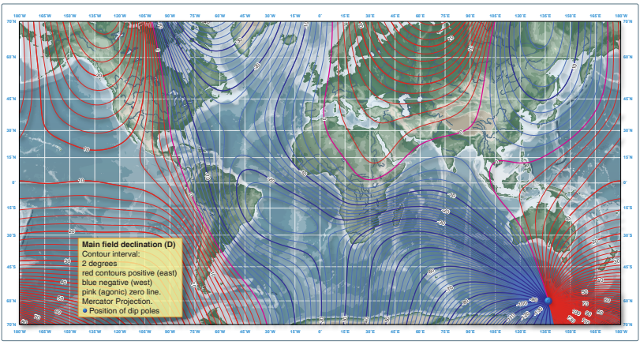
Terminology
Navigation Terms
True North
  Geographic north pole
Magnetic North
  Magnetic north pole
Variation
  Angular difference between true & magnetic north
  Isogonic lines on charts

Slide 4

Terminology
Navigation Terms
True Course
  Direction of flight measure clockwise from true North
True Heading
  Direction of longitudinal axis with respect to true North
Magnetic Course
  True course corrected for magnetic variation

Slide 5
Terminology
Navigation Terms
Magnetic Heading
  Magnetic course corrected for wind
Compass Heading
  Aircraft heading read from the compass
Deviation
  Compass error due to magnetic disturbances from in the airplane
  Correction is displayed on the compass correction card

Slide 6


Terminology
Atmospheric Terms
Standard Pressure: 29.92” Hg at sea level
  Standard Lapse Rate: Pressure decreases 1” Hg per 1,000’
Standard Temperature: 15º C / 59ºF (at sea level)
  Standard Lapse Rate: Temp decreases 2º C (3.5º F) per 1,000’

Slide 7
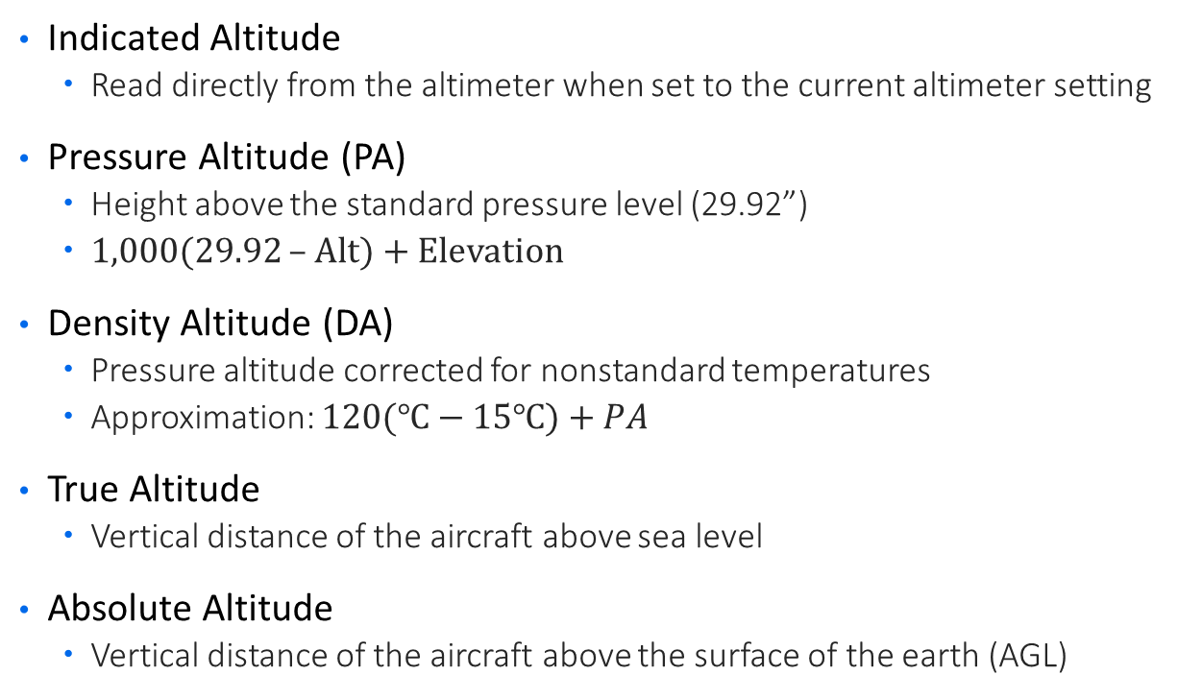
Terminology
Altitude Terms
Indicated Altitude
  Read directly from the altimeter when set to the current altimeter setting
Pressure Altitude (PA)
  Height above the standard pressure level (29.92”)
  1,000(29.92 – Alt) + Elevation
Density Altitude (DA)
  Pressure altitude corrected for nonstandard temperatures
  Approximation: $120(℃−15℃)+PA$
True Altitude
  Vertical distance of the aircraft above sea level
Absolute Altitude
  Vertical distance of the aircraft above the surface of the earth (AGL)

Slide 8
Terminology
Airspeed Terms
Indicated Airspeed (IAS)
  Speed of an aircraft shown on the airspeed indicator
Calibrated Airspeed (CAS)
  IAS corrected for installation and instrument errors
Equivalent Airspeed (EAS)
  CAS corrected for adiabatic compressible flow for the altitude
True Airspeed (TAS)
  Speed at which an aircraft is moving relative to the surrounding air
  CAS corrected for density altitude
Groundspeed (GS)
  Speed of the aircraft in relation to the ground
  TAS corrected for wind

Slide 9
Aeronautical Charts
Pilot’s roadmap
Sectional Chart (most commonly used)
  Airport data, navigation aids, airspace, topography
  1:500,000 scale (1” = 6.86 NM); Revised every 56 days
Terminal Chart
  Helpful around Class B – More detailed version of the Sectional Chart
  1:250,000 scale (1” = 3.43 NM); Revised every 56 days
VFR Wall Planning Chart
  Aeronautical & topographic info covering the conterminous US
  1:3,100,000 scale (1” = 43 NM); Revised annually
Current Charts
  Information changes rapidly, always verify current charts
  Check NOTAMs for updates between publication cycles

Slide 10
Chart Supplement
Essential to planning
Most comprehensive information on a given airport
  Detailed runway info, procedures, frequencies, services, hours of op, & more
Reference all airports during planning
  Departure, Destination, all potential alternates

Slide 11
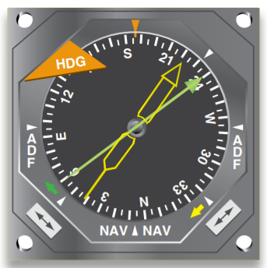
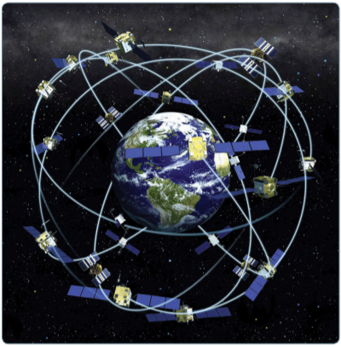
Navigation
Pilotage
  Navigation by landmarks on the ground
  Rivers, mountains, roads, cities, airports, etc.
Dead Reckoning
  Navigation on time, speed, distance, & direction
Radio Navigation
  Navigation by which a preset course is followed
  GPS, VOR, NDB, etc.
Ideally, pilotage, dead reckoning, & radio navigation should be used together

Slide 12
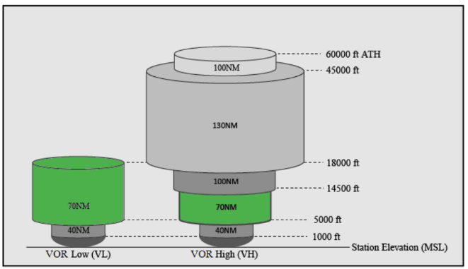
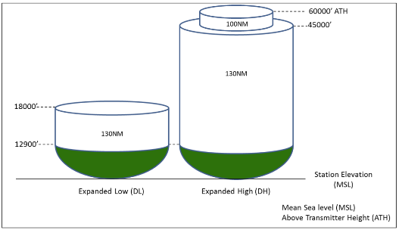
Navigation
VOR Mon (Min Op Network)
MON VOR SERVICE VOLUMES
Minimum Operating Network
  NAS is transitioning to PBN
  Reducing VORs (from 896 to 590)
  New service volumes – VOR service at/above 5,000’ AGL
Enables aircraft having lost GPS to use conventional navigation to reach a MON airport
MON Airport
  Conventional approach
  Assured within 100 nm
MON DME SERVICE VOLUMES
Source (both): FAA

Slide 13
Navigation
Magnetic Compass Errors
Variation
  Difference between magnetic & true North
  Isogonic line: Connect points with the same magnetic variation
  Agonic line: Line along which the two poles are aligned – No variation
Deviation
  Magnetic fields within the aircraft (on compass correction card)
Compass Course
  True course corrected for Variation & Deviation
  True Course ± Variation = Magnetic Course
  Magnetic Course ± Deviation = Compass Course
  East is least, West is best
Source: Instrument Flying Handbook, FAA

Slide 14
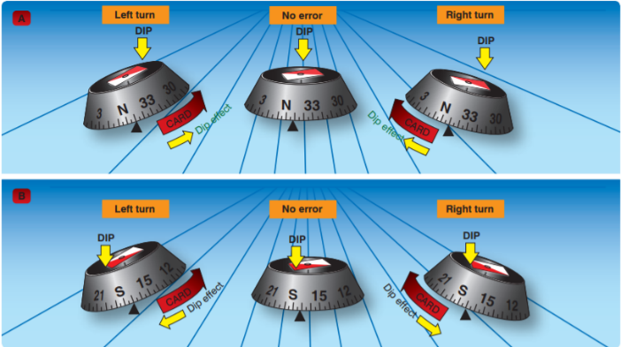
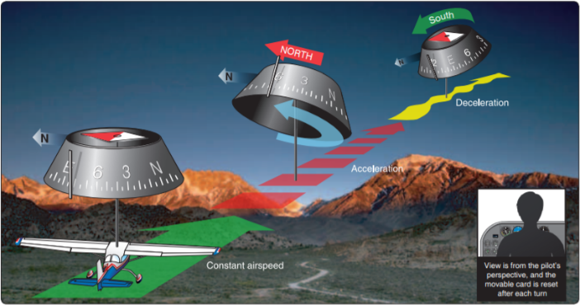
Navigation
Magnetic Compass Errors
Lines of magnetic flux
  Perpendicular at the poles, parallel at the equator
Northerly & Southerly Turning Errors
  Turns from a Southerly Direction: Compass Leads
  Turns from a Northerly Direction: Compass Lags
  UNOS: Undershoot North, Overshoot South
Acceleration Error
  ANDS: Accelerate North, Decelerate South
Oscillation Error
  Combination of errors & plane movement
  Use the average
Source (both): Instrument Flying Handbook, FAA

Slide 15
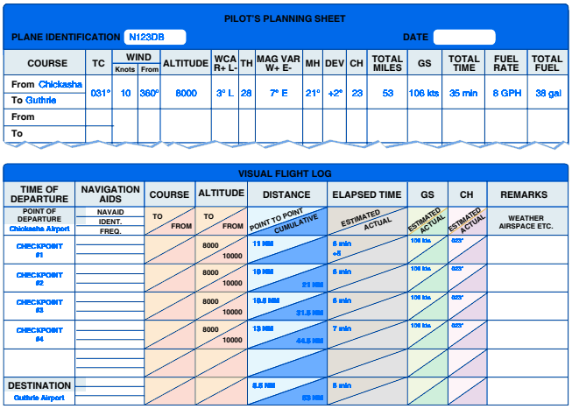
Flight Planning
Nav Log
Flight Log
  Flight plan organized point by point
  Fuel, time, altitudes, headings, & frequencies at each waypoint
Plot the Course
  Route & Altitude
  Checkpoints
    Top of Climb & Top of Descent
    Additional checkpoints along the route
    Record the checkpoints on the Nav Log
  Fuel Stops
    If required, create a separate log for each leg

Slide 16
Flight Planning
Nav Log
Power setting
True Airspeed
Distance between each checkpoint
Magnetic Heading
  True Course for each leg;
  Adjust for wind to get True Heading;
  Adjust for Variation to get Magnetic Heading
  Adjust for Deviation to get Compass Heading
Groundspeed for each leg
  Using wind & true airspeed

Slide 17
Flight Planning
Nav Log
Time for each leg
  Based on departure time, calculate expected arrival times using groundspeed & distance
  Convert to UTC (below)
Fuel burn for each leg
  POH
  Time multiplied by fuel burn
Planned versus Actual
  Planning is never perfect – Recognize & adjust

Slide 18
VFR Flight Plan
Filing a Flight Plan
Not required, but good practice
Can be filed on the ground or airborne
  Ground: 1-800-WX BRIEF, ForeFlight, etc.
  Airborne: FSS
  Held for 1 hour after departure time
ICAO Flight Plan
Once airborne, open the flight plan
  FSS, ForeFlight
Don’t forget to close the flight plan!
  1-800-WX Brief, or ForeFlight
  Radio (discouraged to avoid congestion)

Slide 19
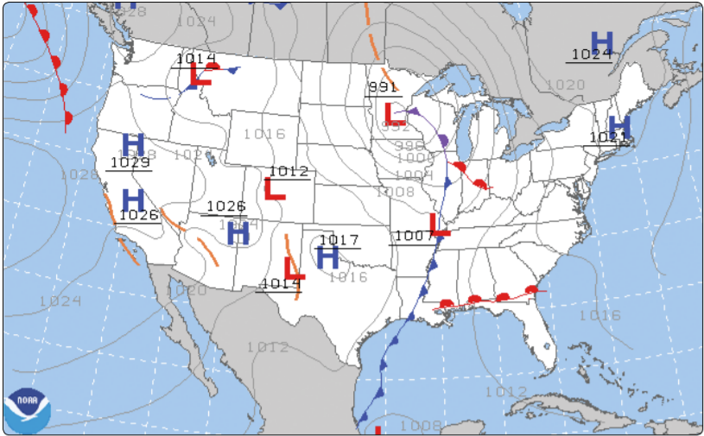
Preflight Weather Check
First step to determining if the flight can be completed safely
  FAR 91.103 requires a weather briefing
Go/No Go Decision
  Set limits and don’t bend them
  Weather is a major factor, but incorporate the entire PAVE checklist
  Continual decision-making process

Slide 20

GPS Navigation
Prior to flight, enter the flight plan waypoints into the GPS
Avoid complacency with the GPS
  Maintain situational awareness

Slide 21
Planned vs Actual Calculations
Planning is never perfect
Recognize deviations & adjust
If time is off
  Adjust power & airspeed
  If fuel burn/power is a concern, accept the speed & adjust timing
Use tools at your disposal
  GPS, ForeFlight, rules of thumb, etc.
Ignoring deviations only makes the problem worse

Slide 22
Diverting to an Alternate
Overview
Preflight Planning: Be aware of potential diversion airports along the route
When necessary to divert, use Shortcuts & Rule of Thumb Computations
  Use your thumb to measure 10 NM increments
  Use a compass rose or airway on the chart to estimate the heading
GPS
  If available, Use the ‘Nearest’ page or Direct To option in the GPS

Slide 23
Diverting to an Alternate
Procedure
Find your position on the chart
Divert immediately to the alternate using shortcuts/rules of thumb (or GPS info)
Note the time
Choose an altitude
  Consider terrain, radio reception, clouds, winds, etc.
Use winds aloft near the diversion point to determine a more exact heading & groundspeed
Determine arrival time & fuel required
Aviate, Navigate, Communicate

Slide 24
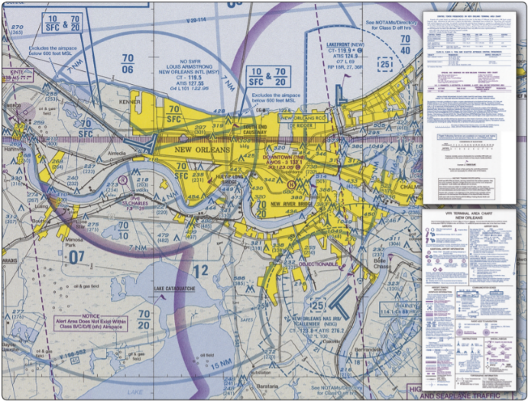
Lost Procedures
Avoid getting lost
  Plan ahead
  Use multiple sources for location (Pilotage, Dead reckoning, Radio navigation, Flight following)
If Lost
  Don’t panic
  Five C’s
    Climb – See more, and improves radio reception
    Communicate – ATC, Frequencies on charts, 121.5
    Confess – Explain the situation
    Comply – Follow ATC instructions
    Conserve – Reduce power / airspeed to save fuel

Slide 25

Flight Following
Radar equipped ATC facilities can provide radar assistance & navigation services
  By request
  Can be requested prior to departure, or airborne
Limitations
  Based on controller discretion
  Advisory only
  Cannot determine if their instructions will result in flight into IMC
  Can only communicate with participating aircraft

Slide 26
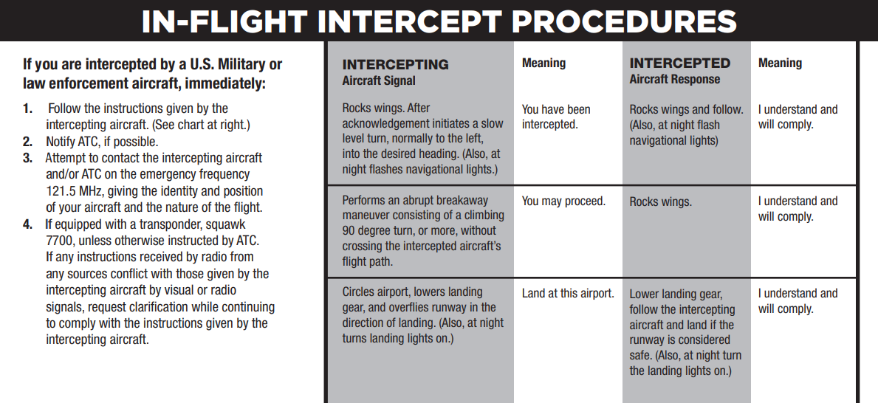
Intercept Procedures
Aircraft may be intercepted in the interest of national security/defense

Slide 27
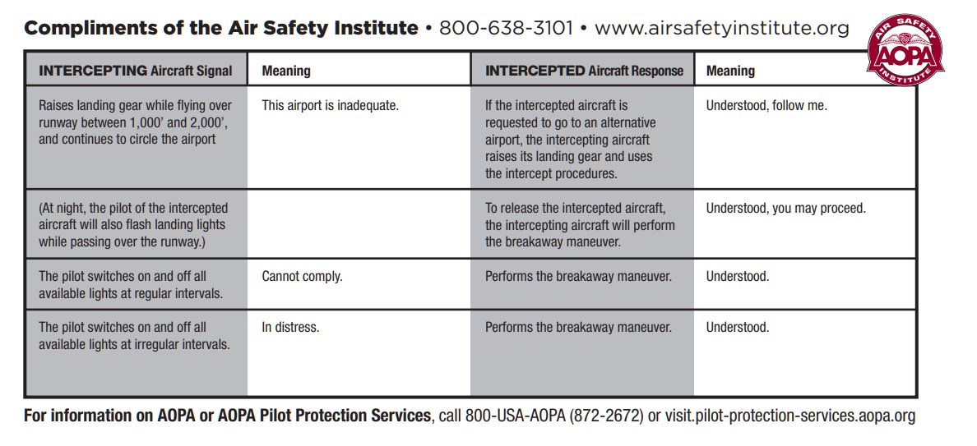
Intercept Procedures
Aircraft may be intercepted in the interest of national security/defense

Slide 28
Questions?

