Slide 1
VMC Demonstration

Slide 2
Overview
WHAT
  An explanation of V_{MC} and how it affects multiengine flying
  Demonstration of the procedure used to regain control of the aircraft in the case it slows below the minimum controllable airspeed
WHY
  Safety!
  Without an understanding of V_{MC} and the proper recovery techniques, decelerating below V_{MC} can lead to a loss of control
CONTENT
One Engine Inoperative Airspeeds
V_{MC}: Minimum Controllable Airspeed
V_{MC} in the Airplane
V_{MC} Demonstration
Hazards

Slide 3
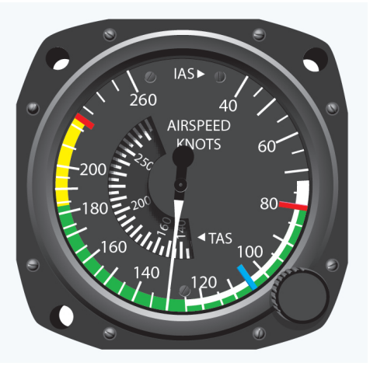
One Engine Inoperative Airspeeds
VSSE
Safe Single Engine Speed
Minimum speed to intentionally render an engine inoperative
  Failing an engine below V_{SSE} creates a high likelihood for loss of control & an accident
Not depicted on the airspeed indicator
  Used for training purposes
ACS
  Evaluator must not simulate engine failure until attaining at least 400’ AGL & V_{SSE} (or V_{XSE} or V_{YSE})
  Apply this during training

Slide 4
One Engine Inoperative Airspeeds
VYSE: Blue Line
Best rate of climb speed with OEI
Blue line on the airspeed indicator
Used for max performance during OEI operations
  Or minimize descent, if above the single engine service ceiling

Slide 5
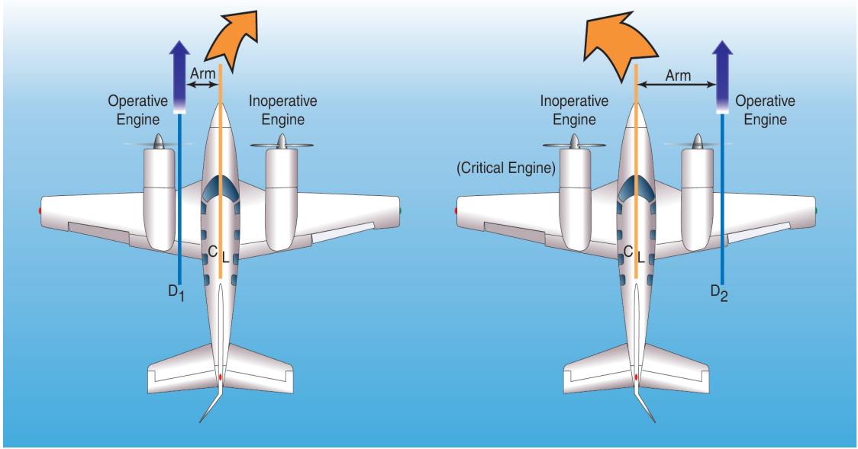
One Engine Inoperative Airspeeds
VMC: RED Line
Min speed that the plane can be controlled when an engine suddenly becomes inoperative
Not a fixed speed
  Only fixed for the very specific set of circumstances under which it was tested during certification
  VMC varies with a variety of factors

Slide 6
VMC: Minimum Controllable Airspeed
What is VMC?
The speed at which the rudder no longer has the authority to overcome the yaw caused by the critical engine being inoperative, under specific criteria mandated by the FAA
A lower V_{MC} is good
V_{MC} deals strictly with maintaining directional control, irrespective of climb performance
Published versus Actual V_{MC}
  Published V_{MC} is based on specific FAA mandated criteria
  Actual V_{MC} varies based on the conditions, configuration, and technique

Slide 7

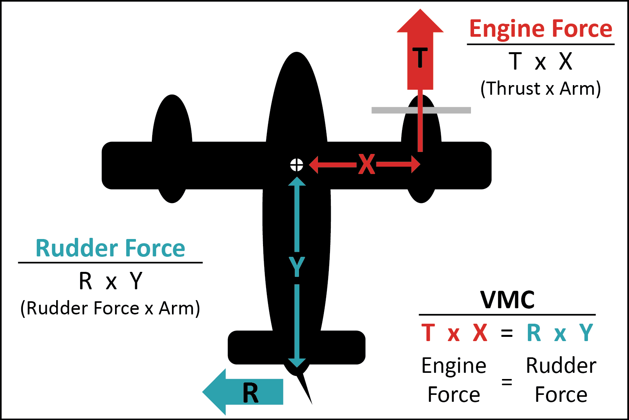
VMC: Minimum Controllable Airspeed
What Causes VMC?
With an engine failed, the operating engine produces a yawing force toward the dead engine
  T x X
Rudder is used to counter the yaw and keep the plane straight
The rudder’s force is based on airspeed
  R x Y
  The slower the plane, the less airflow over the rudder, and therefore the less force

Slide 8
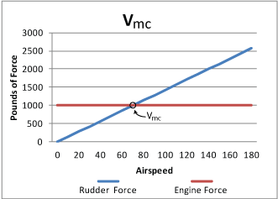
VMC: Minimum Controllable Airspeed
What Causes VMC?
As an aircraft slows, and the rudder’s force decreases, the yawing force remains constant
Therefore, there is a speed where the rudder’s force = the yawing force
  T x X = R x Y
Slower than this speed, the aircraft yaws uncontrollably to the dead engine
  Rudder produces less force than the engine

Slide 9
VMC: Minimum Controllable Airspeed
How is VMC Certified?
The FAA sets forth criteria for manufacturers to follow when establishing V_{MC}
  Critical Engine Inoperative
  Inoperative Engine Propeller Windmilling
  Maximum Available Takeoff Power
  Sea Level Conditions
  Most Adverse Legal Weight
  Most Adverse Legal CG
  Landing Gear Retracted
  Airborne & Out of Ground Effect
  Cowl Flaps in the Takeoff Position
  Maximum 5-degrees of Bank
  Flaps in the Takeoff Position
  Airplane Trimmed for Takeoff

Slide 10
VMC: Minimum Controllable Airspeed
How Does Certification Criteria Affect VMC?
FACTOR | CONTROL | VMC
Critical Engine Inoperative | Decreases | Increases
Windmilling Propeller | Decreases | Increases
Max Takeoff Power | Decreases | Increases
Sea Level Conditions | Decreases | Increases
Most Adverse Legal Weight (Light) | Decreases | Increases
Most Adverse Legal CG (Aft) | Decreases | Increases
Gear Up | Decreases | Increases
Out of Ground Effect | Decreases | Increases
Cowl Flaps set for Takeoff (Open) | Increases | Decreases
Max of 5-degrees of Bank | Increases | Decreases
Flaps Set for Takeoff | Could go either way | Could go either way
Trimmed for Takeoff | Could go either way | Could go either way

Slide 11
VMC in the Airplane
Loss of Control
Control is lost when the moment of the thrust arm of the operating engine exceeds that of the rudder
Indication
  Full rudder is applied into the operating engine and the airplane continues to yaw toward the dead engine
  Visual reference point is the easiest way to recognize
Maintain a zero-sideslip to obtain an accurate VMC

Slide 12
VMC in the Airplane
Recovery
Recover the moment uncontrollable yaw or any stall symptom is recognized
Simultaneously reduce power & pitch
  Reduces the yawing moment
  Makes the rudder more effective
Recover to straight flight at V_{YSE}

Slide 13
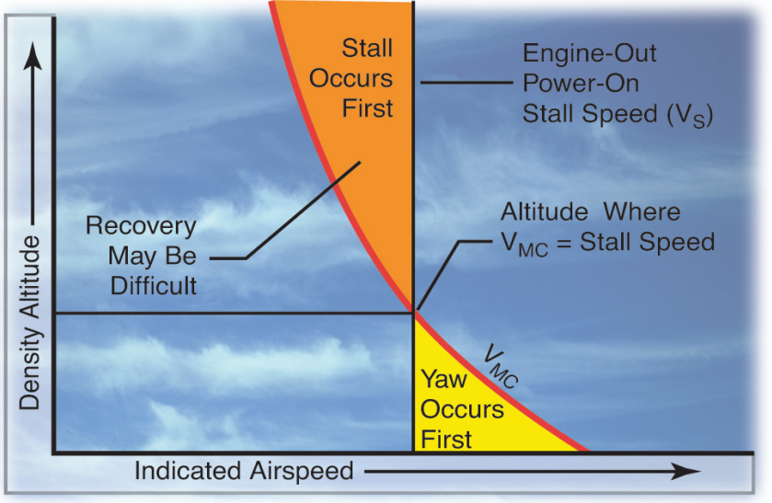
VMC in the Airplane
VMC & Stall Speed
V_{MC} decreases with altitude while stall speed remains the same
The altitude where V_{S} = V_{MC} and above is extremely dangerous
  A stall with one inoperative engine will likely enter a spin
  Departure from controlled flight can be sudden
  Twins are not required to demonstrate spin recovery

Slide 14
VMC in the Airplane
Exceeding Critical AOA
recover at any symptom of an impending stall

Slide 15
VMC Demonstration
Setup
Choose a visual reference point
Configuration
  Gear up, flaps & trim set for takeoff
  High rpm on both prop controls
  Cowl flaps open (as applicable)
Get stable about 10 knots above V_{SSE}/V_{YSE}

Slide 16
VMC Demonstration
Setup
Power
  Left engine to idle power
  Right engine to takeoff power
Establish a zero sideslip
Brief the Maneuver
  “I will pitch up at a rate to realize a decrease of 1 knot per second. At the first indication of a loss of directional control or a stall, I will reduce power on the operating engine and lower the nose.”

Slide 17
VMC Demonstration
Demo
Gently pitch up
Airspeed decreases and control effectiveness decays
  Increase rudder to counter yaw
  Increase aileron to maintain bank
Full rudder deflection = V_{MC}
  Any slower results in a loss of directional control

Slide 18
VMC Demonstration
Recovery
Reduce power on the operating engine and lower the nose
  Smooth inputs/adjustments
Reducing Power
  Reduce rudder to prevent yaw
  Maintain the reference point
Reestablish heading & V_{YSE}
Return to normal flight
  Increase power on the idle engine
  Adjust rudder to maintain the reference point/heading

Slide 19


Common Errors
VMC Demo
Inadequate knowledge of the causes of loss of directional control at airspeeds less than V_{MC}, factors affecting V_{MC}, and safe recovery procedures
Improper entry procedures, including pitch attitude, bank attitude, and airspeed
Failure to recognize imminent loss of directional control
Failure to use proper recovery procedure

Slide 20
Hazards

Slide 21
Hazards
Configuring the Airplane
In relation to V_{MC}, configure as specified for the demonstration
  Understand the effects of different configurations on V_{MC} & controllability
Real-Life Engine Failures
  Airplane will likely not be able to hold altitude OEI with excess drag
  Retract gear & flaps (and any other drag devices), & feather the propeller
  Reduced drag lowers the odds of reaching V_{MC} or slower airspeeds

Slide 22
Hazards
Distractions
They’re dangerous
  Remove them from view
  If a person, explain the situation & ask them to stop
Don’t fixate on the problem at the expense of flying the airplane
  Maintain airspeed & zero sideslip
Aviate, Navigate, Communicate
  Focus on flying, especially with an inoperative engine

Slide 23
Hazards
SA & Disorientation
Maintain Situational Awareness & Orientation
  Starts with preflight planning – Know your options & have a plan
  Know where you are, what’s coming next, & stay ahead of the airplane
  If SA or orientation is lost, admit it, and fix it
Disoriented: Get the aircraft to a safe attitude, airspeed, and altitude
  Zero side-slip at V_{YSE}, never below V_{MC}
  Recover if below V_{MC}
Ask for Help when it’s Needed
  ATC, Guard, other pilot/passengers, etc.

Slide 24
Hazards
Task Prioritization
#1 Task: Safely flying the airplane
Divide attention between the aircraft, scanning, & communicating
  No responsibility should take full attention for more than a short period
  Verify aircraft performance often & consistently during any checklists
Understand what needs to be accomplished and when
  Use standard operating procedures & checklists
Recognize when you’re behind and find a way to catch up
  “Attack the closest alligator”

Slide 25
Hazards
VMC & Density Altitude
ACS Appendix 3 - XIII. Multiengine Operations
  Airplanes with normally aspirated engines will lose power as altitude increases because of the reduced density of the air entering the induction system of the engine. This loss of power will result in a V_{MC} lower than the stall speed at higher altitudes. Therefore, recovery should be made at the first indication of loss of directional control, stall warning, or buffet.
  Do not perform this maneuver by increasing the pitch attitude to a high angle with both engines operating and then reducing power on the critical engine. This technique is hazardous and may result in loss of airplane control.

Slide 26
Questions?

