Slide 1
Effects of Airspeeds
& Configurations
During OEI Performance

Slide 2
Overview
WHAT
  First-person demonstration of the effects of a feathered versus unfeathered propeller, as well as airspeed, flaps, & gear on single engine performance
WHY
  Safety!
  Understanding the importance of feathering the propeller, removing drag devices, and maintaining V_{YSE}
CONTENT
Big Picture
Demonstration
Hazards

Slide 3
Demonstration Overview
Big Picture
First Half
  Critical engine windmilling, full power on the operative engine
  V_{YSE} & zero sideslip
  Four Stages: Clean, Approach Flaps, Gear, Landing Flaps
Second Half
  Critical engine feathered, full power on the operative engine
  V_{YSE} & zero sideslip
  Four Stages: Reverse of the first half
Airspeed will be varied ±5 knots from V_{YSE} to show the effects of improper airspeed control
After each change in configuration/airspeed note:
  Climb Performance (or lack thereof)
  Pitch Attitude to Maintain V_{YSE}

Slide 4
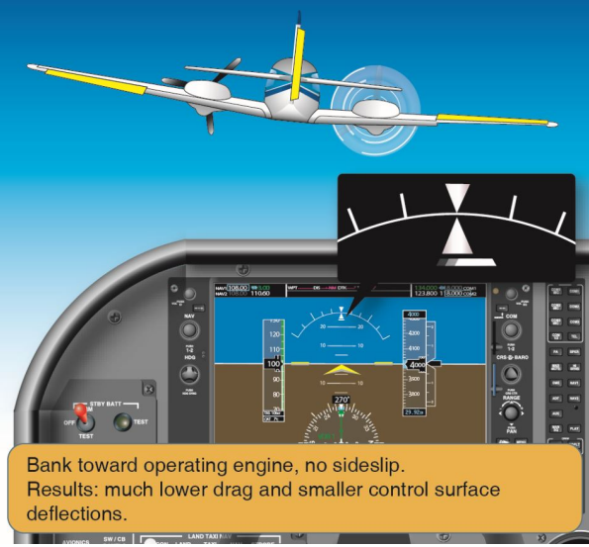
Demonstration Overview
Entry Procedure
Pre-Maneuver Checklist & Clearing Turns
Select an Entry Altitude
  Safe altitude in case the engine won’t restart
  ACS: No lower than 3,000’ AGL or manufacturer’s recommended altitude (whichever is higher)
Reduce Critical Engine Power to Zero
  Windmilling propeller
Establish a Zero Sideslip
  Trim the aircraft
Slow to & Maintain V_{YSE}

Slide 5
Demonstration Overview
Propeller Windmilling
Clean Configuration
  Apply full power, maintain zero sideslip & V_{YSE}
  Adjust airspeed ~5 knots above/below V_{YSE}
Extend the Approach Flaps
  Maintain zero sideslip & V_{YSE}
  Adjust airspeed ~5 knots above/below V_{YSE}
Extend the Landing Gear
  Maintain zero sideslip & V_{YSE}
  Adjust airspeed ~5 knots above/below V_{YSE}
Extend the Landing Flaps
  Maintain zero sideslip & V_{YSE}
  Adjust airspeed ~5 knots above/below V_{YSE}

Slide 6
Demonstration Overview
Propeller Feathered
Landing Configuration
  Maintain zero sideslip & V_{YSE}
  Adjust airspeed ~5 knots above/below V_{YSE}
Retract the Landing Flaps
  Maintain zero sideslip & V_{YSE}
  Adjust airspeed ~5 knots above/below V_{YSE}
Retract the Landing Gear
  Maintain zero sideslip & V_{YSE}
  Adjust airspeed ~5 knots above/below V_{YSE}
Retract the Approach Flaps (Clean)
  Maintain zero sideslip & V_{YSE}
  Adjust airspeed ~5 knots above/below V_{YSE}

Slide 7
Demonstration Overview
Recovery
Restart the Feathered Engine
  Follow POH procedures
Increase Power on the Restarted Engine
  Reduce power on the other engine
  Maintain control during recovery
  Adjust trim
Return to Straight-and-Level, Coordinated Flight

Slide 8

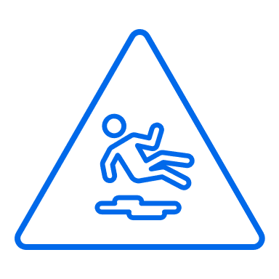
Common Errors
OEI Airspeed & Config Demo
Inadequate knowledge of the effects of airspeeds above/below V_{YSE} & various configurations on performance
Improper entry procedures, including pitch attitude, bank attitude, and airspeed
Improper airspeed control throughout the demonstration
Rough and/or uncoordinated use of flight controls
Improper procedures during resumption of cruise flight

Slide 9
Hazards

Slide 10
Hazards
Loss of Control or Stall
Recover at the first sign of a loss of control or stall
  Reduce power & lower the nose
  Establish V_{YSE}
A stall with asymmetric power will likely lead to a spin
  Multiengine aircraft are not required to demonstrate spin recovery

Slide 11
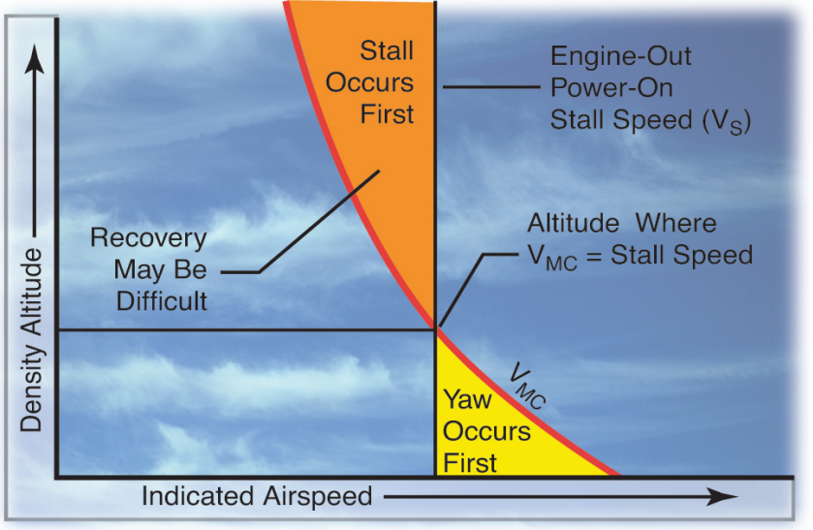
Hazards
Loss of Control or Stall
V_{MC} decreases with altitude while stall speed remains the same
The altitude where V_{S} = V_{MC} and above is extremely dangerous
  Departure from controlled flight can be sudden

Slide 12
Hazards
Configuring the Airplane
Performance is significantly decreased with excess drag
Essential to remove drag, and feather the propeller for max performance
  Maintain Control, Full Power, REDUCE DRAG, Identify, Verify, Fix or FEATHER
Zero Sideslip & V_{YSE}
  Very important to single engine performance

Slide 13
Hazards
Distractions
They’re dangerous
  Remove them from view
  If a person, explain the situation & ask them to stop
Don’t fixate on the problem at the expense of flying the airplane
  Maintain airspeed & zero sideslip
Aviate, Navigate, Communicate
  Focus on flying, especially with an inoperative engine

Slide 14
Hazards
SA & Disorientation
Maintain Situational Awareness & Orientation
  Starts with preflight planning – Know your options & have a plan
  Know where you are, what’s coming next, & stay ahead of the airplane
  If SA or orientation is lost, admit it, and fix it
In an engine failure, slow down & follow the procedures
  Avoid startle response
  Maintain Control, Full Power, Remove Drag, Identify, Verify, Fix or Feather
Disoriented: Get the aircraft to a safe attitude, airspeed, and altitude
  Zero side-slip at V_{YSE}, never below V_{MC}
  Recover if below V_{MC}
Ask for Help when it’s Needed
  ATC, Guard, other pilot/passengers, etc.

Slide 15
Hazards
Task Prioritization
#1 Task: Safely flying the airplane
Divide attention between the aircraft, scanning, & communicating
  No responsibility should take full attention for more than a short period
  Verify aircraft performance often & consistently during any checklists
Understand what needs to be accomplished and when
  Use standard operating procedures & checklists
Recognize when you’re behind and find a way to catch up
  “Attack the closest alligator”
Safety first!
  Aviate, Navigate, Communicate

Slide 16
Hazards
Collision Avoidance
Scanning
  Series of short regularly spaced eye movements
  Continue to scan while OEI
Communication
  Flight Following: Inform ATC & declare an emergency
  Not with Flight Following: Situation permitting, contact Guard and/or ATC
  Uncontrolled Field: Clearly communicate intentions & location
Operation Lights On
  Turn on landing lights below 10,000’ MSL
Right-of-way rules
  Aircraft in distress has the right-of-way
  Be cautious

Slide 17
Hazards
Terrain
Be aware of & plan for hazardous terrain along your route
Study the Charts
  Terminal charts & chart supplement
  IFR/VFR chart altitudes
  Use Maximum Elevation Figures and other data
Performance Data
  Ensure the single engine service ceiling clears all terrain along the route
  Ensure the aircraft matches the performance assumptions
Minimum Safe Altitudes
  Anywhere: Altitude allowing emergency landing without undue hazard
    ACS: Complete all SE tasks above 3,000’ AGL
  Congested: 1,000’ above the highest obstacle within 2,000’
  Uncongested: 500’ from the surface (500’ from people/property)

Slide 18
Hazards
Obstacles & Wire Strikes
Be familiar with any obstacles nearby airports
  NOTAMs & Terminal Procedures
Antenna Towers
  Can extend over 1,000’ to 2,000’ AGL
  Supporting guy wires can extend 1,500’ horizontally
Overhead Wires
  Transmission lines often span runway departures and landmarks pilots follow
    Lakes, highways, railroad tracks, etc.

Slide 19
Hazards
Low Altitude Maneuvering
A small problem at high altitude can be a big problem at low altitude
Be aware of, and avoid obstructions near the airfield
Low Altitude & VMC
  Maintain a zero-sideslip
  Stay at or above VYSE
  In the case of a loss of control, recover promptly
    Reduce power
    Lower the nose
    Establish VYSE
Fly First!

Slide 20
Hazards
Low Altitude Maneuvering
Controlled Flight Into Terrain (CFIT)
  Avoidance starts on the ground with proper planning & decision making
Recommendations
  Don’t attempt to fly into IMC
  Fly above minimum safe altitudes
  Verify ATC clearances & proper altitude
  Maintain SA vertically and horizontally
  Comply with appropriate regulations
  Be extra cautious in unfamiliar areas
  Use current charts & reference all available information
  Use appropriate checklists
  Know your aircraft & its equipment
  Verify single engine performance is compatible with the route

Slide 21
Questions?

