Slide 1
Maneuvering with one engine Inoperative

Slide 2
Overview
WHAT
  Proper & safe control of an engine failure
WHY
  Managing an engine failure is essential to safety in a multiengine airplane
CONTENT
One Engine Inoperative Airspeeds
Managing an Engine Failure
Maneuvering with One Engine Inoperative
Hazards

Slide 3
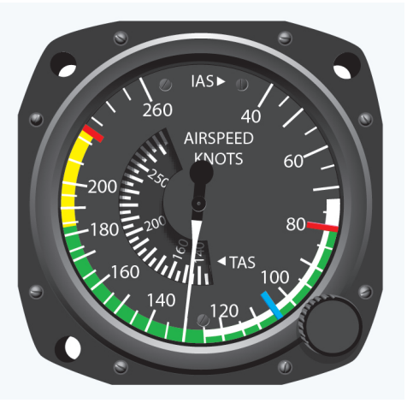
OEI Airspeeds & Performance
VMC: RED Line
Speed at which the rudder no longer has the authority to overcome the yaw caused by the critical engine being inoperative
  Under specific FAA criteria
Lower V_{MC} is safer
V_{MC} is strictly concerned with directional control
  Irrespective of performance

Slide 4
OEI Airspeeds & Performance
VMC: RED Line
Published versus Actual V_{MC}
  Published: Based on specific FAA mandated criteria
  Actual: Varies based on conditions, configuration, & pilot technique during an engine failure
Varies with a variety of factors

Slide 5
OEI Airspeeds & Performance
VMC: Red Line
FACTOR | CONTROL | VMC
Critical Engine Inoperative | Decreases | Increases
Windmilling Propeller | Decreases | Increases
Max Takeoff Power | Decreases | Increases
Sea Level Conditions | Decreases | Increases
Most Adverse Legal Weight (Light) | Decreases | Increases
Most Adverse Legal CG (Aft) | Decreases | Increases
Gear Up | Decreases | Increases
Out of Ground Effect | Decreases | Increases
Cowl Flaps set for Takeoff (Open) | Increases | Decreases
Max of 5-degrees of Bank | Increases | Decreases
Flaps Set for Takeoff | Could go either way | Could go either way
Trimmed for Takeoff | Could go either way | Could go either way

Slide 6
OEI Airspeeds & Performance
VYSE: Blue Line
Best rate of climb speed with OEI
Blue line on the airspeed indicator
Used for max performance during OEI operations
  Or minimize descent, if above the single engine service ceiling

Slide 7

Managing an Engine Failure
Recognition & Control
Recognize the Engine Failure
  Visual: Easiest way to recognize an engine failure
  Instrument: Use the instruments
    Yaw toward the dead engine, nose drop, engine gauges indicate a failure
Maintain Control
  Use rudder & aileron to establish a zero sideslip
  Pitch for V_{YSE}
Zero Sideslip
  1-3º of bank & ½ ball deflection toward the operating engine
  Anything other than a zero sideslip reduces performance
  “Raise the Dead”

Slide 8
Managing an Engine Failure
Recognition & Control
Maintain Control
  Zero side-slip, pitch for V_{YSE}
Max Power
  Throttles, Prop, Mixture
Reduce Drag
  Gear up, flaps up
Identify
  Dead foot, dead engine
Verify
  Slowly & smoothly reduce the throttle on the dead engine
Fix or Feather
  Generally, feather the propeller & secure the engine in these situations

Slide 9
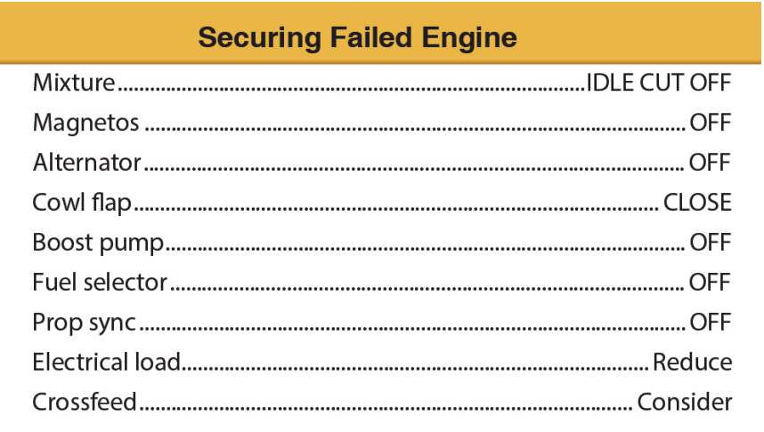
Managing an Engine Failure
Checklists
Take a break from the checklist every step or two to verify aircraft performance
  Flying safely is the primary concern
There’s rarely a rush to get the checklist done
  The aircraft is under control & memory items are complete

Slide 10
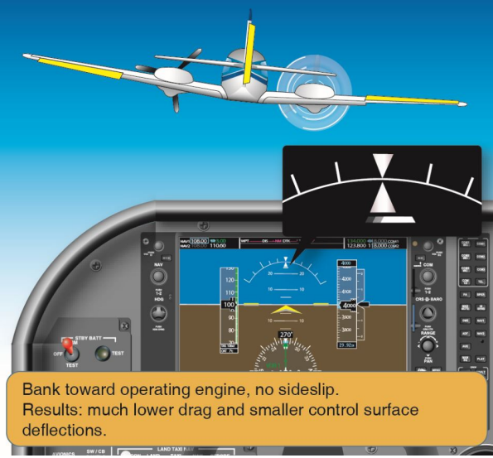
Maneuvering with OEI
Maintain a zero-sideslip
  Straight: 1-3º bank & ½ ball deflection Turning: Maintain ½ ball deflection
Trim
  Elevator & rudder trim
Maintain level flight at or above V_{YSE}
  If impossible, maintain V_{YSE}
Monitor fuel & crossfeed as necessary
Decide whether to divert
Common Error: Failure to Maintain Positive Control while Maneuvering
  Flying comes first!

Slide 11

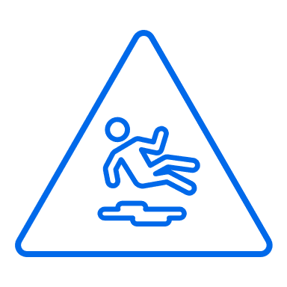
Common Errors
Maneuvering with OEI
Failure to follow prescribed emergency checklist
Failure to recognize an inoperative engine
Failure to maintain best engine inoperative speed
Failure to properly adjust engine controls and reduce drag
Hazards of improperly identifying and verifying the inoperative engine
Failure to maintain positive control while maneuvering
Hazards of attempting flight contrary to the airplane’s operating limitations

Slide 12
Hazards

Slide 13
Hazards
Low Altitude Maneuvering
A small problem at high altitude can be a big problem at low altitude
Be aware of, and avoid obstructions near the airfield
Low Altitude & V_{MC}
  Maintain a zero-sideslip
  Stay at or above V_{YSE}
  In the case of a loss of control, recover promptly
    Reduce power
    Lower the nose
    Establish V_{YSE}
Fly First!

Slide 14
Hazards
Low Altitude Maneuvering
Controlled Flight Into Terrain (CFIT)
  Avoidance starts on the ground with proper planning & decision making
Recommendations
  Don’t attempt to fly into IMC
  Fly above minimum safe altitudes
  Verify ATC clearances & proper altitude
  Maintain SA vertically and horizontally
  Comply with appropriate regulations
  Be extra cautious in unfamiliar areas
  Use current charts & reference all available information
  Use appropriate checklists
  Know your aircraft & its equipment
  Verify single engine performance is compatible with the route

Slide 15
Hazards
Collision Avoidance
Scanning
  Series of short regularly spaced eye movements
  Continue to scan while OEI
Communication
  Flight Following: Inform ATC & declare an emergency
  Not with Flight Following: Situation permitting, contact Guard and/or ATC
  Uncontrolled Field: Clearly communicate intentions & location
Operation Lights On
  Turn on landing lights below 10,000’ MSL
Right-of-way rules
  Aircraft in distress has the right-of-way
  Be cautious

Slide 16
Hazards
Terrain
Be aware of & plan for hazardous terrain along your route
Study the Charts
  Terminal charts & chart supplement
  IFR/VFR chart altitudes
  Use Maximum Elevation Figures and other data
Performance Data
  Ensure the single engine service ceiling clears all terrain along the route
Minimum Safe Altitudes
  Anywhere: Altitude allowing emergency landing without undue hazard
    ACS: Complete all SE tasks above 3,000’ AGL
  Congested: 1,000’ above the highest obstacle within 2,000’
  Uncongested: 500’ from the surface (500’ from people/property)

Slide 17
Hazards
Obstacles & Wire Strikes
Be familiar with any obstacles nearby airports
  NOTAMs & Terminal Procedures
Antenna Towers
  Can extend over 1,000’ to 2,000’ AGL
  Supporting guy wires can extend 1,500’ horizontally
Overhead Wires
  Transmission lines often span runway departures and landmarks pilots follow
    Lakes, highways, railroad tracks, etc.
Minimum Safe Altitudes
  ACS: Complete all single engine tasks > 3,000’ AGL
    Or the manufacturer’s recommended altitude, whichever is higher

Slide 18
Hazards
Distractions
They’re dangerous
  Remove them from view
  If a person, explain the situation & ask them to stop
Don’t fixate on the problem at the detriment of flying
  Airplanes have been lost due to engine failures at altitude for this reason
Aviate, Navigate, Communicate
  Focus on flying, especially with an inoperative engine

Slide 19
Hazards
SA & Disorientation
Maintain Situational Awareness & Orientation
  Starts with preflight planning – Know your options & have a plan
  Know where you are, what’s coming next, & stay ahead of the airplane
  If SA or orientation is lost, admit it, and fix it
Disoriented: Get the aircraft to a safe attitude, airspeed, and altitude
  Zero side-slip at V_{YSE} - never below V_{MC}
  Recover if below V_{MC}
Ask for Help when it’s Needed
  ATC, Guard, other pilot/passengers, etc.

Slide 20
Hazards
Task Prioritization
#1 Task: Safely flying the airplane
Divide attention between the aircraft, scanning, & communicating
  No responsibility should take full attention for more than a short period
  Verify aircraft performance often & consistently during any checklists
Understand what needs to be accomplished and when
  Use standard operating procedures & checklists
Recognize when you’re behind and find a way to catch up
  “Attack the closest alligator”

Slide 21
Questions?

